Slide 1
Utah State University Safety Committee Vision Statement
“The Utah State University Safety Committee strives to promote a university-wide culture of safety where individuals are safe to work, learn, and visit by actively identifying, preventing, and correcting safety concerns."

Slide 2
USU Environmental Health & Safety Identify, Prevent, & Correct
Why & How?
Three Priorities
Why are these impactful?
Good safety plans promote a strong culture of safety
The use and maintenance of engineered safety controls reduces hazards
Slips, Trips, and Falls remains the #1 Accident at USU
How will improvement be measured?
Track and quantify approved Safety Plans
Increased functionality of equipment
Monitor accident rates
New/preventative measures?
Safety Plan evaluation is part of the annual review
Develop a USU Safety Plan library
Help USU Administrators, Faculty, Staff and Students develop, implement, evaluate and apply Safety Plans as outlined on Policy 337.3
Facilitate the implementation, inspection, and maintenance of Engineered Safety Infrastructure across USU camps
Help promote Safe Travel
Walking, Driving, Traveling

Slide 3
Chemical Hygiene Committee Identify, Prevent, & Correct
Three Priorities
Why & How?
1. Chemical Hygiene Plans
All laboratories are required to complete and update a CHP annually
2. Laboratory Close-outs
Chemicals, equipment, etc. should be dealt with prior to faculty leaving the University
3. Training
Training requirements should match activities personnel are involved in
Track using ILS (?)
Why are these impactful?
Creation and maintenance of a CHP provides vital lab specific hazard information.
Chemicals are not being left for others to deal with.
Personnel would receive training appropriate to the task.
How will improvement be measured?
Annual accounting of who does and does not have an updated CHP.
Start tracking laboratory close-outs and when they do not occur.
Focused safety training and documentation
New/preventative measures?
1 and 3 are established practices but communication and documentation needs improvement
2. Policy needed at the university level with implementation

Slide 4
Field Safety/EHS Identify, Prevent, & Correct
Three Priorities
Why & How?
Emergency Response Plans
Communications plans
Ensure all employees are trained on how to submit an accident report.
Why are these impactful?
Without clear emergency response plans and communications plans/pathways, planning and emergency response can be delayed.
Not knowing how to effectively investigate an accident and report it can lead to similar accidents in the future. (Heinrich Pyramid)
How will improvement be measured?
Successful completion and review of Field Safety Plans
Adequate supervisor investigations in accident reports to ServiceNow
New/preventative measures?
Field Safety Plan, peer review of research, communications, and safety plans, and the continuance of fostering a culture of safety here at USU

Slide 5
Institutional Biosafety Committee (IBC) Identify, Prevent, & Correct
Three Priorities
Why & How?
Review all approved protocols annually.
Ensure labs with approval protocols meet the requirements of the BMBL 6th Edition.
Ensure laboratory SOPs are updated and reviewed by all personnel at least annually.
Why are these impactful?
Help ensure funding is not jeopardized
Enhance safety in all BSL-2&3 labs
How will improvement be measured?
With an annual review report
New/preventative measures?
These will be on a case-by-case bases and then communicated and applied with other labs as applicable

Slide 6
Radiation Safety Committee Identify, Prevent, & Correct
Three Priorities
Why & How?
Ensure compliance with DWMRC
Ensure all X-ray and radioactive material users are trained; establish laser training
Routinely audit the system
Why are these impactful?
Maintains our license; supports the research enterprise; reduces health risks
How will improvement be measured?
Tally of training; quantify accidents and violations at in-lab visits
New/preventative measures?
Departmental information sheet on equipment that requires authorization and/or training

Slide 7
Caine College Safety Priorities: AWARE Identify, Prevent, & Correct
Be AWARE
Three Priorities
I: Identify Checklist-(a safety issue): training, safety, equipment, availability of safety items
P: Prevention: Annual training, review safety sheets SOP’s before operation.
C: Correction: Run & review training + work with the Safety Office to improve communication. Make sure safety equipment and literature is available.
A Actively participate in safety training.
W Watch & Witness to ensure equipment is safely used.
A Adjust and improve to create a keen awareness.
R Respect each other and respect equipment.
E Engage early to improve communication about SOP’s.

Slide 8
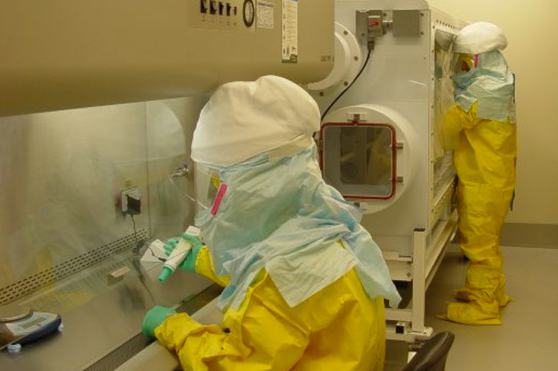
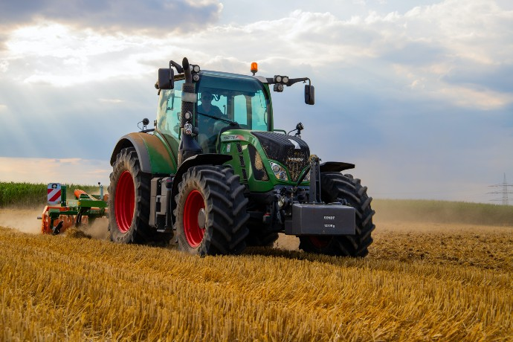
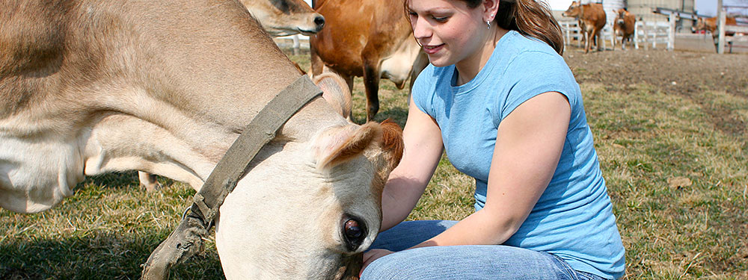
CAAS
Three Priorities
Why & How?
Recommit to PPE
Risk/safety assessments in classroom/teaching laboratory settings
Census of safety plans in farm/field work settings
Why are these impactful?
Increase PPE compliance
Expand vision beyond laboratories
How will improvement be measured?
Dept self-evaluations
Increase proportion of plans on hand
New/preventative measures?
As needed in classroom/teaching labs

Slide 9
College of Engineering/Biological Engineering Identify, Prevent, & Correct
Three Priorities
Why & How?
Develop a shared digital chemical inventory.
Develop standardized lab door placards indicating lab layout, hazards, emergency resources.
Develop online resources for lab use requirements.
Why are these impactful? – Will facilitate tracking, storage, sharing, disposal of all chemicals
How will improvement be measured? – Real-time updates on a web server or box folder
New/preventative measures? – Link key card lab access to required user trainings as posted on each lab door

Slide 10
College of Humanities and Social Science Identify, Prevent, & Correct
Three Priorities
Why & How?
Create an evacuation plan for emergencies
Ensure all employees are trained on the evacuation plan
Ensure employees & students have clear access to the evacuation plan
This is impactful because the Staff Committee isn’t aware of an evacuation plan
Improvements will be measured by training per department
This information will be distributed with the help of the college’s staff committee

Slide 11
College of Science
Identify, Prevent, & Correct
Three Priorities
Why & How?
Maintain safety infrastructure to deal with fainting incidents during tours of Cadaver lab
Improve safety instruction for field trips
Campus-wide: separation of electric wheeled and pedestrian traffic on paved pathways
Why are these impactful? CoS has fainting incidents during tours of Cadaver lab every year
How will improvement be measured? Possible reduction of incidents
New/preventative measures? Open to suggestions

Slide 12
College of Education and Human Services Identify, Prevent, & Correct
Three Priorities
Why & How?
Review safety incidents from past three years and identify common safety concerns in the college.
Ensure all employees are trained on how to submit an accident report.
Review Emergency Response Plans for College
Why are these impactful?
1&3 will provide insights into safety issues and preparedness. 2 will train faculty in accurate and timely reporting
How will improvement be measured?
Safety representatives will discuss, identify gaps, and report at semesterly safety committee meetings
New/preventative measures?
Identification of common safety concerns (1) and challenges will allow the development of new prevention measures and better trained employees (2 & 3) will promote a safer environment.

Slide 13
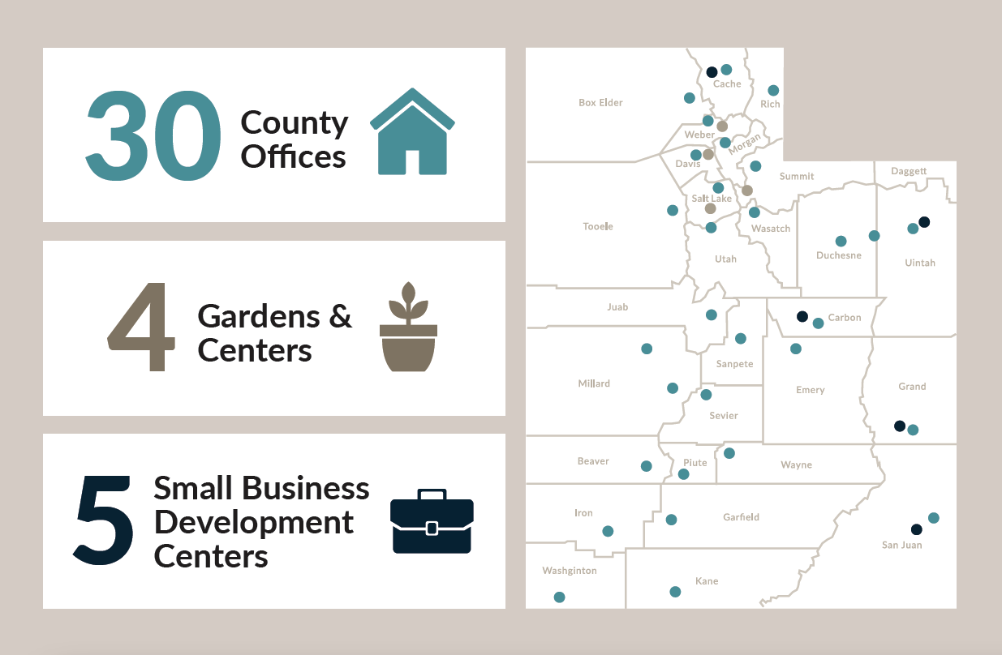
Extension Safety Priorities: Identify, Prevent, & Correct
Three Priorities
Why & How?
Provide participants, including youth, with safe educational experiences
Train volunteers on safety related policies and procedures
Off- and On-campus Extension faculty using county-owned, public, or private facilities should be knowledgeable of local emergency/safety plans
Why are these impactful?
Extension faculty provide experiential learning opportunities throughout the state in a variety of settings, many of which are not controlled by USU.
How will improvement be measured?
Volunteer background checks and trainings; participant enrollment; staff and volunteers trained in safety-related policies and procedures.
New/preventative measures?
Improvements and best practices will be discussed in the SC Safety Meeting, staff meetings, and county director meetings. Trainings will be provided as needed.

Slide 14
USU Jon M Huntsman School of Business Identify, Prevent, & Correct
Three Priorities
Why & How?
Proper AED Training to employees.
Find a better way to give actual addresses of locations on campuses, and train staff.
Educate employees and give them the number to contact Facilities in the winter months to report icy or slick spots.
Increases survival rates curing cardiac emergencies (staff training required).
Enhances response time for emergency services.
Reduces risk of slips, trips, and falls in winter months.

Slide 15
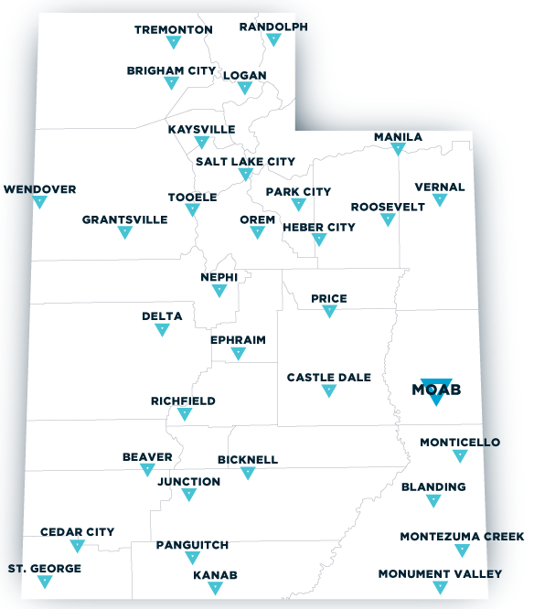
QCNR Safety Priorities: Identify, Prevent, & Correct
Why & How?
Three Priorities
Maintain Safety Plans
Maintain Communication of Common Risks, Injuries, and Remedies to Members of our College.
Increase Support for Spot Trackers, Satellite Phones
These can be updated for annual review and posted on department websites to keep everyone up to date.

Slide 16
USU Fire Marshal’s Office Identify, Prevent, & Correct
Three Priorities
Why & How?
Meet OSHA requirements on construction site visits by wearing hard hats, safety glasses, hard toe boots, and safety vests.
Wear proper PPE when the need arises to enter BLS-3 labs and research areas.
Obtain and wear “crampons” while walking around on campus during extremely icy conditions.
Items #1 and #2 are already requirements and have impact not only for the safety of my employees, but also shows that we respect the safety environment established by the construction companies and the lab personnel.
Zero injuries.
Crampons would be a new measure to keep employees from injuries due to slipping on ice. This would result in less injuries reported to Workman’s Comp, reduced time off of work, and potentially improve quality of life for employees.

Slide 17
Department of Public Safety Identify, Prevent, & Correct
Three Priorities
Why & How?
Ensure all employees are aware properly trained on all safety requirements as they pertain to their respective assignments.
Ensure all employees are trained on how to submit an accident report.
Ensure employees receive proper training of equipment before use.
Why are these impactful?
It provides a clear understanding of all safety requirements that employees are expected to follow. Understanding and knowing the reporting routes go hand in hand.
How will improvement be measured?
Tracking of all requirements and training of employees.
Number of incidents vs number of reports officially submitted.
New/preventative measures?
Department safety officer/champion.
Creation of training and tracking sheets.

Slide 18
Dining Services Identify, Prevent, & Correct
Three Priorities
Why & How?
Update Knife Safety Training and make sure all employees complete annually.
Replace flooring in dish room.
Update Safety training to include proper lifting and team lift guidelines and have employees complete annually.
Why are these impactful?
Our most common causes of accidents are cuts, slips, muscle strains, and burns. These address 3 of the 4.
2. How will improvement be measured?
Safety trainings will be tracked in ILS. Floor will be replaced in May.
New/ Preventative Measures?
Safety concerns will be reviewed in manager meetings to ensure we are addressing most pressing issues.

Slide 19
Project analysis slide 11
USU Facilities
Safety Priorities
Three Priorities | Why & How
Emergency Response Plan | Overall impact will be an increased preparedness in responding to emergency situations Measurement: fully developed plan and implementation.
New Hire Safety Onboarding | Data analysis has shown new hires with less than 1 year on the job suffer injuries at a greater rate than their peers. Measurement: Reduction in new hire injuries.
Meet with Area Supervisors that have high frequency of injuries | Supervisors have meaningful impact on expectation of safety among their crew. Measurement: Meet with all identified area supervisors which leads to reduction of injuries within those areas.

Slide 20
Housing

Slide 21
Dept. of Libraries Identify, Prevent, & Correct
Three Priorities
Why & How?
Update Emergency Response Plans
Provide Employees emergency trainings on varying topics
Conduct Slip/Fall hazard assessment
Impact: Ensure safe operations and environment for patrons and employees
Measures: Safety Committee will review the Emergency Response Plan and update with campus in the current FY, facilitate an employee training on Active Shooter response, and conduct a slip/fall assessment of the building working with appropriate divisional employees.
3. New issues and appropriate remedies will be implemented generated from the feedback and problems identified by the Safety Committee.

Slide 22
Risk Control Committee

Slide 23
Staff Employees Association

Slide 24
Statewide Campuses Safety Priorities: Identify, Prevent, & Correct
Why & How?
Three Priorities
Emergency Response Plans
Train employees for emergencies
Identify relevant trainings
Conduct a Security Site Assessment
Use Crime Prevention Through Environmental Design (CPTED) principles to identify gaps and determine actions
Why are these impactful?
1 &2. Creating ERPs and training employees will save lives in the most critical situations.
3. Identifying areas to improve will help us to prioritized and act.
How will improvement be measured?
SC Safety Reps will identify current status, track progress, and report in SC Safety Meeting.
New/preventative measures?
Improvements and best practices will be discussed in the SC Safety Meeting to increase implementation of effective measures.

Slide 25
Division of Student Affairs Identify, Prevent, & Correct
Three Priorities
Why & How?
Record trainings and certifications within division
Current training and certified trainers
Reporting
Standardize reporting channels
Education
Who has obligation to report? Eliminate stigma around reporting
Report on what trainings are currently required and offered within Division
Document standard procedures for division reporting
Educate current staff/students along with onboarding new hires

