Slide 1
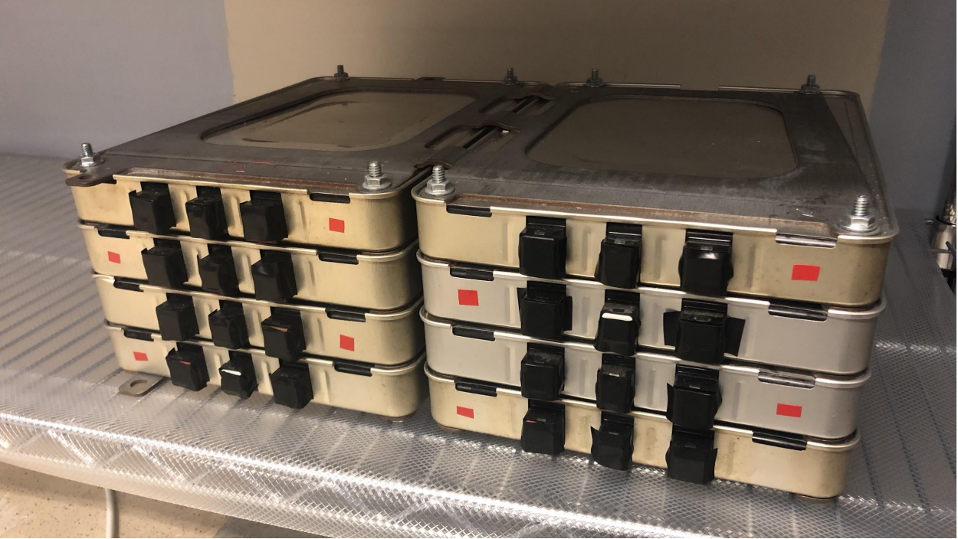
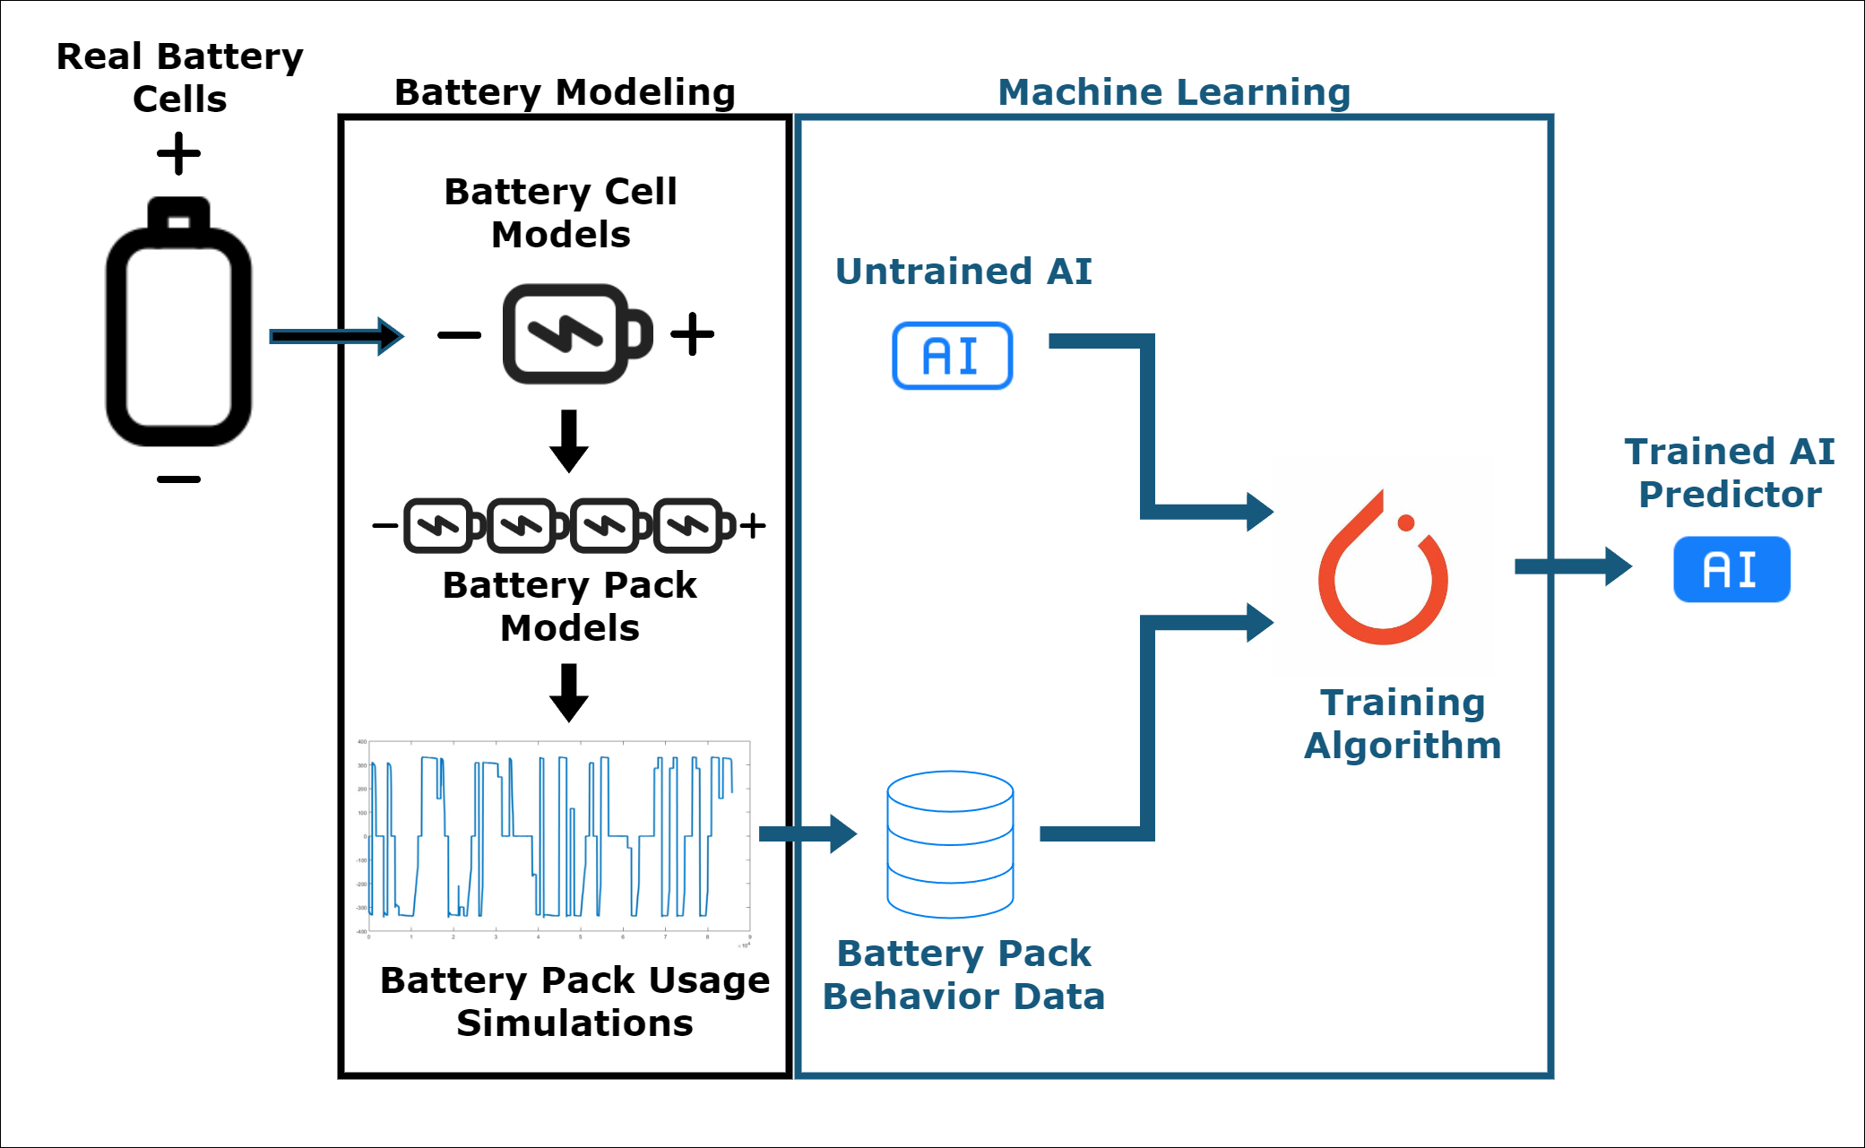
Artificial Intelligence (AI) can improve our ability to reuse retired or recycled Lithium batteries
A.I. may be able to measure the capacity of used electric vehicle batteries.
Teaching the AI
Battery Modeling: Simulating real batteries allows for the collection of large quantities of battery use data without performing long expensive battery tests.
Machine Learning: The data from the battery models is used to train the AI, which can then predict the complex relationships between battery behavior during normal use and battery capacity afterwards.
Paul Bradford
Utah State University
Dr. Hongjie Wang
Utah State University
Wasted Potential
EV batteries reach the end of their useful lifetime in vehicles around 70-80% of initial capacity. However, many of these batteries can still hold large amounts of energy and can be particularly useful for stationary applications.
Nissan Leaf batteries similar to those used in simulation models
Reuse is Expensive
Used batteries must be tested to determine how much energy they can hold. Right now, the equipment to run each test is expensive and the process is time-consuming. Using AI will allow for battery energy capacity to be quickly predicted without special tests or equipment.
A Promising Start
A preliminary AI was trained on data from on 4 pack setups with 1,600 simulated battery packs each. We then tested it on a dataset of 200 similar packs.
The percent of incorrect predictions made by the AI is shown in the table. It is likely that as we keep training the AI, it will quickly and effectively measure battery capacity.
Solution
Artificial Intelligence offers the potential to skip these tests by using data already obtained from the battery packs during their normal use. These data can be collected without disassembling battery packs or using additional equipment.
Cell Predictions |  | Parallel | Series
Individual Cell Capacity | Power | 6.88% | 6.54%
 | Current | 6.65% | 6.61%
Worst Cell Capacity | Power | 2.68% | 3.39%
 | Current | 2.84% | 3.06%
Best Cell Capacity | Power | 1.13% | 0.55%
 | Current | 1.13% | 1.13%
Average Cell Capacity | Power | 1.34% | 1.42%
 | Current | 1.72% | 1.53%
A diagram of the process for creating an AI tool that can easily and effectively predict battery cell capacity
AI prediction error for various battery pack metrics
Notes:
The original Better Poster format

