Slide 1
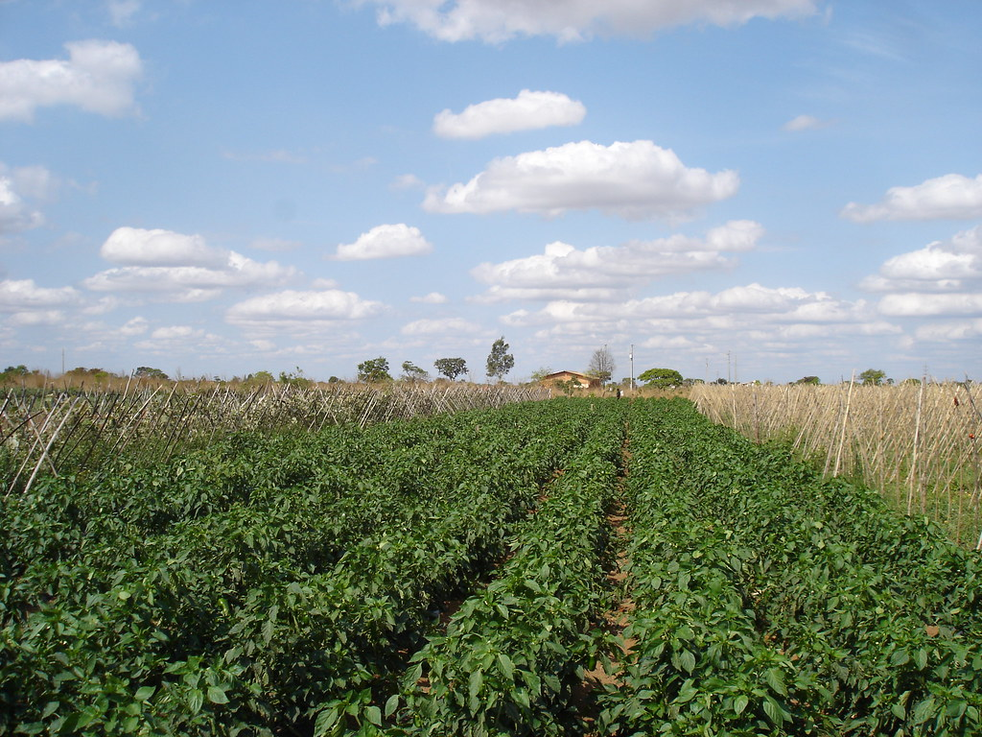
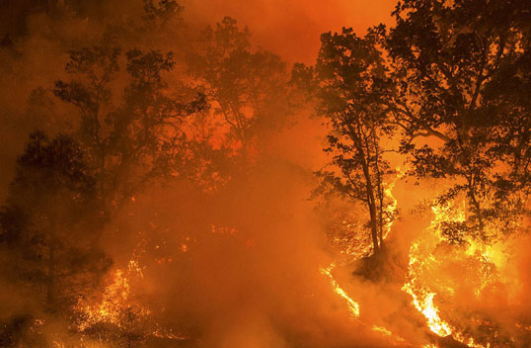
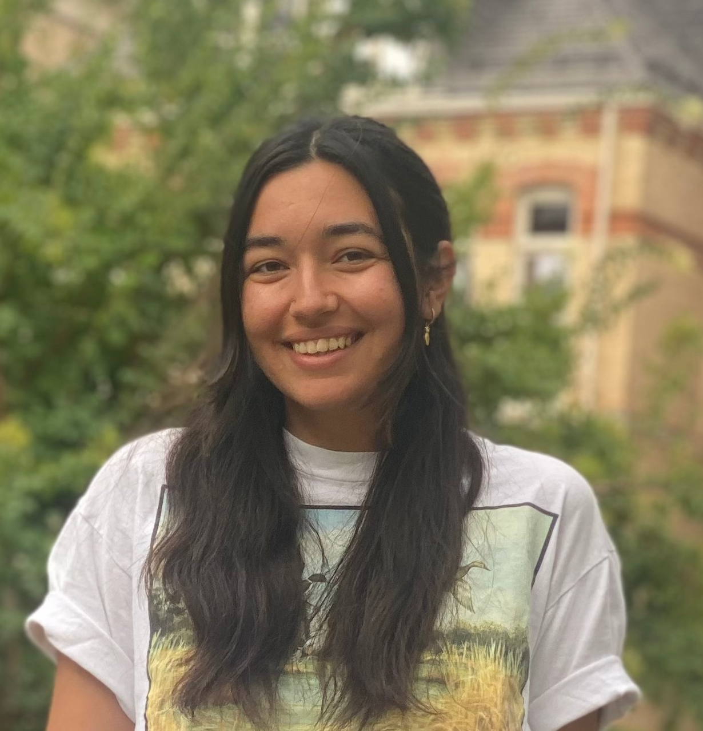
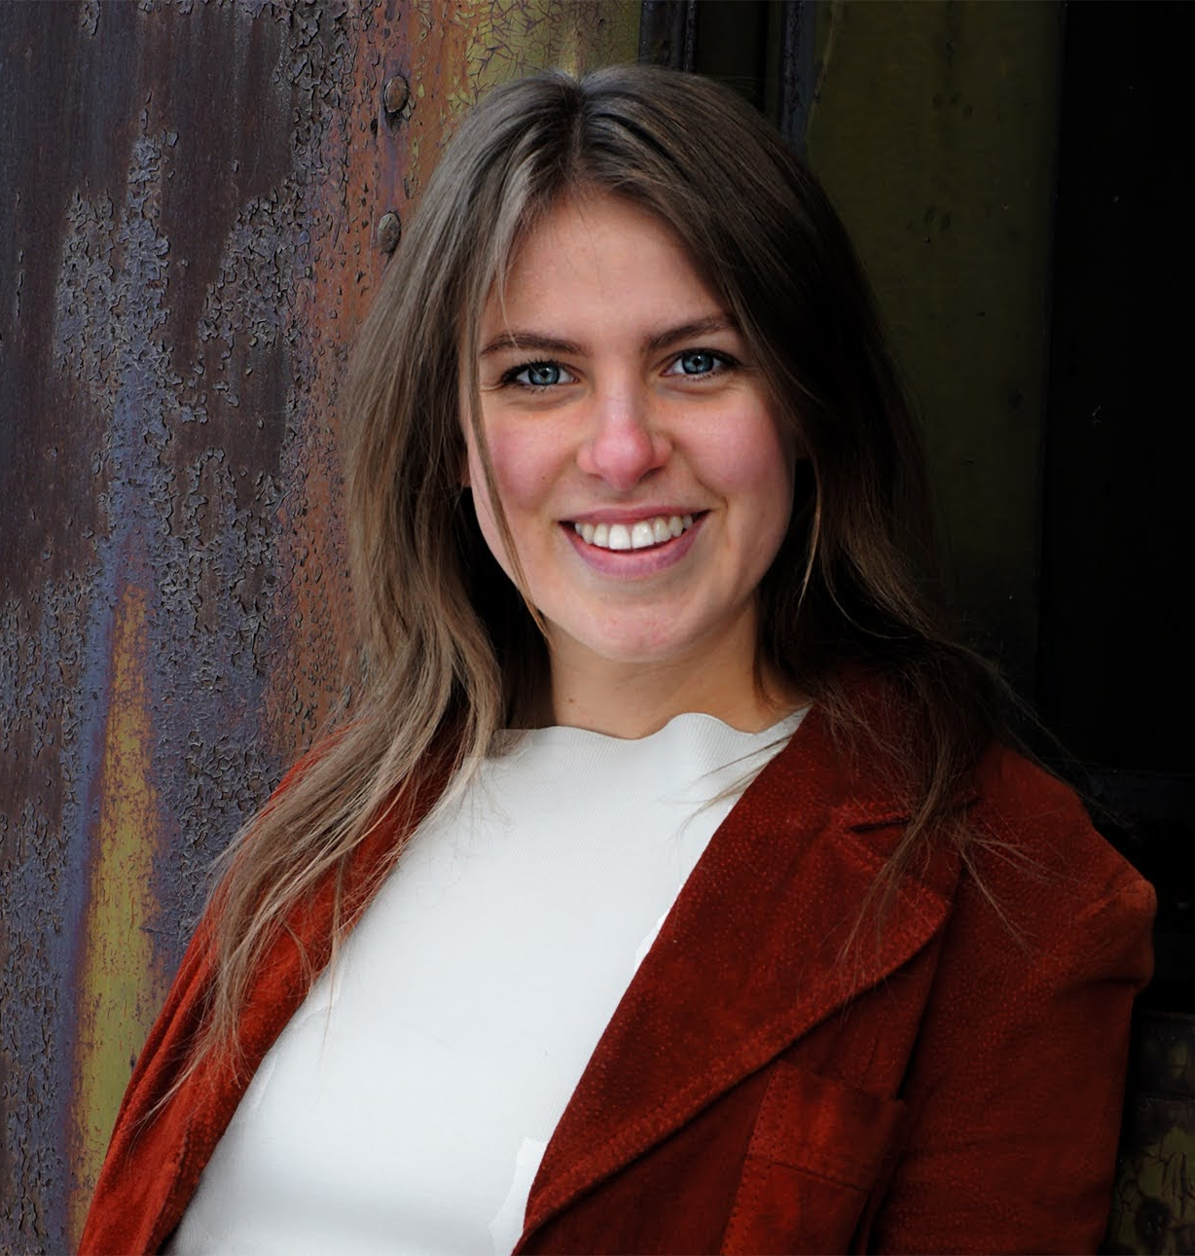
USU students and faculty think more should be done about climate change.
Renewable Energy
Electrification
Green Investment
Public Transit
Green spaces
Emissions Policy
Focus Groups Help Develop Policy
67% of Utahns are concerned about climate change. Support for decarbonization strategies is growing, including ways to both reduce and capture carbon.
Community input helps actions be successful over time. Focus groups allow participants to explain their opinions in depth and discuss ideas with one another. We held focus groups for students, faculty, and staff to ask:
What their main concerns about climate change are
What they know about climate change and decarbonization
What decarbonization and sustainability strategies they would support
Our focus groups will help us develop a survey to share with randomly selected individuals in Cache Valley and at USU. The results of the survey will be shared with USU and municipal leadership to inform environmental policy decisions.
Faculty and staff at Utah State University said that USU and Cache Valley can be leaders on climate change.
Climate change concerns
Focus group participants believe we are in a state of emergency with climate change and need more impactful solutions at the institution level.
Taking these steps can elevate Cache Valley & USU on a global scale.
Water Security
Food Security
Using Insights to Advocate for Policy
Economy
Migration
These results will be turned into policy white papers for USU and local municipalities to use
We will be engaging in an educational campaign to inform the Cache Valley community about decarbonization
Our results will inform actions by the USU student club Decarbonize Cache Valley and the Office of Sustainability
Air Quality
Air Quality
Wildfires
Cristina is a senior in fisheries and wildlife, a Goldwater Scholar, and hopes to use her expertise to influence climate policy.
Rivkah is a sophomore in economics, focusing on the interplay between economics, politics and public policy.
Cristina Chirvasa | Utah State University
Rivkah Haubner | Utah State University
Dr. Stacia Ryder | Utah State University
IRB #14008
Notes:
Presenter Better Poster format

