Slide 1
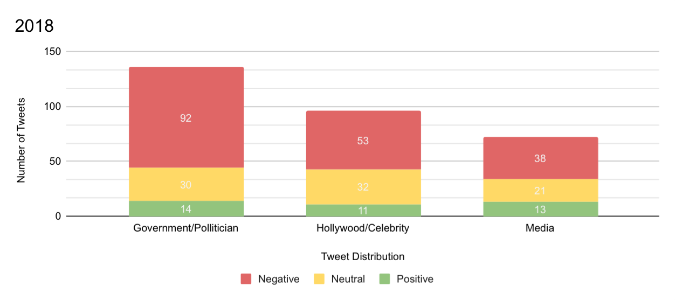
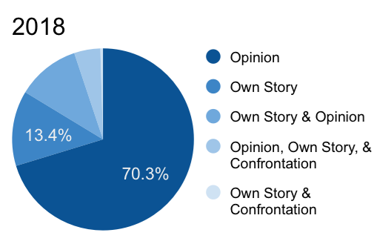
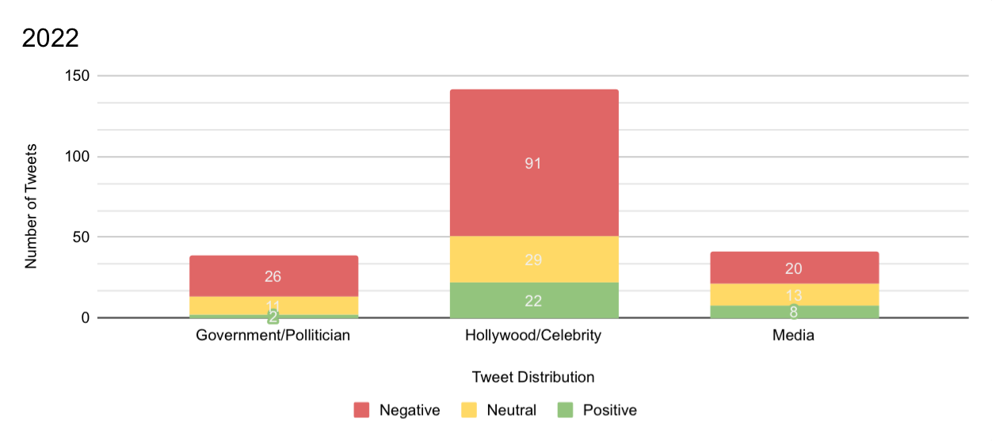
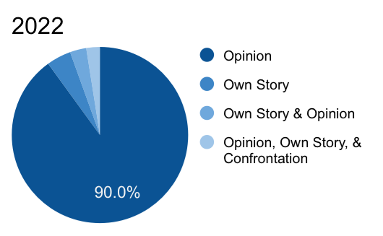
“Sexual violence thrives in silence. It’s time to break the silence and address this epidemic
head-on.”
-Tarana Burke, founder of Me Too
The online social movement #metoo influenced real-life change.
Shift in Tweet Usage
Although the Me Too hashtag was originally shared with the intent to create a safe space to share personal stories of sexual violence, it quickly turned into a social movement as people shared opinions on where they believed change needed to take place.
Over a quarter of the tweets in 2018 shared personal stories and often expressed gratitude that they finally had a platform to safely share their story and connect with other survivors. By 2022, however, nearly all the tweets were just sharing the user’s opinion. In many ways, the movement has been more divisive than inclusive. Although it has inspired real-life change, it has not created a space for survivors to share.
Tori Dehlin
Utah State University
Melanie M. Domenech Rodríguez, Ph.D.
Birth of a Movement
The Twitter/X hashtag trend #metoo began in 2017. By 2018, users worldwide were using #metoo to share personal stories of sexual violence, call out or identify people or groups that perpetrated sexual violence, and voice their opinions about the movement or perpetrators of sexual violence.
By 2022, the movement had become part of popular culture and similar hashtag movements became a way to share opinions and push for change in the world.
Analyzing Tweets
Using an AI tool that scans tweets, I gathered all posts containing the hashtag #metoo each month for the years 2018 and 2022. Tweets were then organized by content and results were compared between years to see if there was a shift in how users discuss sexual violence and if groups or individuals identified have changed or improved over time.
Personal tweets’ usage in 2018
Platforms like Twitter/X can be powerful tools for change, but can also create echo chambers of negativity. Instead of praising where positive changes have occurred, users shifted negativity to another group or individual.
Personal tweets’ usage in 2022
Notes:
The original Better Poster format

