Slide 1
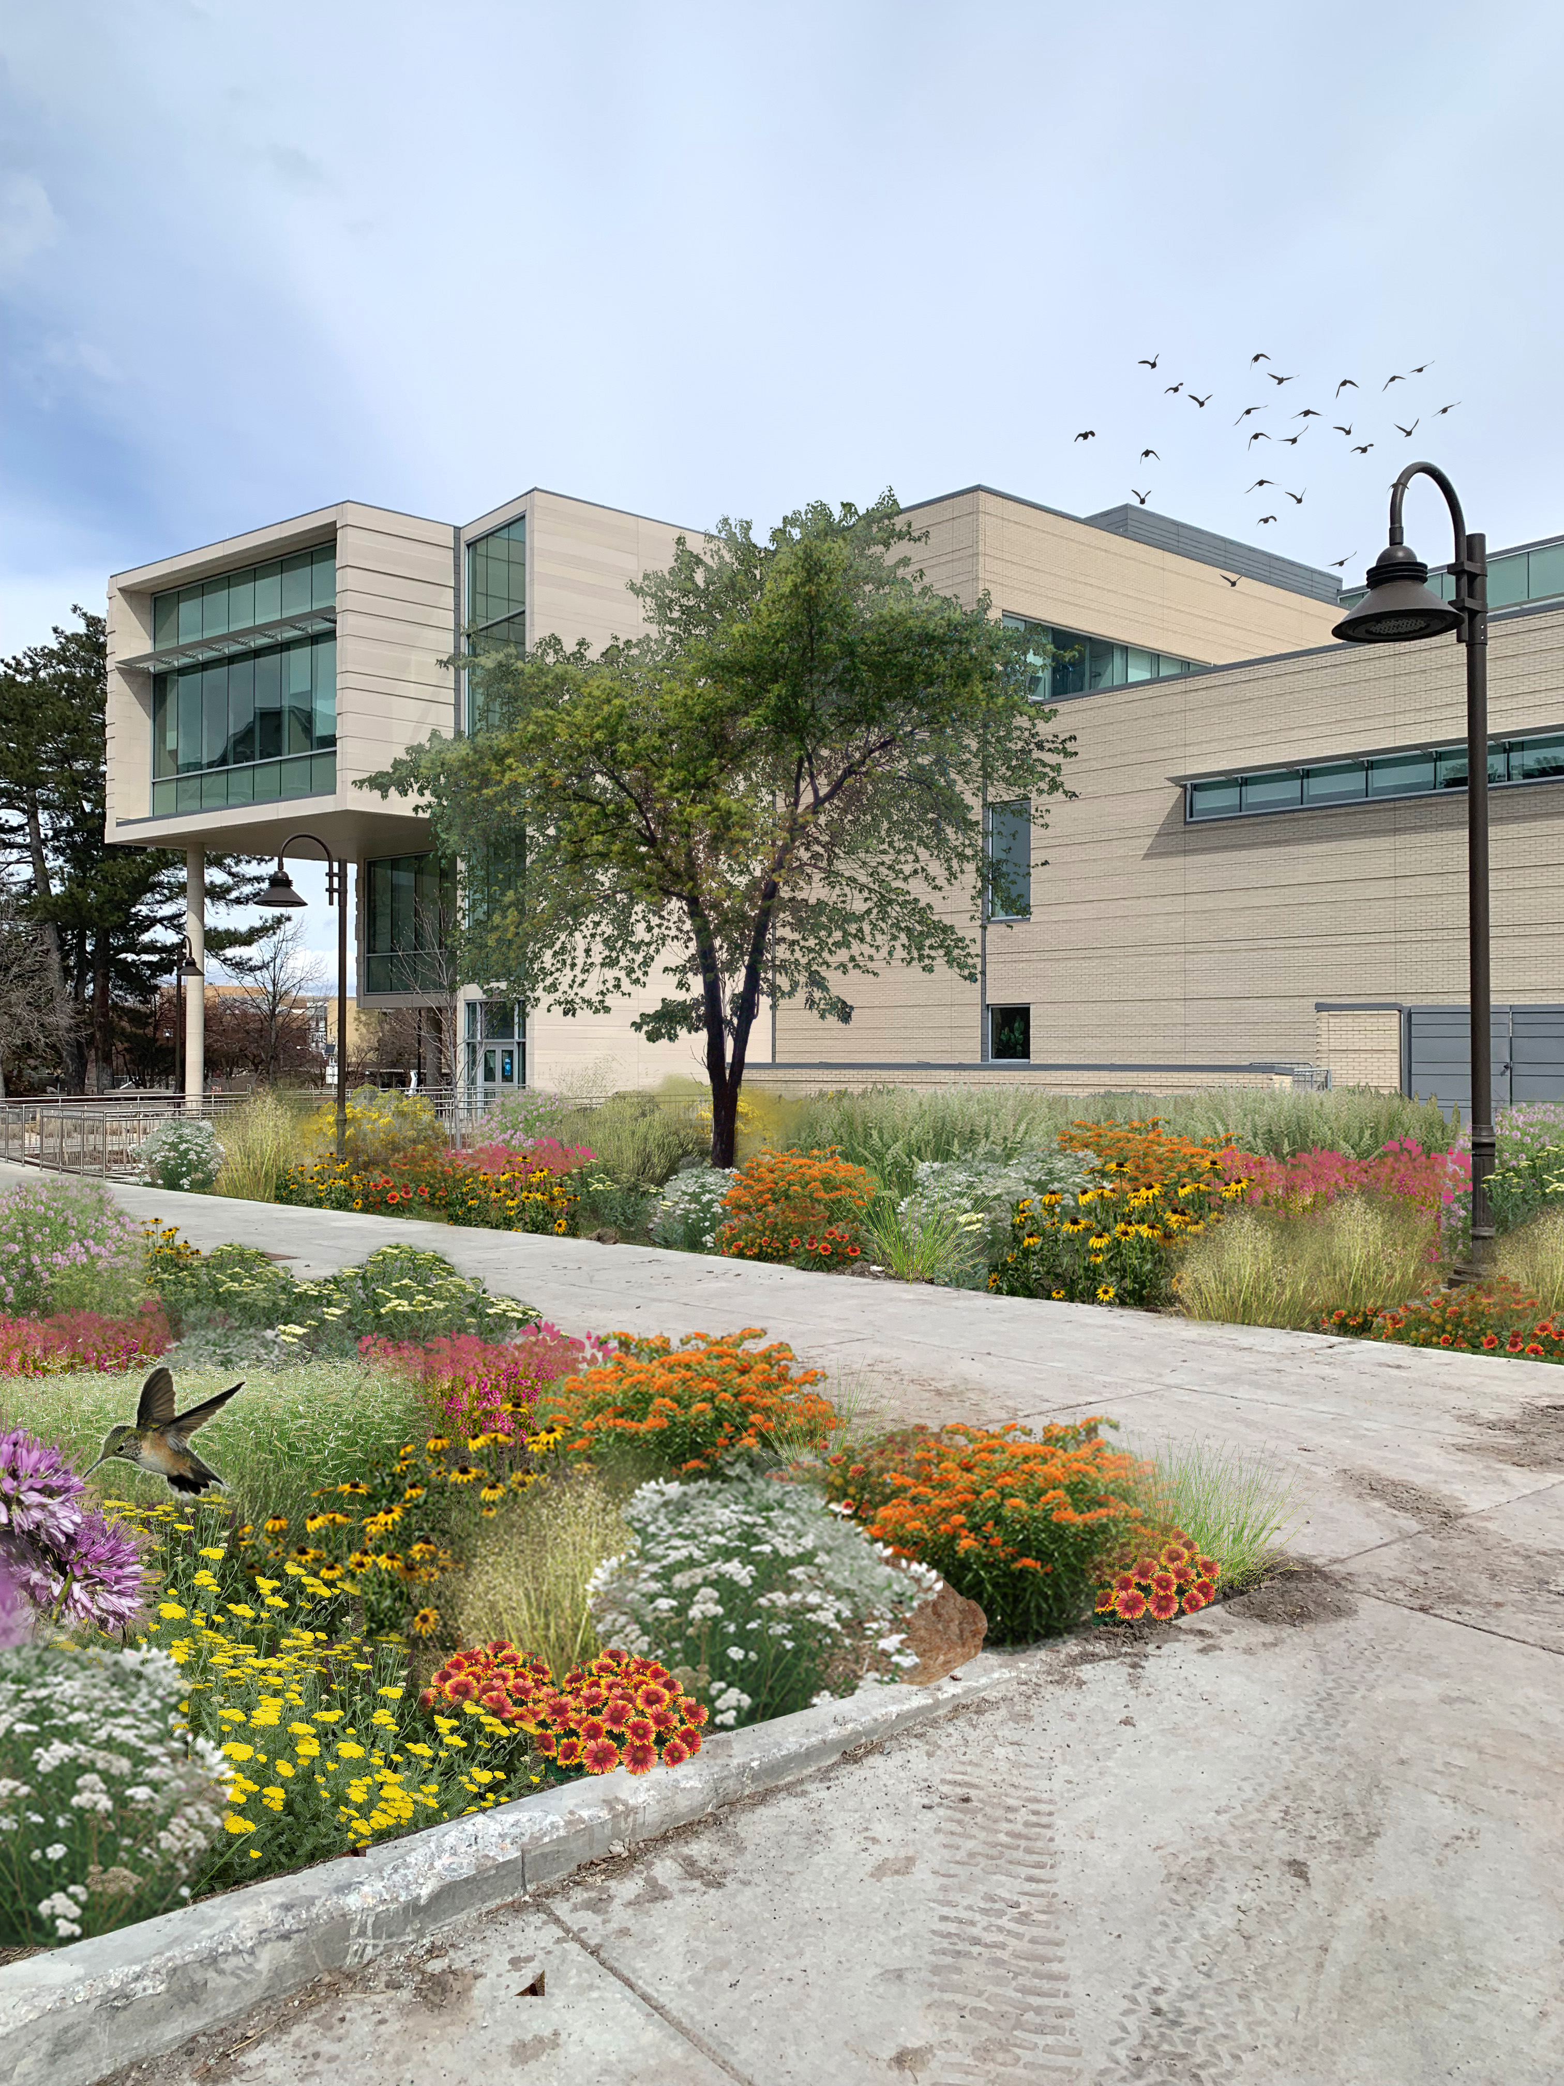
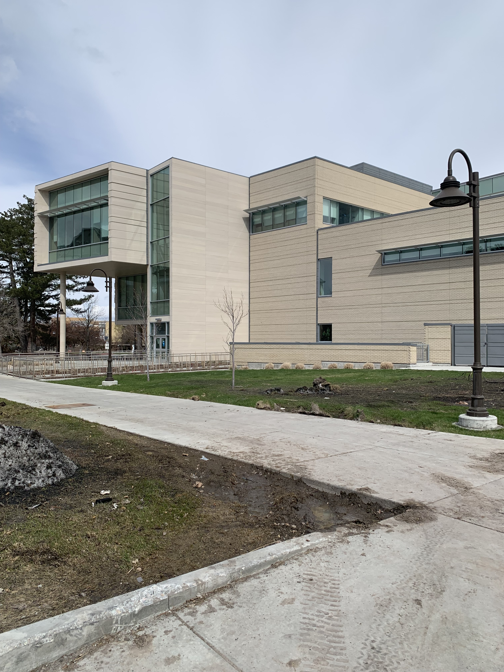
Water Efficient Landscaping at Utah State University could save 8 million gallons of water a year.
Mary Claire Jennings
Utah State University
Dr. Brent Chamberlain
Utah State University
Janet Quinney Lawson
Institute for Land, Water & Air
UtahStateUniversity
Turf is Inefficient
Utah has persistent drought conditions. Many discussions about land use revolve around water. As state institutions look at strategies to lower water usage, replacing turf with low water use plants is an attractive way to save significant volumes of water.
Water efficient landscaping conversion incentives don’t consider one critical factor: Solar Radiation, or the average daily hours of sunlight an area receives per day each growing season.
The ingredient that has been left out of the equation:
Solar Radiation.
Visualizing Potential and Calculating Impact
Conversion Areas
Water Efficient Landscape
Building a Solar Planting Key
Data Collection
LiDAR
Building Footprints
Topography
Green Spaces
2. Solar Analysis
3. Identify Conversion Areas
Underused Spaces
South-facing/Exposed areas
Proximity to roadways
High Solar Radiation
4. Visualizing Impact
Example Location
Calculating Impact
Before
After
Savings
Before
After
$485,000
$209,000
$171,000
Improve Student Experience
Create Pollinator Habitat
Make Use of Unused Turf
Save Water and Money
Watering Grass
Watering Grass
Total
Existing Planted Areas
Existing Grass Areas
Conversion Areas
$51,000
$156,000
-$105,000
Watering Plants
Watering Plants
Total
26,830,000
18,245,000
8,585,000
Gallons of Water
Gallons of Water
Gallons of Water
Notes:
Figure hero mod

