Slide 1
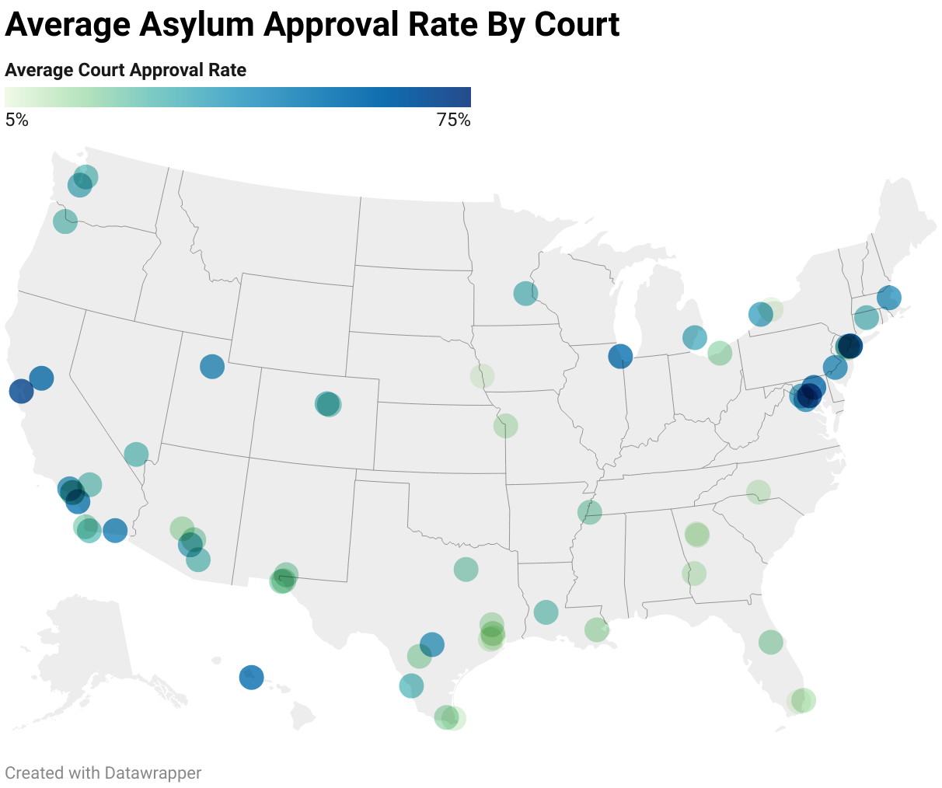
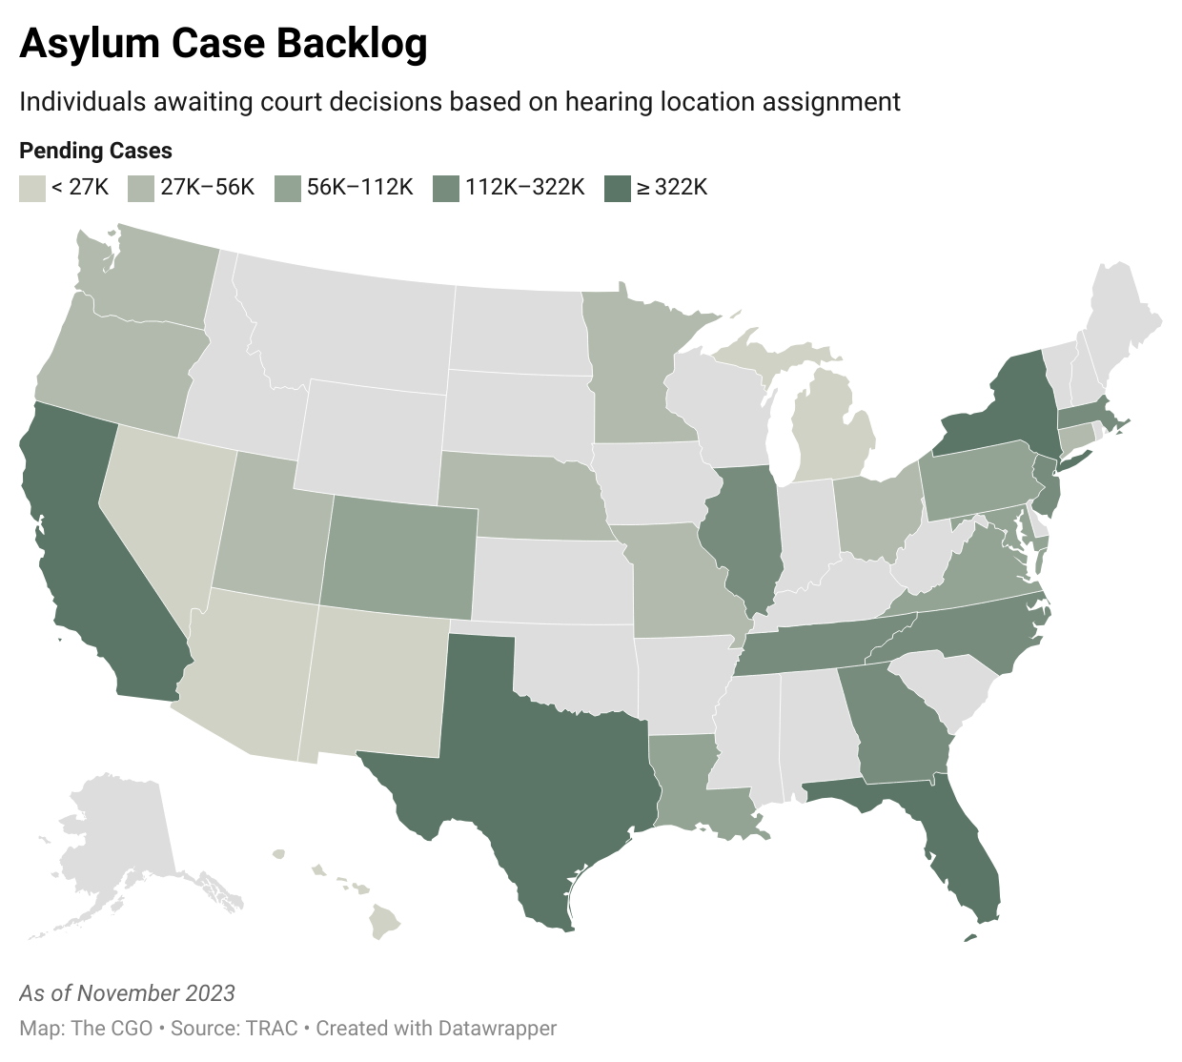
“Band-aid fixes and short-term solutions are no longer enough to reverse course.”
The court system needs to change to meet the asylum needs of deserving immigrants.
What is Asylum
Asylum is sanctuary granted to a person because they have suffered persecution or fear that they will suffer persecution due to:
Race
Religion
Nationality
Membership in a particular social group
Political opinion
—American Immigration Lawyers Association
Kallin Kelley
Utah State University
Josh T. Smith
Center for Growth and Opportunity
Viable Proposals
Three accomplishable solutions exist to help immigration courts better promote justice:
Re-establish courts under Article III of the US Constitution to insulate them from changing presidential administrations
Provide clarification as to what constitutes a “particular social group”
Hire more immigration judges to hear new cases faster and reduce the large case backlog
Introduction
Immigrants have always been fundamental to the United States’ success. Mia Love, a former U.S. congresswoman, once stated, “behind closed doors, every legislator will tell you that immigration is a good thing.” Immigration is vital to the success of the country and ensuring that our systems are capable of adequately and fairly managing immigration is vital. Immigration courts, however, are ill-equipped to do so.
Immigration Court Challenges
Immigration courts are established under the Department of Justice, not Article III of the constitution
No clear definition of “particular social group” in asylum requirements
Case backlog in immigration courts has exceeded over 2 million immigrants
Next Steps
Asylum approval ratings vary greatly among the 69 immigration courts in the United States.
This spring and summer we will conduct a poll of Americans on their definition of and opinion on “particular social group” are.
Scan to read more about court limitations
Notes:
The original Better Poster format

