Slide 1

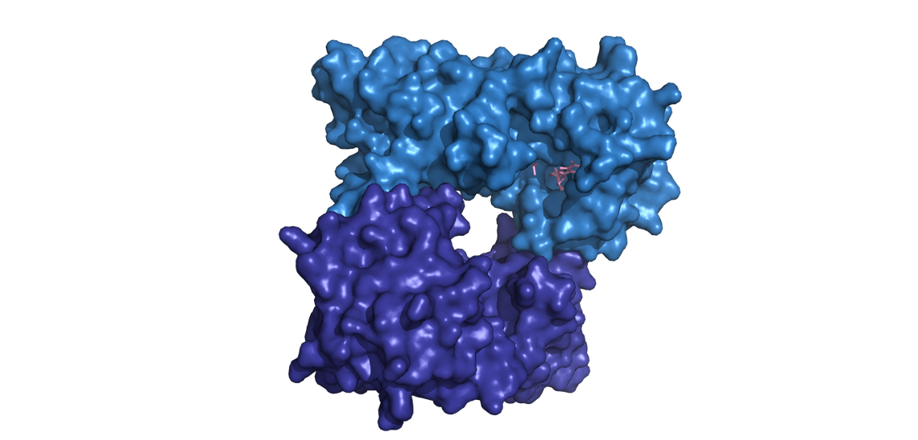
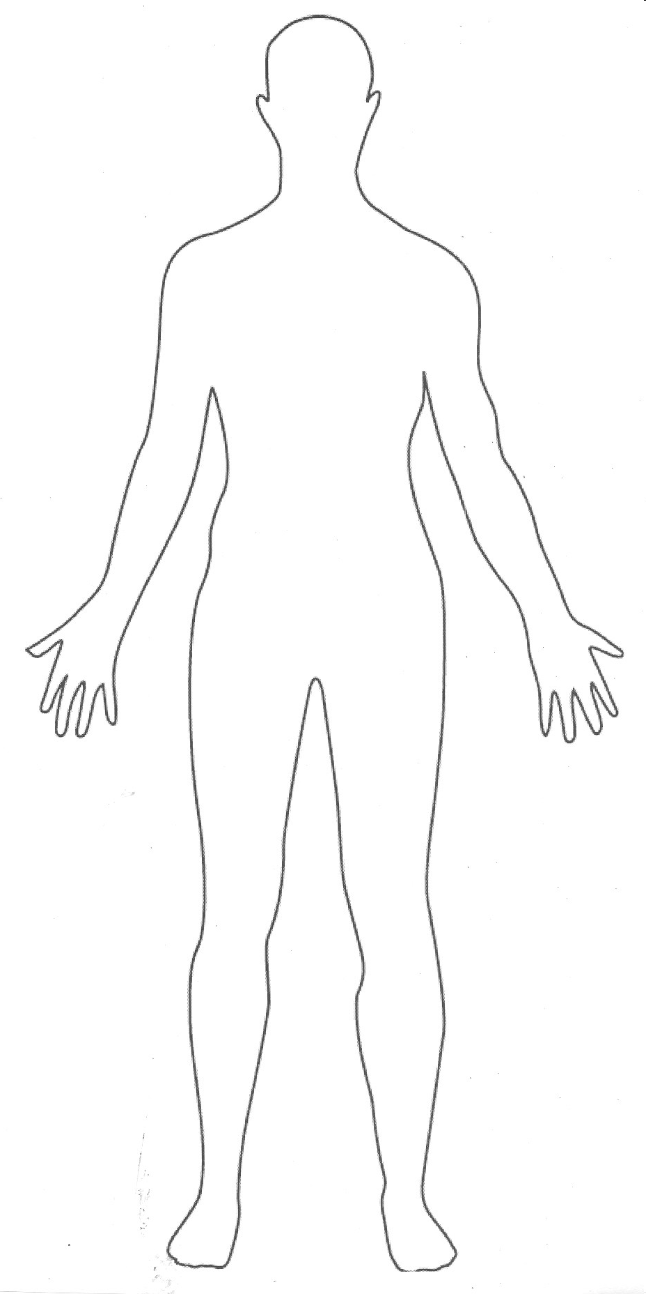
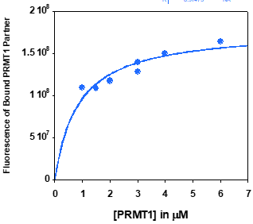
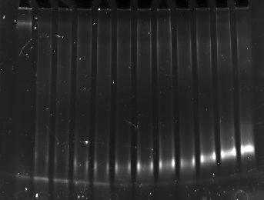
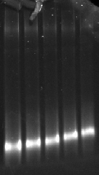
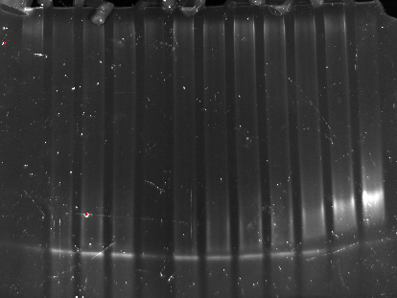
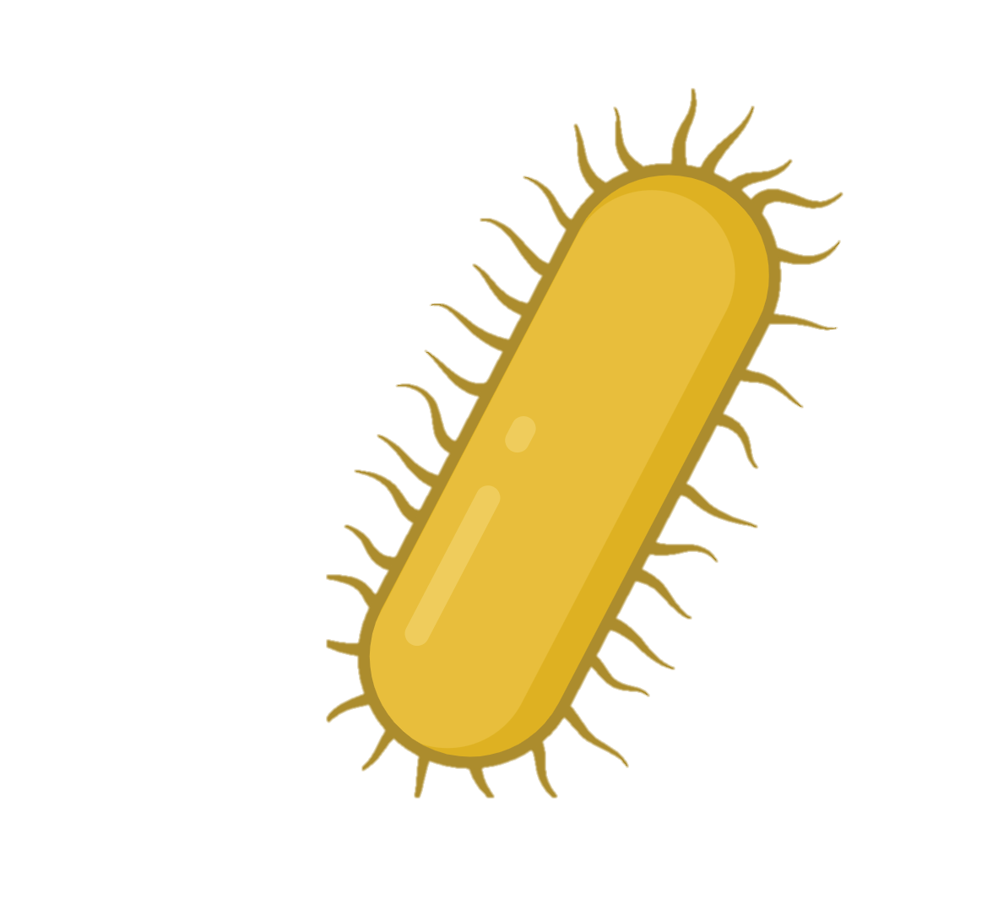


Human health relies on proper cellular communication, which starts with protein recognition.
We removed a structured protein region to assess its role in PRMT1 recognition
Known PRMT1 Target Protein
Removal of bulky structured region
Bulky structured region
Cells Have Rules for Communication
+
+
Just like humans have rules about how to communicate within a society, cells also need rules to govern communication.
Protein Arginine Methyltransferases (PRMTs) are enzymes that make modifications to specific proteins in a cell to communicate. Importantly, PRMTs need to distinguish a target protein from a non-target protein.
What are the rules that govern PRMT cellular communication?
?
Proper Recognition of Target by PRMT1: Normal Binding
Decreased Recognition of Target by PRMT1: Decreased Binding
PRMT1
Human PRMT1 modifies certain proteins in the body
Specific structured regions of target protein don’t impact PRMT1 recognition
How does it select which proteins to modify?
Modified protein
PRMT1
Protein Synthesis
We used E.coli to synthesize PRMT1 and a known protein binding partner, combined them, separated bound from unbound with an electric current, and visualized with fluorescence.
E.coli manufactures PRMT1 and protein binding partner
Fluorescent control
LARGER MOLECULES
E. Coli bacteria
PRMT1
Electrical current
The removal of the structured region in the protein partner does not significantly change PRMT1 recognition. The amount of protein partner needed to have equal bound and unbound protein does not change when the structured region is removed.
Binding partner
SMALLER MOLECULES
A gel matrix to separates molecules based on size
Use different proteins with different structural and chemical attributes… which bind?
Zaharah Rossi | Utah State University
Bella Lonardo | Utah State University
Dr. Joanie Hevel | Faculty Mentor
Funded by USU Undergraduate Research and Creative Opportunity Grants and National Science Foundation Grant # 2003769
Notes:
Presenter Better Poster format

