Slide 1
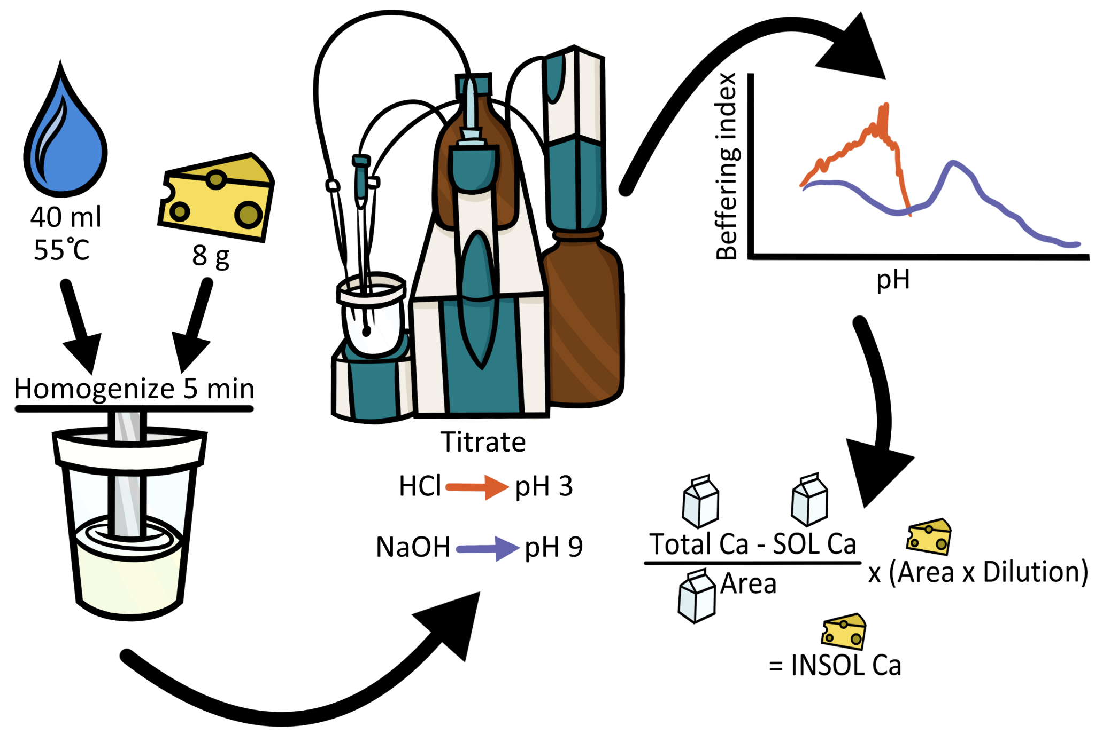
Colloidal Calcium Phosphate (CCP) causes problematic acid variation in cheddar cheese.
Understanding PH Variations in Cheese
pH variation in cheese during the early ripening stages causes changes in the texture, body, and flavor of cheese. The dairy industry, encompassing over 50,000 dairy farms nationwide and several regional dairy farmers and companies in Utah, suffers substantial financial loss as cheese with varying pH is rendered mostly useless.
Hypothesis: A cause of pH variation is CCP equilibrium.
The goal of this research is to develop a method which can accurately determine the state of CCP in different steps of the cheese making process. ​The critical aspect of this project was to find a best method preserving state of calcium.
The titration method using tritando used during this project. Image courtesy of Anna Lindstrom.
Analyzing the Cheese
Different types of cheese samples were prepared: Cut curd, cooked curd, whey drained curd, milled curd and salted curd.
Three different types of these preperations were analyzed: Fresh, liquid nitrogen and blast frozen.
Moisture, fat, and protein content on all samples were measured.
Calcium content was analyzed via titration and pH measurement methods.
Calcium content to protein ratio as a function of preservation methods in different cheese samples.
Liquid nitrogen and air blast freezing methods best preserved CCP during the cheese-making process, suggesting that they may hold the key to finding the cause of pH variation in the cheese.
Sakshi Singh | Utah State University
Dr. Prateek Sharma | Utah State University
Notes:
Presenter Better Poster format

