Slide 1
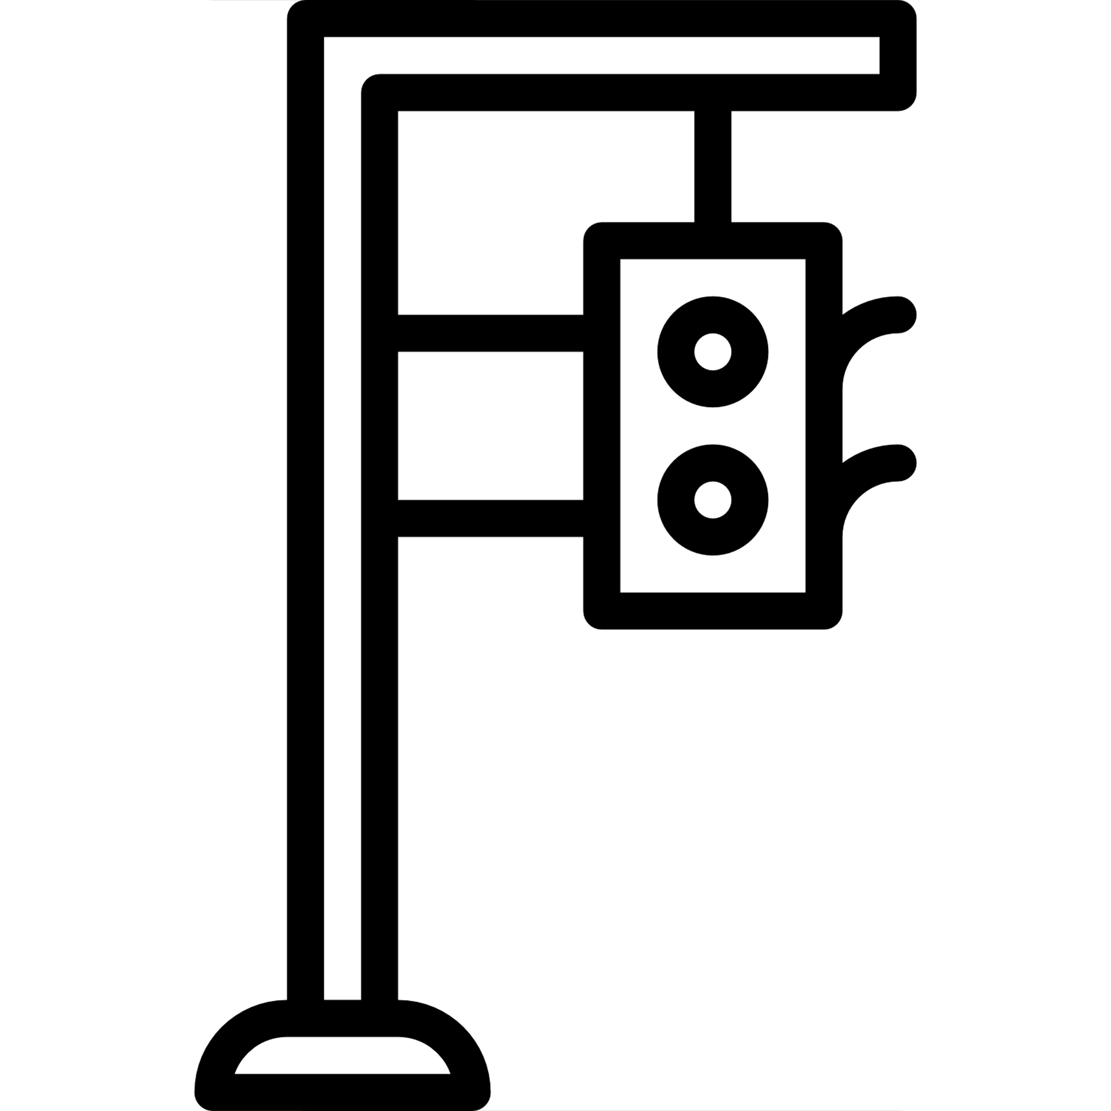
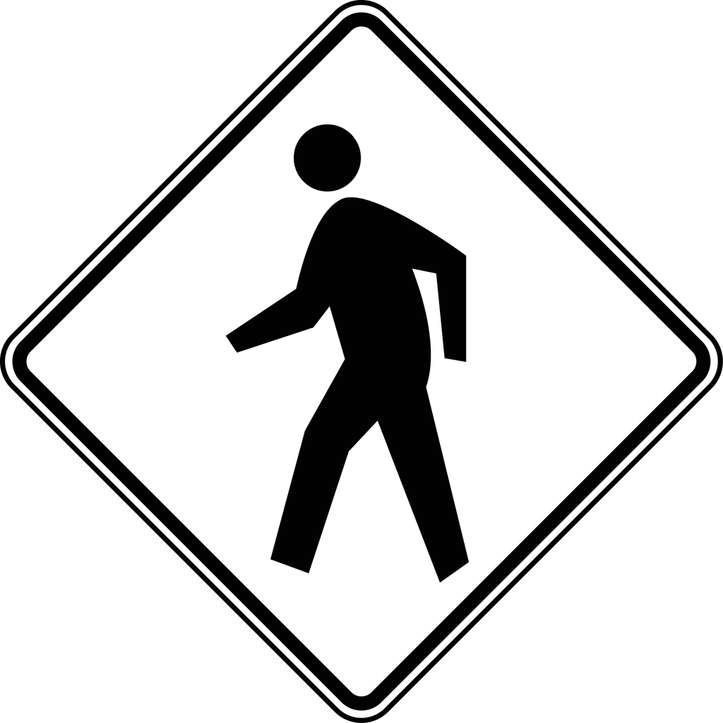
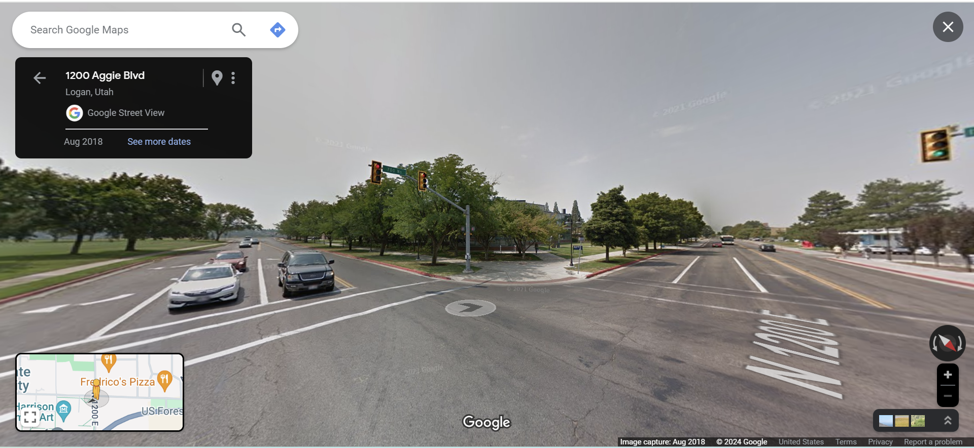
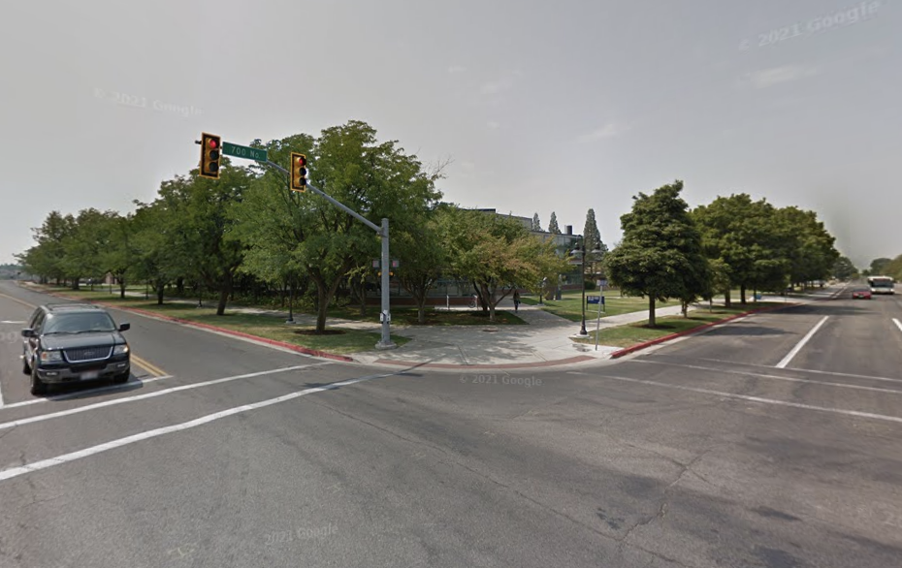
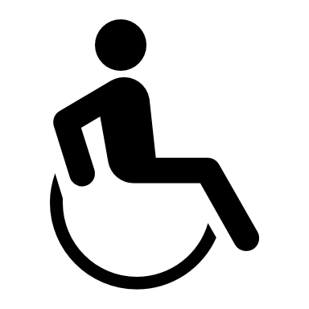
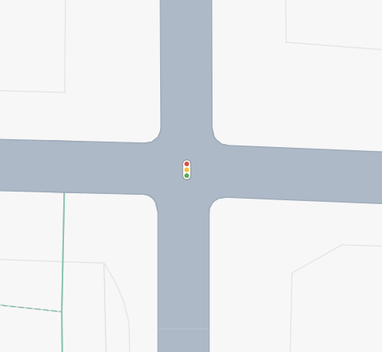
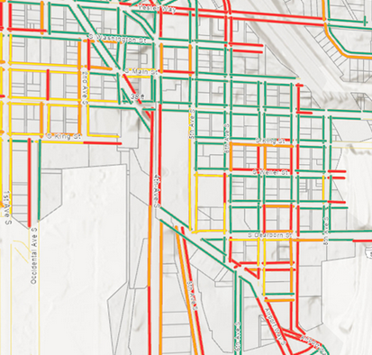
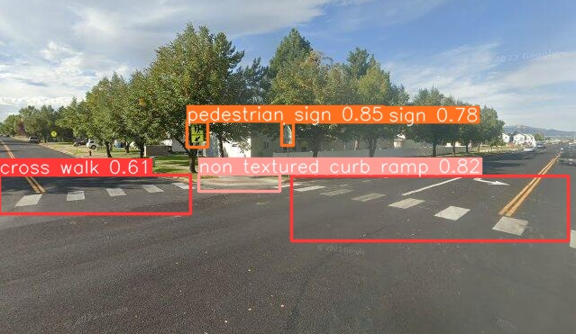
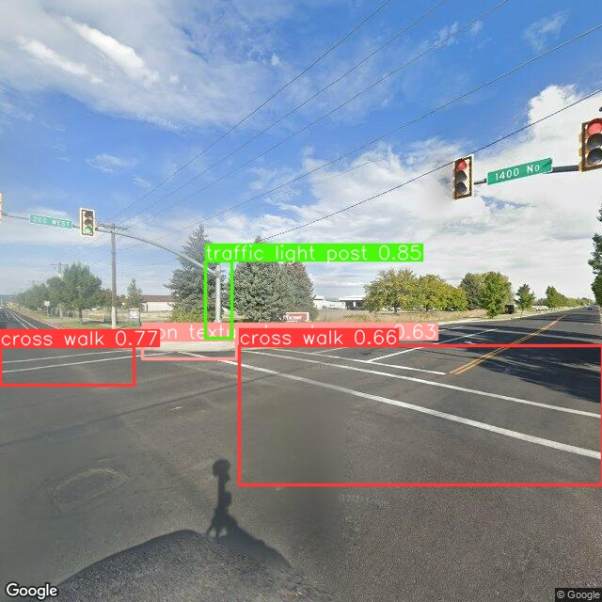
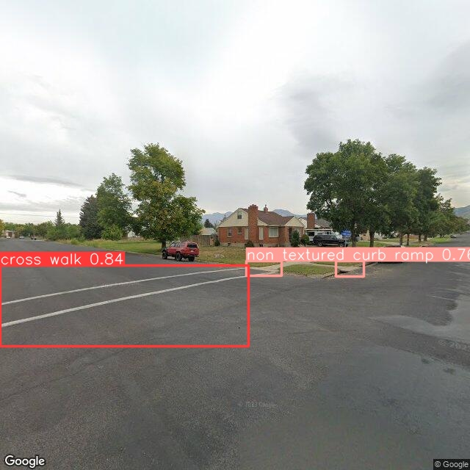
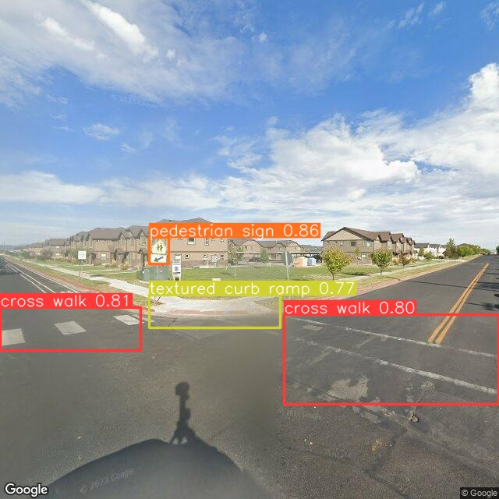
Asset management is expensive. Computer vision makes collecting data efficient and saleable.
Artificial Intelligence can help detect ADA accessibility assets and compliance.
Asset Detection Accuracy
Computer Vision models detect these accessibility assets with no user interaction.
Camille Tischner
Utah State University
Brent Chamberlain, Ph.D
Utah State University
Curb Ramp: 81%
Traffic Light Pole: 89%
Problematic Pedestrian Access
85% of cities do not have an accessible transpiration plan for pedestrians.
Inaccessible pedestrian networks provide challenges for seniors, people who live with disability, and children walking to school.
Of Utah's population...
Crosswalk: 95%
1. Extract Images from Google Street View
2. Utilize AI to Detect Accessibility Assets
Pedestrian Sign: 90%
Traffic light post: 98.7%
Stop Sign: 92%
Curb ramp: 98.7%
Accuracy metrics for accessibility asset detection.
Crosswalk: 98.7%
Crosswalk: 98.7%
22.3% live with disability
Transition Maps
3. Calculate Locations of Detected Assets
Detected assets are used to generate maps for planners and policy makers to assess the accessibility of public rights-of-way spaces.
12% are seniors age 65+
40% households have children under 18
Problems in the transportation network has resulted in billions of dollars of lawsuits in the US.
Lack of asset data makes addressing accessibility challenges in the pedestrian network almost impossible.
Automatic detection of accessibility assets at various intersections in Logan, UT with accuracy of detection
Process for gathering accessibility assets using Google Street View and Computer Vision
Transition map generated using detected objects
Notes:
The original Better Poster format

