Slide 1
How to Write a Successful Seed Grant Proposal

Slide 2
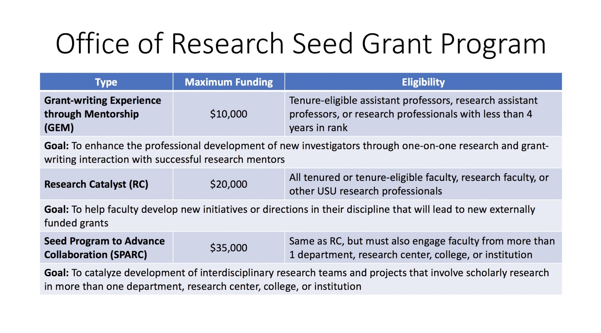

Slide 3
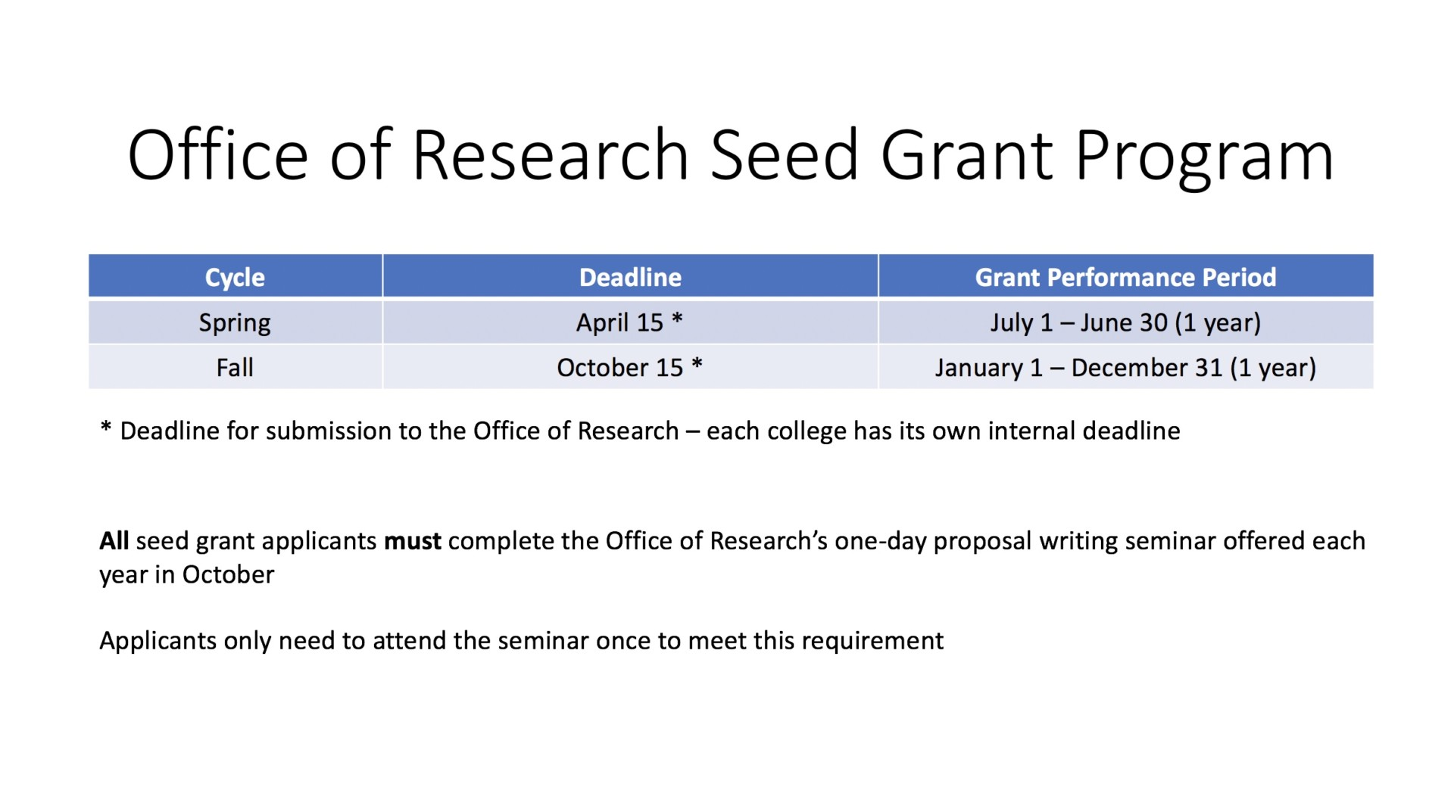

Slide 4
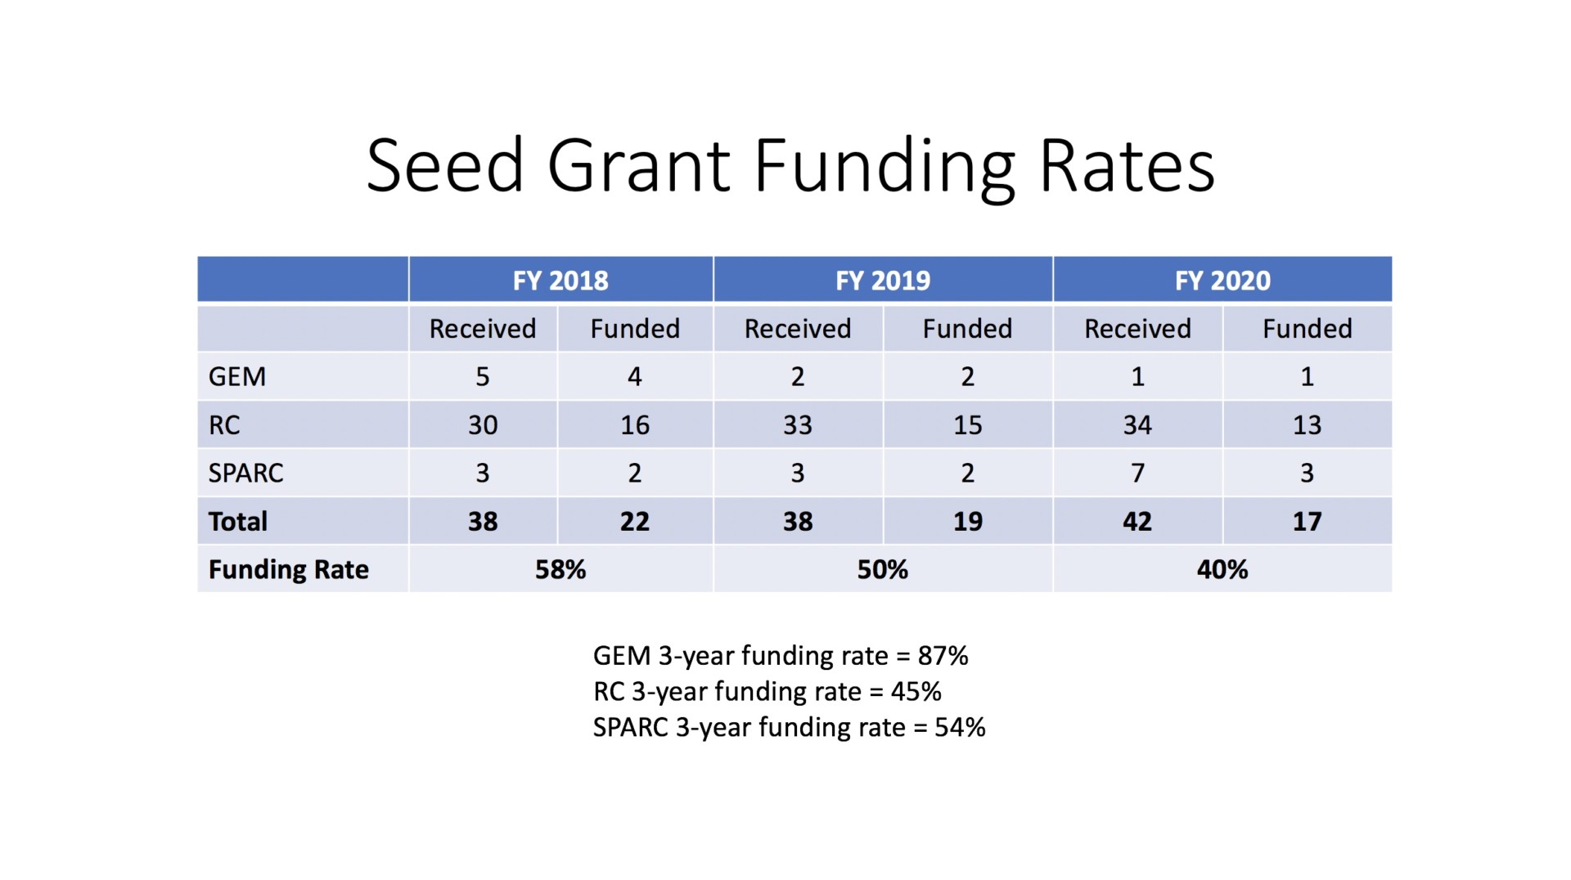

Slide 5
