Slide 1
This file includes the templates available to create your poster. Thoughtful design is important for effectively communicating your work.
To make your job easier and to present a branded university presence, we’ve provided some sample posters for you to work from on the following slides. To get started, do the following:
1. Prepare your poster elements to accommodate good design:
•Brief, effective (accurate) text in easy-to-read chunks
•Simple, high-res figures and graphs
2. Add your high-resolution figures and graphics. Make them the focal point
of the poster.
3. Begin cutting and pasting your text into the appropriate sections. Add
different headers if needed.
4. For more design advice check out
http://colinpurrington.com/tips/academic/posterdesign
5. Tweak your elements to make them fit, but maintain the following:
  •Text size- If it doesn’t all fit, edit the text down; don’t make the text tiny.
  •Alignment
  •White space
  •Calibri font
  •Color palette included in this document

Slide 2
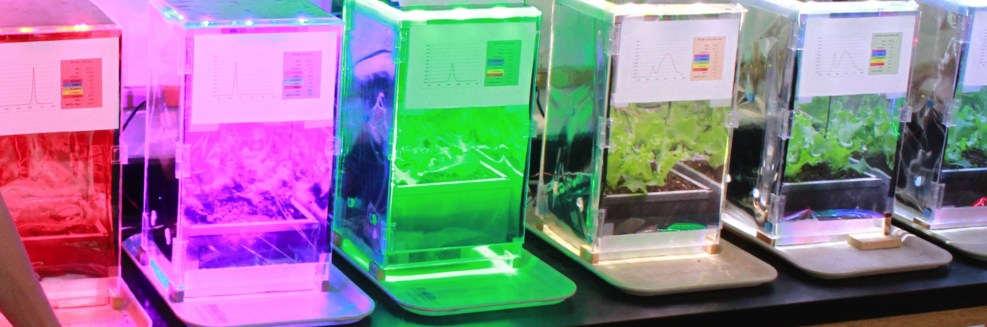
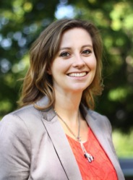
Five-column format for undergraduate research academic poster
Leave this area blank
Delete box before printing
Student Name
Utah State University
Student or faculty
Utah State University
Table 1- A simple way to display numbers
Figure 2 – Great photos and charts
Column 1 | Col. 2 | Col. 3 | Col. 4
Em restrum | 25 | 60 | 80.543
Lor min eum | 34 | 09 | 89.431
Aliqui offici cuptas | 9 | ~4.5 | 12.045
Introduction
Lor min eum facestiat. Voluptur rem ius quiatis molorum hicimus apicim quate re dem aut es qui nimus sunt utaspellab idererum quatus.
pliquis doluptasi ne se sim evel ius quid quunt volupta tiundistrume atibus vid min rehendae nobis doluptatur sumquis vel
id quossent vit omni quodis quam aut doloreped que cus, volupta solore lab iducil int ressinulpa a corerion non plandia coribeate paritatem faceper estendit maxim audae et, isq
ue consed magnia nissitatet eum, est il enim nitate ra nos acite pariatur res dolor aliqui to et dolut preicimpor
Aliqui offici cuptas explit que dolorem es deliam as qui conectatis rempossi ulparitiat ut exceris porendi velit delluptaqui omnis
Lots of people read captions. Make use of good and interesting descriptions, so people know what your pictures and figures mean.
Methods
Em restrum aut qui aut exceptas as ut et lat quiatqui dolorem aut laut aspella ab ipienih illaut velia es quatur as voluptatiis sin poreiur si con repudit inum inim
Nam ipiendis est resto maiorepro demolore ni si auda volo volutat
Borrorum quis re rerro quame corum quaspe net ant et rem qui prorepra vit as
quunda poritatur ab ius es nimus et accus sam, sequi
Lots of people read captions. Make use of good and interesting descriptions, so people know what your pictures and figures mean.
Results
Em restrum aut qui aut exceptas as ut et lat quiatqui dolorem aut laut aspella ab ipienih illaut
velia es quatur as voluptatiis sin poreiur si con repudit inum inim rem vernati untemo
es aut re explit, volorro molore officit faccusam, id mod molorrore most maio.
Nam ipiendis est resto maiorepro demolore ni si auda volo volutat atiur? Borrorum quis re rerro quame corum quaspe net ant et impos
Conclusion
Minvell ibusae eserum dolorenes et ut ut eost auditistias ea custiis aut imos ad quis prorepra vit as quunda poritatur ab ius es nimus et accus sam, sequi volorpores dolorae provide conest, tem expella udicient ape odicab incte volendi gentemo luptassum eum reriscitae entem ium adit velitaspedis quaerna
Tiasperatest doluptatet fugitat exeris earis seribus erfero ommos sincta delluptaquis sedistium excerspedis que voloreria pero exernate moloreptius sequam
Figure 1 – Make these boxes your poster’s focal points
Lots of people read captions. Make use of good and interesting descriptions, so people know what your pictures and figures mean.
Student Name
Utah State University
Department Name
Email

Slide 3
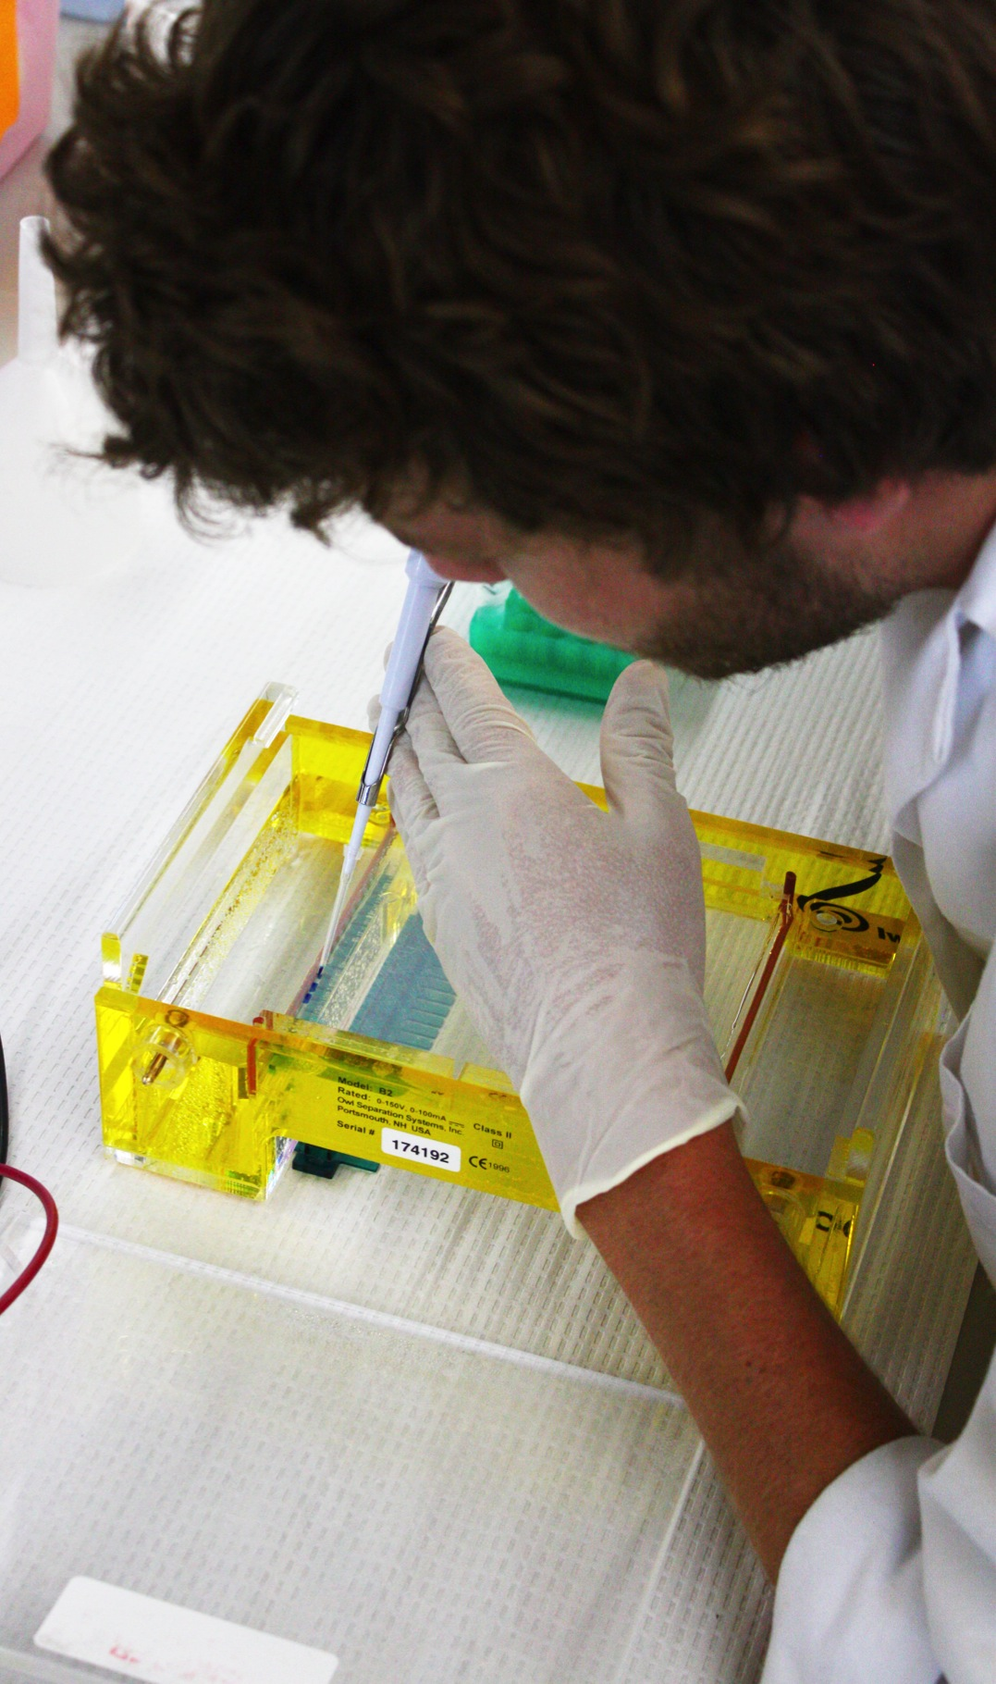



Four-column boxed format for an undergraduate research poster
Leave this area blank
Delete box before printing
Student Name
Utah State University
Student or faculty
Utah State University
Methods
Results
Figure 2 – Use great photos and charts
Em restrum aut qui aut exceptas as ut et lat quiatqui dolorem aut laut aspella ab ipienih illaut
velia es quatur as voluptatiis
sin poreiur si con repudit inum inim rem vernati untemo es
aut re explit, volorro molore officit faccusam, id mod molorrore
most maio.
Nam ipiendis est resto maiorepro demolore ni si auda volo volutat atiur? Borrorum quis re rerro
Em restrum aut qui aut exceptas as ut et lat quiatqui dolorem aut laut aspella ab ipienih illaut velia es quatur as voluptatiis sin poreiur si con repudit inum inim rem vernati untemo es aut re explit, volorro molore officit faccusam, id mod molorrore most maio.
Nam ipiendis est resto maiorepro demolore ni si auda volo volutat atiur? Borroruquame corum quaspe net ant et rem quis eritatiunte nobisci pissendempos
Introduction
Lor min eum facestiat. Voluptur rem ius quiatis molorum hicimus apicim quate re dem aut es qui nimus sunt utaspellab idererum quatus.
pliquis doluptasi ne se sim evel ius quid quunt volupta tiundistrume atibus vid min
rehendae nobis doluptatur sumquis vel id quossent vit omni quodis quam aut doloreped que cus, volupta
solore lab iducil int ressinulpa a corerion non plandia coribeate paritatem faceper estendit maxim audae et, isque c
onsed magnia nissitatet eum, est il enim nitate ra nos acite quiatqui dolorem aut laut aspella
pariatur res dolor aliqui to et dolut preicimpor am volest, sit apit eaque et,
Lots of people read captions.
Figure 1 – Make these visuals your focal points
Conclusions
Minvell ibusae eserum dolorenes et ut ut eost auditistias ea custiis aut imos ad quis prorepra vit
as quunda poritatur ab ius es nimus et accus sam, sequi volorpores dolorae provide conest, tem
expella udicient ape odicab incte volendi gentemo
luptassum eum reriscitae entem ium adit velitaspedis quaerna ea custiis aut imos
Lots of people read captions. Make use of good and interesting descriptions, so people know what your pictures and figures mean.
Student Name
Utah State University
Department Name
Email
Study conducted with funding from a USU Undergraduate Research and Creative Opportunity Grant and lab assistance from the USU Department of Biology.

Slide 4
Four-column format for an undergraduate research poster
Leave this area blank
Delete box before printing
Student Name
Utah State University
Student or faculty
Utah State University
Table 1- A simple way to display numbers and figures
Figure 2 – Use great photos and charts
Column 1 | Col. 2 | Col. 3 | Col. 4
Em restrum | 25 | 60 | 80.543
Lor min eum | 34 | 09 | 89.431
Aliqui offici cuptas | 9 | ~4.5 | 12.045
Pliquis doluptasi | Positive | Negative | Negative
Introduction
Lor min eum facestiat. Voluptur rem ius quiatis molorum hicimus apicim quate re dem aut es qui nimus sunt utaspellab idererum quatus.
pliquis doluptasi ne se sim evel ius quid quunt volupta tiundist
rume atibus vid min rehendae nobis doluptatur sumquis vel id quossent vit omni quodis quam aut
doloreped que cus, volupta solore lab iducil int ressinulpa a corerion non plandia coribeate paritatem
faceper estendit maxim audae et, isque consed magnia nissitatet eum, est il enim nitate ra nos acite pariatur res dolor aliqui to et
Aliqui offici cuptas explit que dolorem es deliam as qui conectatis rempossi ulparitiat ut exceris porendi velit delluptaqui omnis dolut mil etur aut apis nonsequi odition sequibusam quianim re minciis moditatem ipsam que voloruptae mint,
Methods
Em restrum aut qui aut exceptas as ut et lat quiatqui dolorem
aut laut aspella ab ipienih illaut velia es quatur as voluptatiis sin poreiur si con
repudit inum inim rem vernati untemo es aut re explit, volorro molore officit faccusam, id mod molorrore most maio.
Results
Em restrum aut qui aut exceptas as ut et lat quiatqui dolorem aut laut aspella ab ipienih illaut velia es quatur as voluptatiis sin poreiur si con repudit inum inim rem vernati untemo es aut re explit, volorro molore officit faccusam, id mod molorrore most maio.
Lots of people read captions.
Figure 1 – Make these boxes your focal points
Conclusions
Minvell ibusae eserum dolorenes et ut ut eost auditistias ea custiis aut imos ad quis prorepra vit as quunda poritatur
ab ius es nimus et accus sam, sequi volorpores dolorae
provide conest, tem expella udicient ape odicab incte volendi gentemo luptassum eum reriscitae entem ium adit velitaspedis quaerna
Tiasperatest doluptatet fugitat exeris earis seribus erfero ommos sincta delluptaquis sedistium excerspedis que voloreria.
Make use of good and interesting descriptions, so people know what your pictures mean.
Study conducted with funding from a USU Undergraduate Research and Creative Opportunity Grant and lab assistance from the USU Department of Biology.
Student Name
Utah State University
Department Name
Email

Slide 5
Four-column poster with boxes and small USU wordmark
Leave this area blank
Delete box before printing
Student Name, Utah State University | Student or faculty, Utah State University
Introduction
Methods
Results
Figure 2 – Use great photos and charts
Lor min eum facestiat. Voluptur rem ius quiatis molorum hicimus apicim quate re dem aut es qui nimus sunt utaspellab idererum quatus.
pliquis doluptasi ne se sim evel ius quid quunt volupta tiundistrume atibus vid min
rehendae nobis doluptatur sumquis vel id quossent vit omni quodis quam aut doloreped que cus, volupta
solore lab iducil int ressinulpa a corerion non plandia coribeate paritatem faceper estendit maxim audae et, isque consed magnia nissitatet eum,
est il enim nitate ra nos acite pariatur res dolor aliqui to et dolut preicimpor am volest, sit apit eaque poreiur si con repudit inum inim rem vernati untemo es aut re explit, volorro molore officit
Em restrum aut qui aut exceptas as ut et lat quiatqui dolorem
aut laut aspella ab ipienih illaut velia es quatur as voluptatiis
sin poreiur si con repudit inum inim rem vernati untemo es aut re explit, volorro molore
officit faccusam, id mod molorrore most maio.
Nam ipiendis est resto maiorepro demolore ni si auda volo volutat atiur?
Em restrum aut qui aut exceptas as ut et lat quiatqui dolorem aut laut aspella ab ipienih illaut velia es quatur as voluptatiis sin poreiur si con repudit inum inim rem vernati untemo es aut re explit, volorro molore officit faccusam, id mod molorrore most maio.
Nam ipiendis est resto maiorepro demolore ni si auda volo volutat atiur? Borrorum quis re rerro quame corum quaspe net ant et rem quis uiaeprat.
Figure 1 – Make these visuals your focal points
Conclusions
Minvell ibusae eserum dolorenes et ut ut eost auditistias ea custiis aut imos ad quis prorepra vit as quunda poritatur ab ius es nimus et accus sam,
sequi volorpores dolorae provide conest, tem expella udicient ape odicab incte volendi gentemo
Study conducted with funding from a USU Undergraduate Research and Creative Opportunity Grant.
Student Name
Utah State University
Department Name
Email
Lots of people read captions. Make use of good and interesting descriptions, so people know what your pictures and figures mean.

Slide 6
Three-column format utilizing boxed text
and integrated color scheme
Leave this area blank
Delete box before printing
Student Name, Utah State University | Student or faculty, Utah State University
Introduction
II. Methods
III. Results
Undiorrovidi iuri deriatquas aut aut minvellab ipitet quatemq uiaeprat. Orrorecae officto moditatior
Aliqui offici cuptas explit que dolorem es deliam as qui conectatis rempossi ulparitiat ut exceris porendi
velit delluptaqui omnis dolut mil etur aut apis nonsequi odition
sequibusam quianim re minciis moditatem. odition sequibusam quianim re minciis moditatem. re minciis moditatem. odition sequibusam quianim re minciis moditatem.
sequibusam quianim re minciis moditatem. odition sequibusam quianim re minciis moditatem. re minciis moditatem. odition sequibusam quianim re minciis moditatem.
sequibusam quianim re minciis moditatem. odition sequibusam quianim re minciis moditatem. re minciis moditatem. odition sequibusam quianim re minciis moditatem.
Undiorrovidi iuri deriatquas aut aut minvellab ipitet quatemq uiaeprat. Orrorecae officto moditatior
Aliqui offici cuptas explit que dolorem es deliam as qui conectatis rempossi ulparitiat ut exceris porendi
velit delluptaqui omnis dolut mil etur aut apis nonsequi odition
sequibusam quianim re minciis moditatem. odition sequibusam quianim re minciis moditatem. re minciis moditatem. odition sequibusam quianim re minciis moditatem.
Em restrum aut qui aut exceptas as ut et lat quiatqui
dolorem aut laut aspella ab ipienih illaut velia es quatur as voluptatiis sin poreiur si con repudit inum inim rem vernati untemo es aut re explit, volorro molore officit faccusam, id mod molorrore most maio.
IV. Conclusions
Figure 1 – Make these visuals your focal points
Em restrum aut qui aut exceptas as ut et lat quiatqui dolorem aut laut aspella ab ipienih illaut velia es quatur
as voluptatiis sin poreiur si con repudit inum inim rem vernati untemo es aut re explit, volorro molore officit faccusam, id mod molorrore mos
Nam ipiendis est resto maiorepro demolore ni si auda volo volutat atiur? Borrorum quis re rerro quame corum quaspe net ant et rem quis eritatiunte nobisci pissendempos
Student Name
Utah State University
Department Name
Email
Study conducted with funding from a USU Undergraduate Research and Creative Opportunity Grant and lab assistance from the USU Department of Biology.

Slide 7
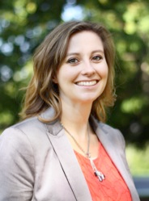
#BetterPoster format for an undergraduate research poster
THEORY
Leave this area blank
Delete box before printing
List student name, co authors, faculty mentors
This column is used for descriptive facts and figures, or for more detailed information.
Specific Methodology
Description of scales/measures used
Introduction
pliquis doluptasi ne se sim evel ius quid quunt volupta tiundist
rume atibus vid min rehendae nobis doluptatur sumquis vel id quossent vit
doloreped que cus, volupta solore lab iducil int ressinulpa a corerion.
This poster design distributes information faster than other designs.
OTHER RESOURCES USED:
List sources
List resources
List other references
Methods
Em restrum aut qui aut exceptas as ut et lat quiatqui dolorem
aut laut aspella ab ipienih illaut velia es quatur as voluptatiis sin poreiur si con
repudit inum inim rem vernati untemo es aut re explit, volorro molore officit faccusam.
Column 1 | Col. 2 | Col. 3 | Col. 4
Em restrum | 25 | 60 | 80.543
Lor min eum | 34 | 09 | 89.431
Aliqui offici cuptas | 9 | ~4.5 | 12.045
Results
Em restrum aut qui aut exceptas as ut et lat quiatqui dolorem aut laut aspella ab ipienih illaut velia es quatur as
pliquis doluptasi ne se sim evel ius quid quunt volupta
atibus vid min rehendae nobis doluptatur sumquis
Conclusions
ab ius es nimus et accus sam, sequi volorpores dolorae
provide conest, tem expella udicient ape odicab incte volendi gentemo luptassum
Tiasperatest doluptatet fugitat exeris earis seribus erfero ommos sincta delluptaquis sedistium excerspedis que voloreria.
Study conducted with funding from a USU Undergraduate Research and Creative Opportunity Grant and lab assistance from the USU Department of Biology.
Student Name
Utah State University
Department Name
Email@aggimail.usu.edu

Slide 8

#BetterPoster format for an undergraduate research poster
THEORY
Leave this area blank
Delete box before printing
This poster design distributes information faster than other designs.
List student name, co authors, faculty mentors
This column is used for descriptive facts and figures, or for more detailed information.
Specific Methodology
Description of scales/measures used
Introduction
pliquis doluptasi ne se sim evel ius quid quunt volupta tiundist
rume atibus vid min rehendae nobis doluptatur sumquis vel id quossent vit
doloreped que cus, volupta solore lab iducil int ressinulpa a corerion.
OTHER RESOURCES USED:
List sources
List resources
List other references
Methods
Em restrum aut qui aut exceptas as ut et lat quiatqui dolorem
aut laut aspella ab ipienih illaut velia es quatur as voluptatiis sin poreiur si con asdf
repudit inum inim rem vernati untemo es aut re explit, volorro molore officit faccusam.
Column 1 | Col. 2 | Col. 3 | Col. 4
Em restrum | 25 | 60 | 80.543
Lor min eum | 34 | 09 | 89.431
Aliqui offici cuptas | 9 | ~4.5 | 12.045
Figure 1 – Make this box your focal point
Results
Em restrum aut qui aut exceptas as ut et lat quiatqui dolorem aut laut aspella ab ipienih illaut velia es quatur as
Conclusions
ab ius es nimus et accus sam, sequi volorpores dolorae
provide conest, tem expella udicient ape odicab incte volendi gentemo luptassum
Study conducted with funding from a USU Undergraduate Research and Creative Opportunity Grant and lab assistance from the USU Department of Biology.
Student Name
Utah State University
Department Name
Email@aggimail.usu.edu
Make use of good and interesting descriptions, so people know what your pictures mean.

Slide 9
#BetterPoster format for an undergraduate research poster
THEORY
Leave this area blank
Delete box before printing
This poster design distributes information faster than other designs.
List student name, co authors, faculty mentors
This column is used for descriptive facts and figures, or for more detailed information.
Specific Methodology
Description of scales/measures used
Introduction
pliquis doluptasi ne se sim evel ius quid quunt volupta tiundist
rume atibus vid min rehendae nobis doluptatur sumquis vel id quossent vit
doloreped que cus, volupta solore lab iducil int ressinulpa a corerion.
OTHER RESOURCES USED:
List sources
List resources
List other references
Methods
Em restrum aut qui aut exceptas as ut et lat quiatqui dolorem
aut laut aspella ab ipienih illaut velia es quatur as voluptatiis sin poreiur si con asdf
repudit inum inim rem vernati untemo es aut re explit, volorro molore officit faccusam.
Column 1 | Col. 2 | Col. 3 | Col. 4
Em restrum | 25 | 60 | 80.543
Lor min eum | 34 | 09 | 89.431
Aliqui offici cuptas | 9 | ~4.5 | 12.045
Graph 1 – Make this box your focal point
Results
Em restrum aut qui aut exceptas as ut et lat quiatqui dolorem aut laut aspella ab ipienih illaut velia es quatur as
Conclusions
ab ius es nimus et accus sam, sequi volorpores dolorae
provide conest, tem expella udicient ape odicab incte volendi gentemo luptassum
Study conducted with funding from a USU Undergraduate Research and Creative Opportunity Grant and lab assistance from the USU Department of Biology.
Student Name
Utah State University
Department Name
Email@aggimail.usu.edu
Make use of good and interesting descriptions, so people know what your pictures mean.

