Slide 1
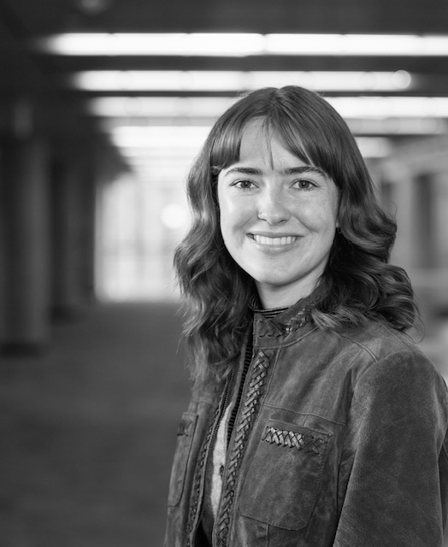
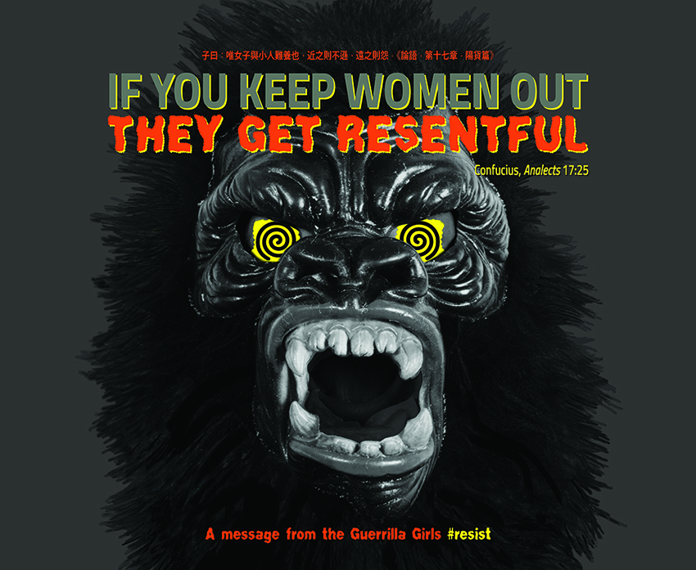
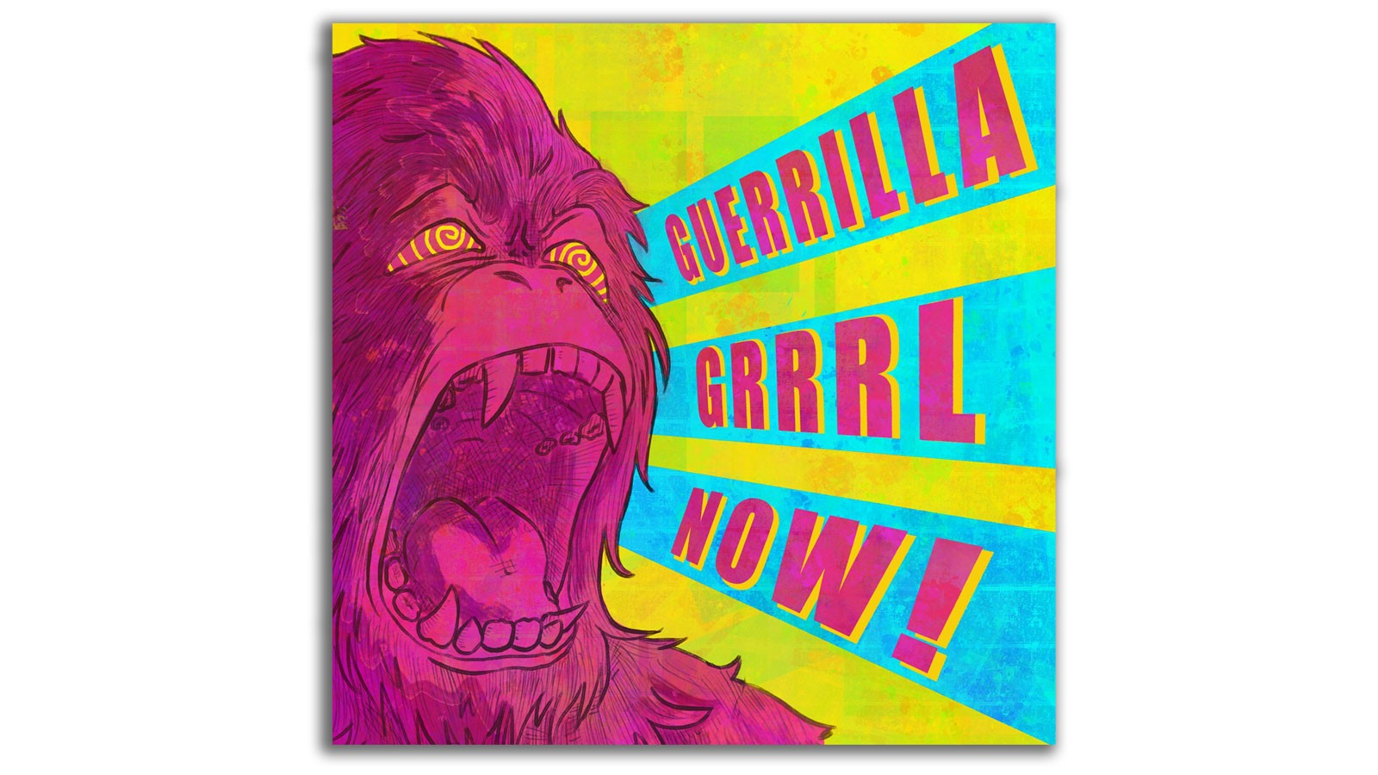
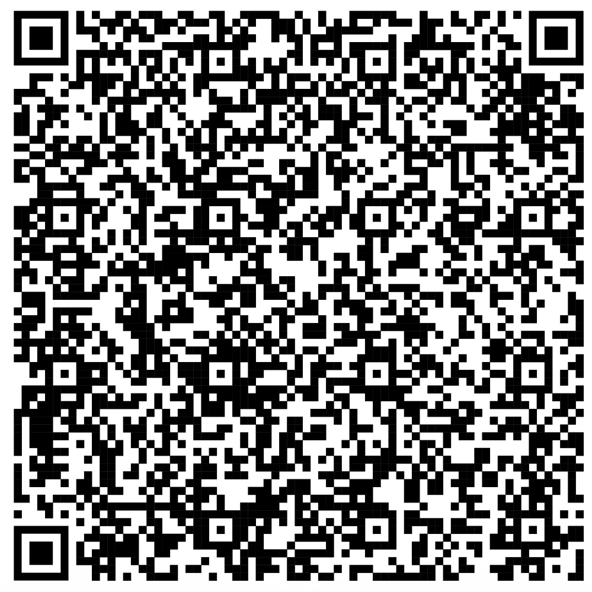
Guerrilla Grrrl Now! An exhibition that calls out inequality.
The Evolution of Feminist Art and the NOW!
Making a Difference
The exhibition brought together people from Utah State University’s campus and throughout Cache Valley. We asked our audience to participate in the exhibition by writing and speaking about their own experiences of discriminatory practices in the arts (and undervaluing of female artists) as they moved through the galleries.
We donated the money raised by the exhibition to organizations around Utah and the Cache Valley that support marginalized groups.
The movement that the Guerilla Girls started continues!
Eliza Bell
Utah State University
Aislinn Baker
Utah State University
Dr. Marissa Vigneault
Utah State University
Reinventing the “F” Word
The Guerilla Girls are a feminist-identifying activist group founded in 1985. The main goal of the group is to draw attention to marginalized groups, such as women and people of color, and show how underrepresented their art is. Through humor and slogans, the Guerilla Girls seek to call out inequalities in the art industry—and in the world beyond.
“Guerilla Grrrl Now!” by student Jenna Erickson, 2023.
Sharing The Message
USU is the only institution in the world that has the entire collection of Guerilla Girls works. We set up an exhibition called ‘Guerilla Grrrl Now!’ to display these pieces at our campus alongside the work of art students. ‘Grrrl’ is a nod to the Riot Grrrls, another feminist group, and we include modern pieces to highlight the continuing importance of the work NOW!
What NOW?
We still have work to do. To start, we recommend:
Funding female artists
Making galleries accessible and welcoming for all
Diversifying gallery spaces and the works they show
Including works from marginalized groups in collections
Projects like ours give voice to these important conversations about inequality. #resist
If You Keep Women Out They Get Resentful by the Guerilla Girls, 2018.
Take a picture to checkout the gallery!
Notes:
The original Better Poster format

