Slide 1
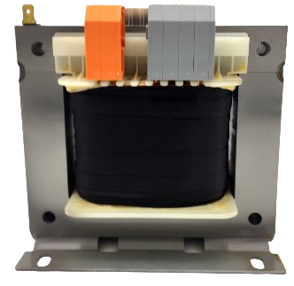
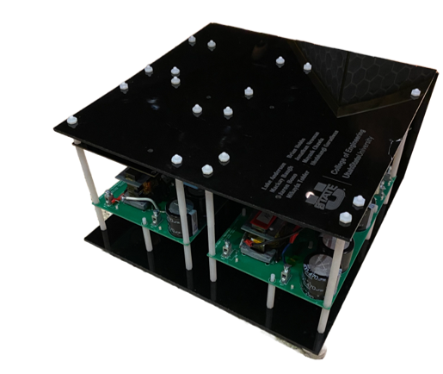
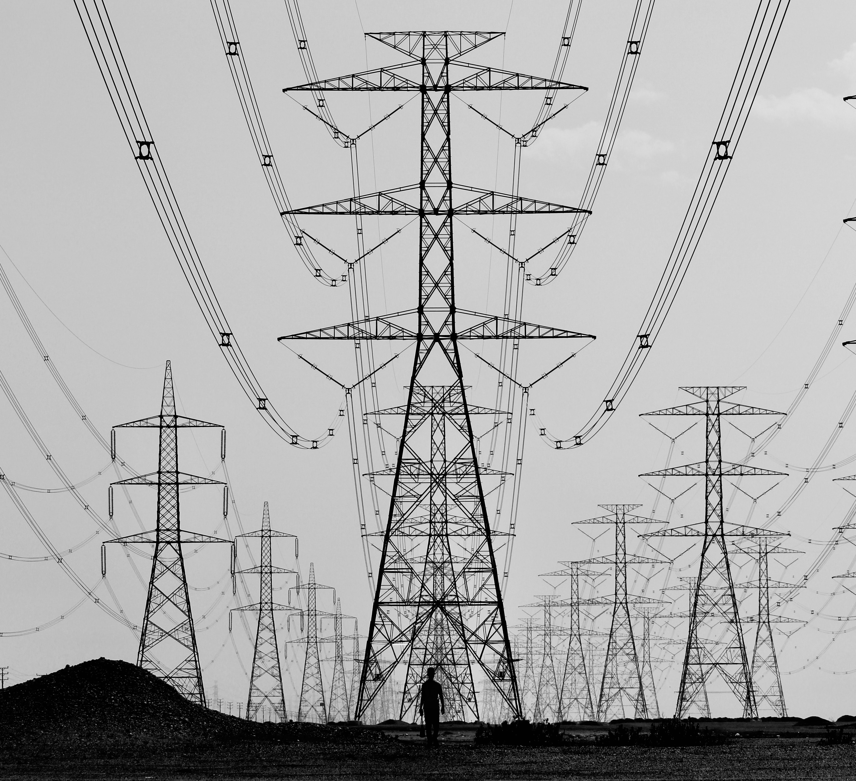
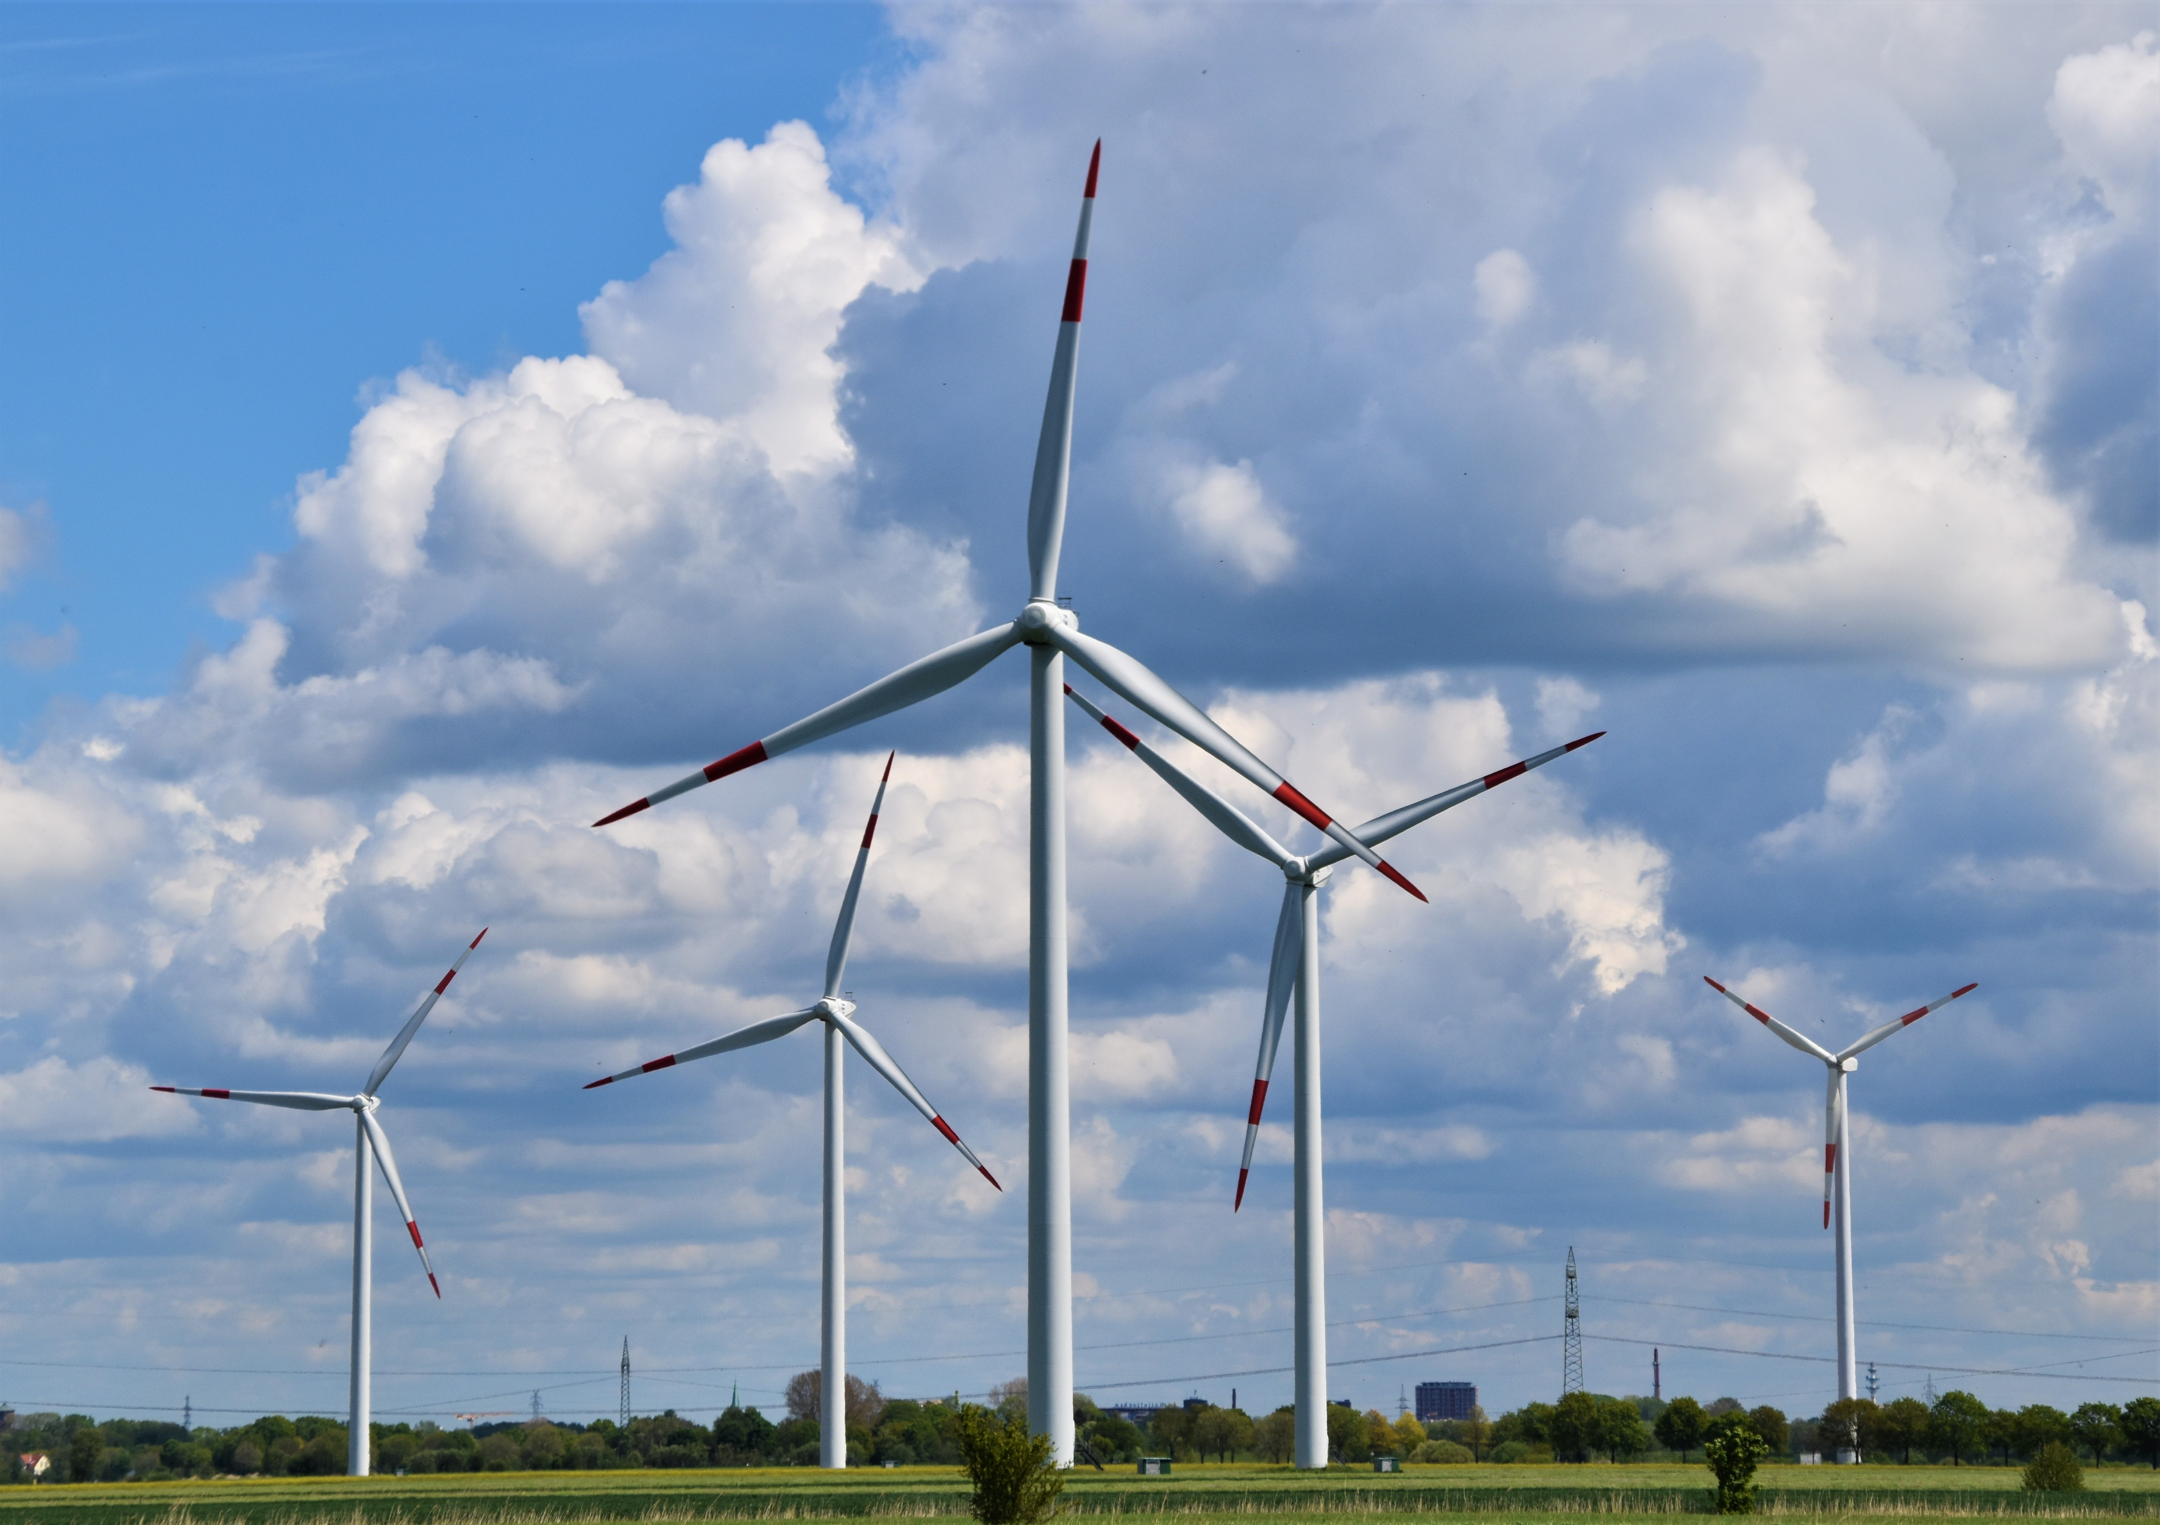
Solid State Transformers are critical for a smarter, more efficient electrical grid.
Conventional low frequency transformer
Solid state transformer
Improving on Past Technology
Solid State Transformers are power converters that mimic conventional low frequency transformers for alternating current (AC) electric power distribution. ​ Adopting these transformers will allow us to modernize the electrical power infrastructure for a sustainable and resilient energy future. Compared to conventional transformers, they are:
Lighter and more compact
More efficient
Easier to repair
Protected against overvoltage
Easier to produce at large quantities
Compatible with smart electric grids
Interfaceable with both alternating and direct current distribution systems and devices
The Validated Prototype
Future Improvements
High frequency AC power conversion from modern SiC semiconductor devices reduces both size and weight
88% overall efficiency
Autonomous operation with safety protections
Further increase in efficiency and reduction in size can be achieved with GaN semiconductor devices newly released in 2023
Optimize filters for efficiency
Reduction in volume by streamlining cooling system
Microgrid
Replacing Outdated Transformers
In order to make our power grid smart, the Solid State Transformer needs to meet or exceed the functions of conventional transformers. To measure our success, it must:
Operate at 93% or higher peak efficiency
Isolate power between end user and the grid
Run autonomously
Interface with grid voltage
Battery Storage
Power Grid
Solid state transformer
End User
This project won 3rd place at the 2023 International Future Energy Challenge.
Jaron Bono | Utah State University
Dr. Abhilash Kamineni | Utah State University
Notes:
Presenter Better Poster format

