Slide 1
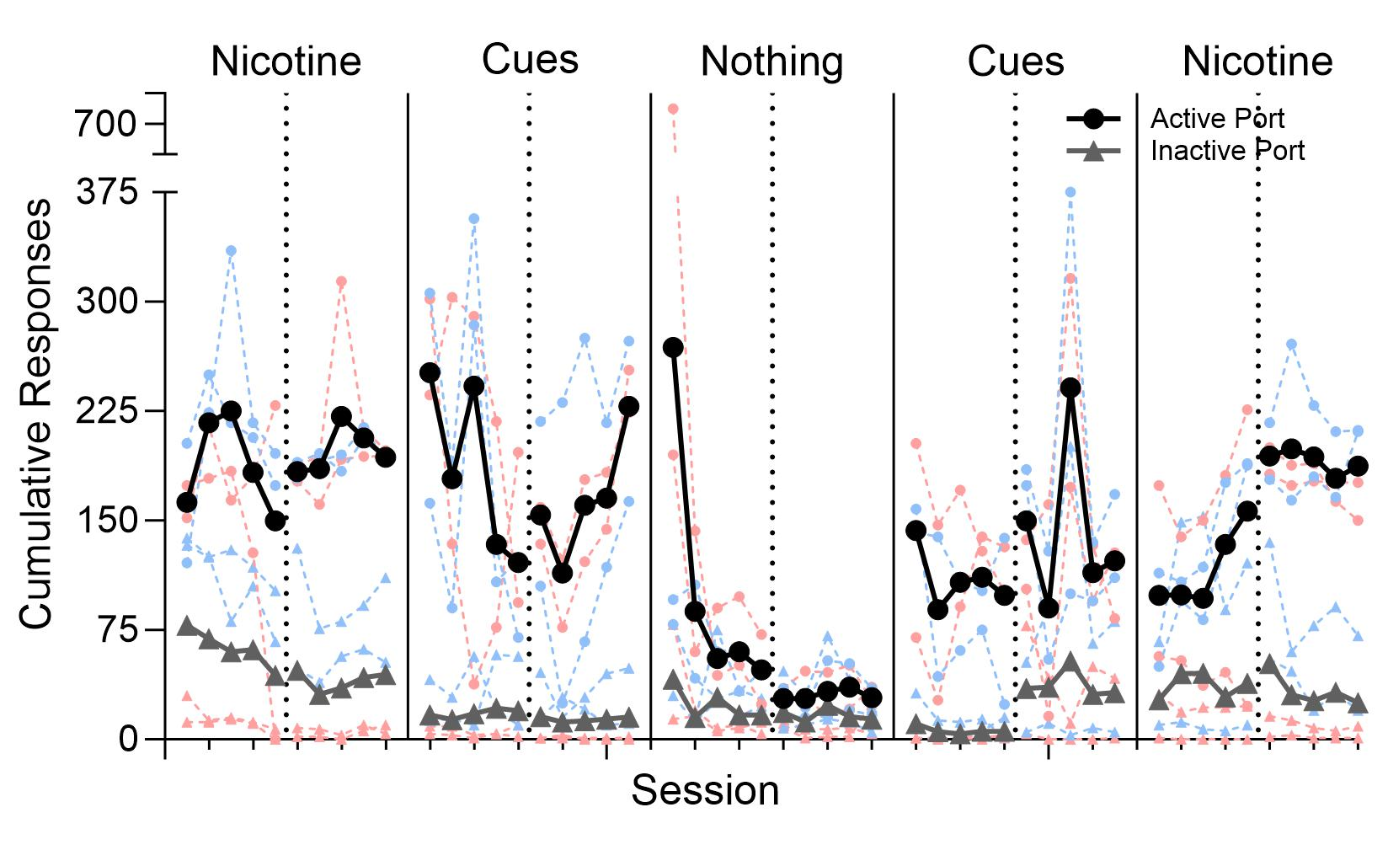
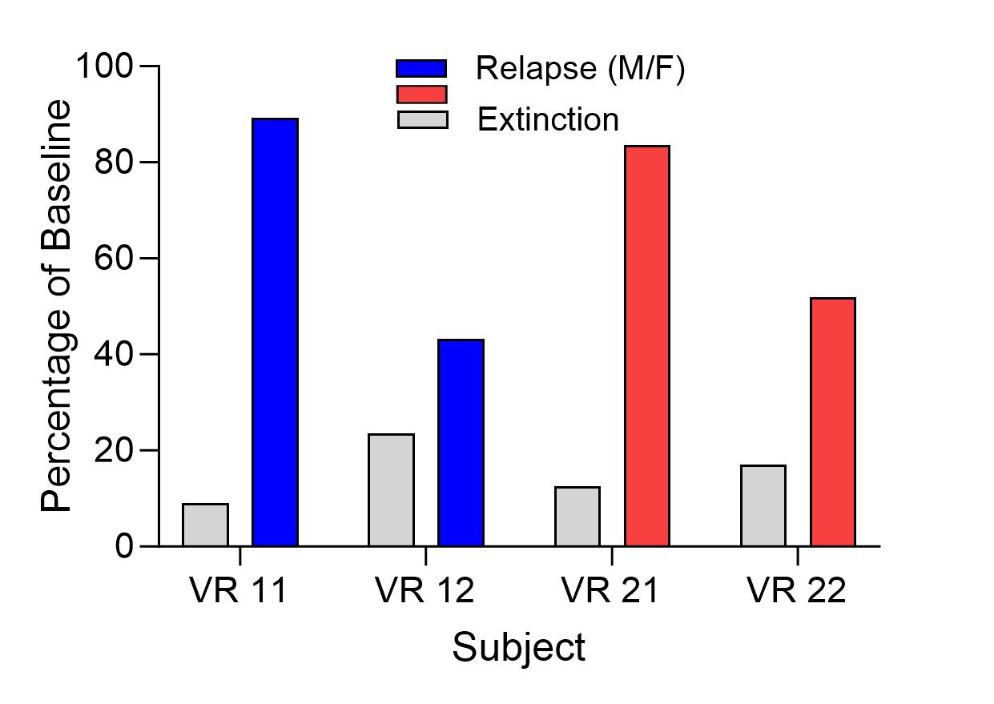
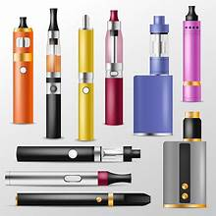
Vape consumption in rats helps to understand human vaping behaviors.
Persistent voluntary vaping in rats supports biological basis for electronic cigarette use.
Nicotine Delivery
We collected data from two female and two male rats who completed daily 85-minute sessions of nicotine vaping.
We developed a Rat Electronic Nicotine Delivery System (RENDS) which is the first to allow rats to voluntarily self-administer vaporized nicotine by snout only.
Kiernan T. Callister
Utah State University
Mariah E. Willis-Moore
Utah State University
Dr. Amy L. Odum
Utah State University
Rats Choose to Vape
We validated RENDS by comparing the amount of nicotine in the rats’ blood with how frequently they consumed vaporized nicotine.
Environmental cues (or lack of) impact the rate of self-administration and help to uncover factors possibly leading to greater vape consumption in humans.
Results demonstrate a strong biological basis for nicotine vaping, as rats consistently vape without some of the variables that propel human vaping (e.g., peer pressure).
Vaping/E-Cigarettes
Nicotine vaping, or e-cigarette use, is a pervasive health concern among adolescents and young adults that has many harmful impacts, such as permanent changes in brain development.
Rats have shared neurobiology with humans and can therefore be used to examine phenomena that are difficult to experimentally study in humans.
Our study seeks to develop and validate a new system of nicotine vaping in rats.
Note: Our relapse/reinstatement phase models situations in which humans who are trying to quit vaping would contact environmental cues that remind them of their nicotine addiction.
Note: Phases progress as follows: 1) voluntary nicotine vape consumption, 2) environmental cues (e.g.. lights that used to signal the availability of nicotine vape) but lack of vapor, 3) no environmental cues or nicotine vapor, 4) environmental cues but lack of vapor, 5) voluntary nicotine vape consumption. Dark lines represent the average cumulative responding of all subjects. Lightly shaded data points represent individual data from the male rats (blue) and female rats (red).
Next Steps
Scan this code for the abstract, references, apparatus information, and more.
We are beginning to investigate the impacts of vaping on the development of dementia in rats.
Notes:
The original Better Poster format

