Slide 1
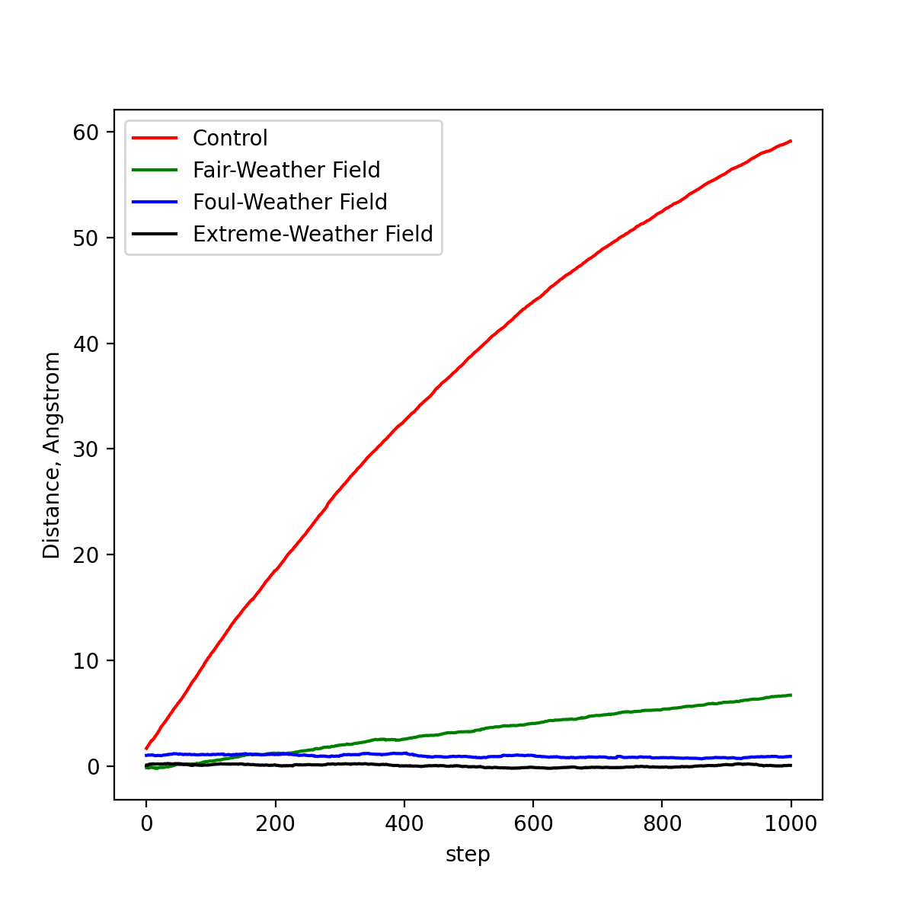
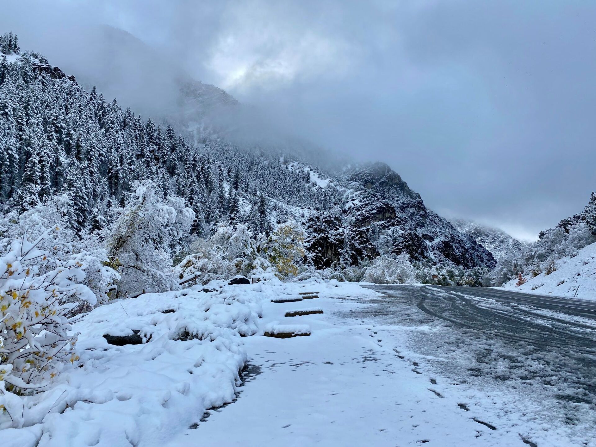
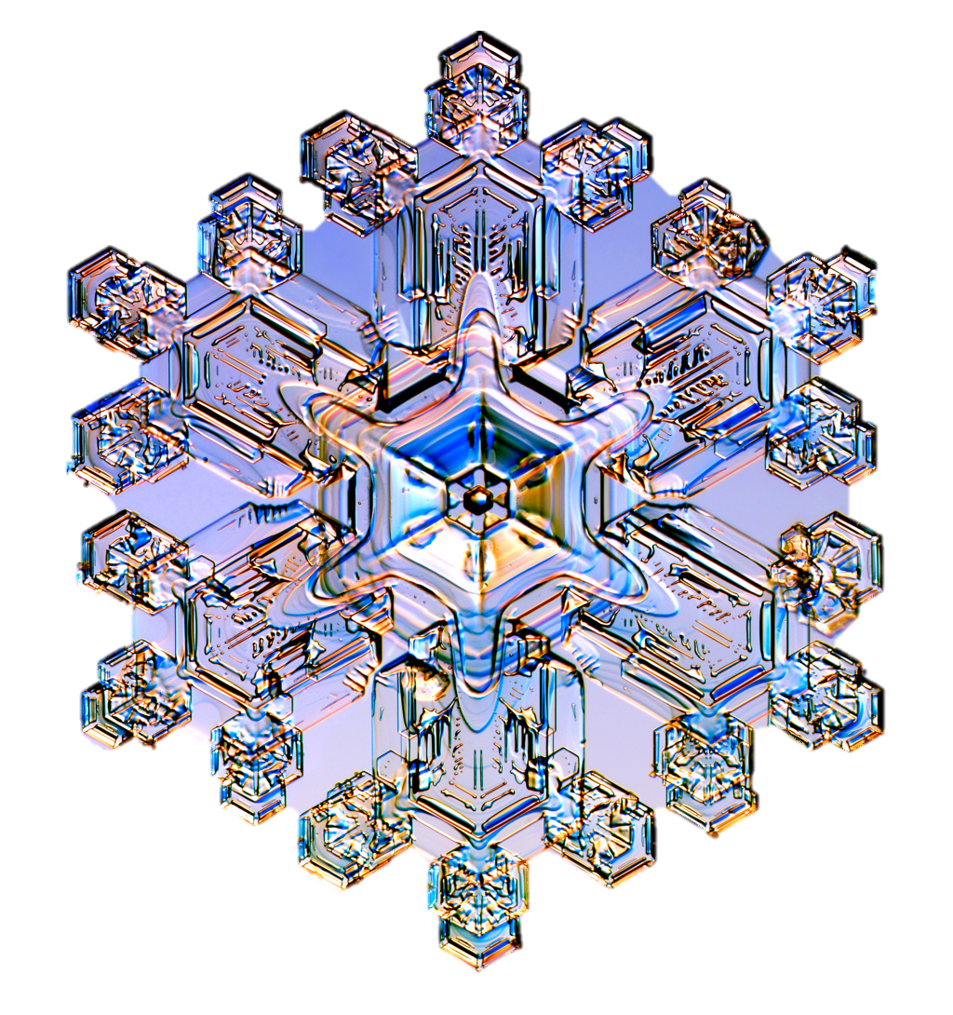
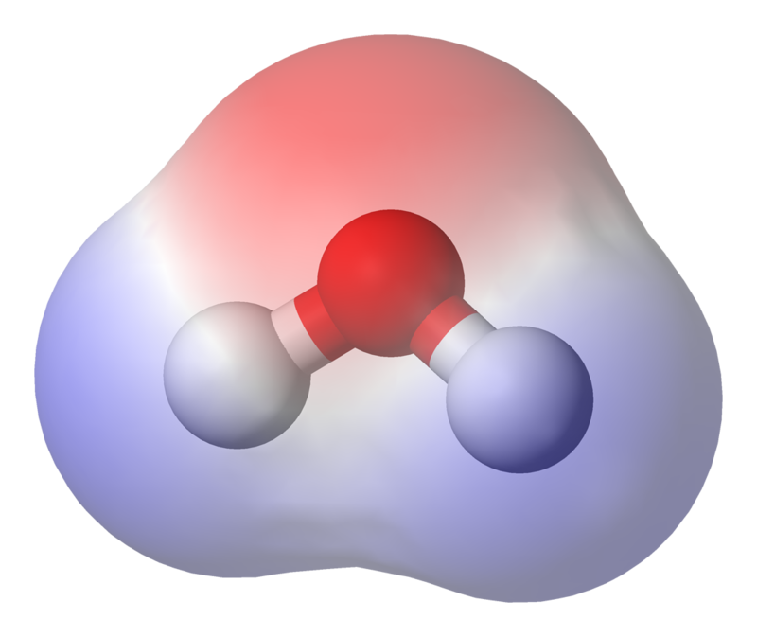
Electricity can change ice crystals in the atmosphere.
Electric fields in the atmosphere might help snow crystals form.
Weather Variations
As we thought, stronger electric fields changed the particles.
In a controlled setting without any electric field, particles form denser, sparser groups of molecules.
Particles’ molecules in highly charged fields (such as we see during foul or extreme weather) remain close to the nuclei and are more uniformly distributed.
Stronger electric fields as we see in bad weather cause molecules to arrange more densely and evenly, creating better conditions for ice crystal formation.
Joseph Cooney
Utah State University
Dr. Binod Pokharel
Utah State University
Dr. Jonathan Meyer
Utah State University
Why Electricity?
Distance From Nucleation Point
Orographic clouds generally form over mountains when valleys are sunny. The unstable atmosphere can trigger clouds over the mountains, which can be convective. When this happens, the cloud particles (water droplets and ice particles) become charged, ultimately creating ice crystals. I wanted to evaluate the impact of electricity on the formation of ice crystals and built a computer simulation to do so.
Stronger electric fields keep molecules close to the nucleus. This can help crystals grow.
Ice crystals also grow faster under stronger electric fields.
No Field
Molecular Level
Water molecules sometimes align differently under electric fields.
Could this cause different crystals to form?
An ice nucleus is subjected to electrical fields that influence the macroscopic properties of the nucleus.
Sparser nuclei may require more molecules to become stable enough to crystallize, making them less likely to result in snowfall in drier climates, where less atmospheric water is present.
Denser, more uniform nuclei may be more stable and likely to form crystals and fall as snow.
Credit: snowcrystals.com
Simulating Snow
We designed a computer program to run scenarios on ice crystal formation with different electrical charges in their nuclei (called ice nuclei). The range of charges represents the fluctuation of natural electric fields in the atmosphere during fair, foul, and extreme weather.
Strong Field
Notes:
The original Better Poster format

