Slide 1

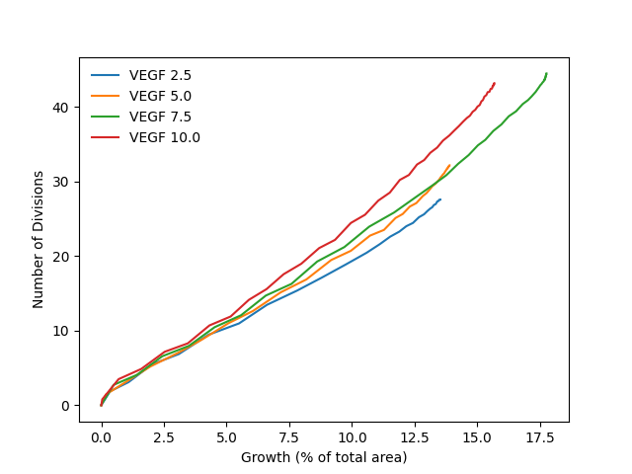
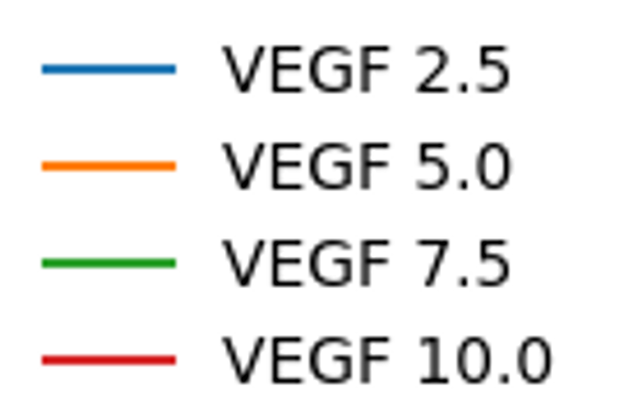
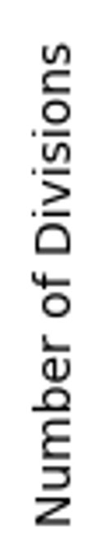
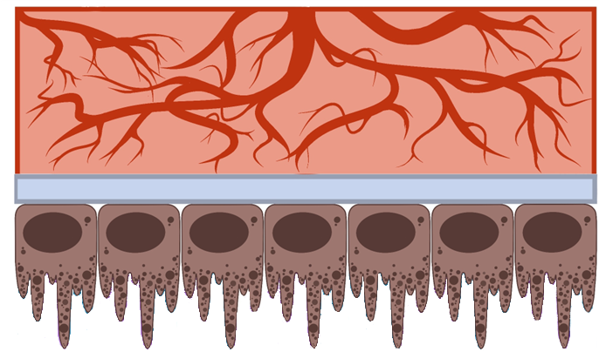
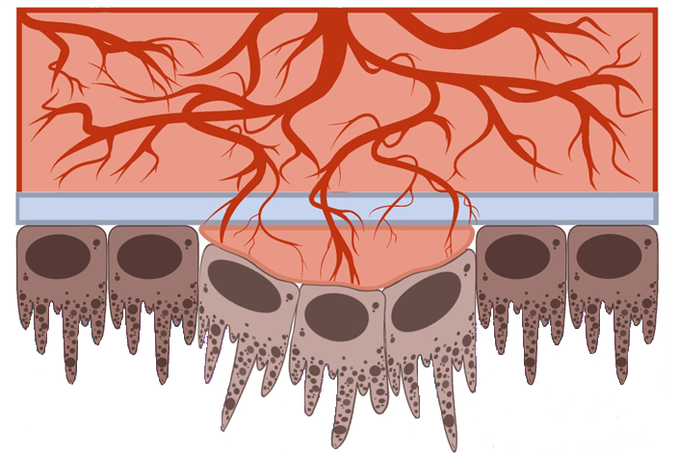

Our simulations model the factors
found in Wet Age-Related Macular Degeneration.
Mimicking Reality
There are ideal amounts of VEGF and PEDF in the eye for healthy function (no blood vessel growth occurs)
In a healthy eye, our model accurately predicted no growth
In scenarios with more VEGF:
Blood vessel coverage increased over the eye
Cell divisions per blood vessel increased, which causes leaky blood vessels like those found in AMD patients
There is a level of VEGF that maximizes the overall growth of blood vessels
Computer models can help us learn more about how eye diseases progress.
Cassandra Corry
Utah State University
Dr. Elizabeth Vargis
Dr. Zhen Zhang
Utah State University
Need for Test Model
Eye diseases are difficult to study because taking samples from living eyes can be challenging and uncomfortable. We need a model that mimics the human eye; running computer simulations seems like a promising way to conduct this research.
To see how viable our model is, we used it to look at Wet Age-Related Macular Degeneration (AMD).
Our model includes five substrates of the eye that can impact eye health and function.
Choroid
Bruch’s Membrane
Higher levels of VEGF change the structure of blood vessels, creating leaking blood vessels, like what is found in eye diseases
RPE Cell Layer
Extra results
Design of Simulation
Blood vessels have a layer of endothelial cells (ECs) that can perform a range of behaviors: move, stay, divide, or die.
The chance that an EC will do one of these actions is based on how high the levels are of each protein
The simulation generated random numbers and then determined how the ECs would act based on those numbers and the levels of protein surrounding it, like rolling a weighted dice
Computational modeling is a powerful tool that can be adapted as we learn more about how the human body functions. Running this computer eye simulation gave us new information about what might be causing exudative AMD, and we can continue adjusting the model as the medical community learns more about the eye.
Next, we will conduct physical experiments to confirm our results from the computer simulations. Our findings will be plugged back into the model to increase its accuracy!
Exudative AMD is one of the leading cause of blindness in the world, as it causes leaky blood vessels to move towards distressed retinal pigment epithelium (RPE) cells. (World Health Organization, 2010). Two proteins are critical for studying this disease. Vascular endothelial growth factor (VEGF) helps new blood vessel growth, and Pigment epithelial derived factor (PEDF) stops new blood vessel formation.
Notes:
The original Better Poster format

