Slide 1
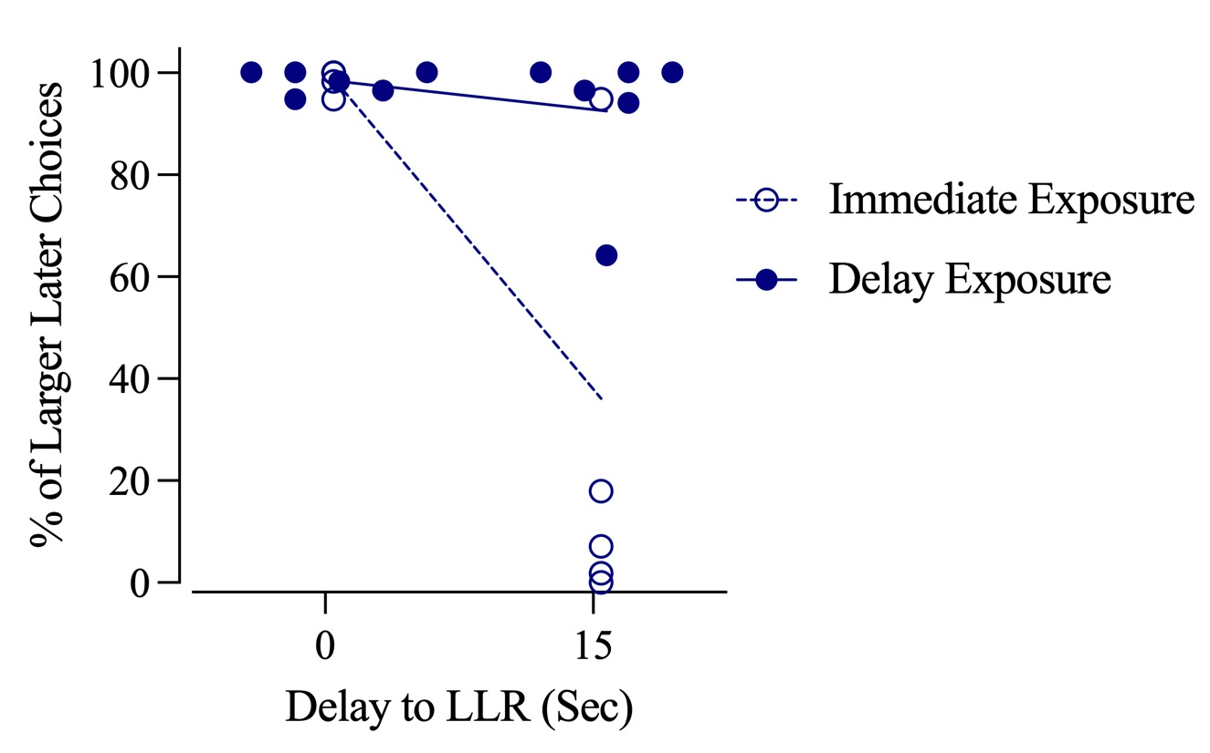
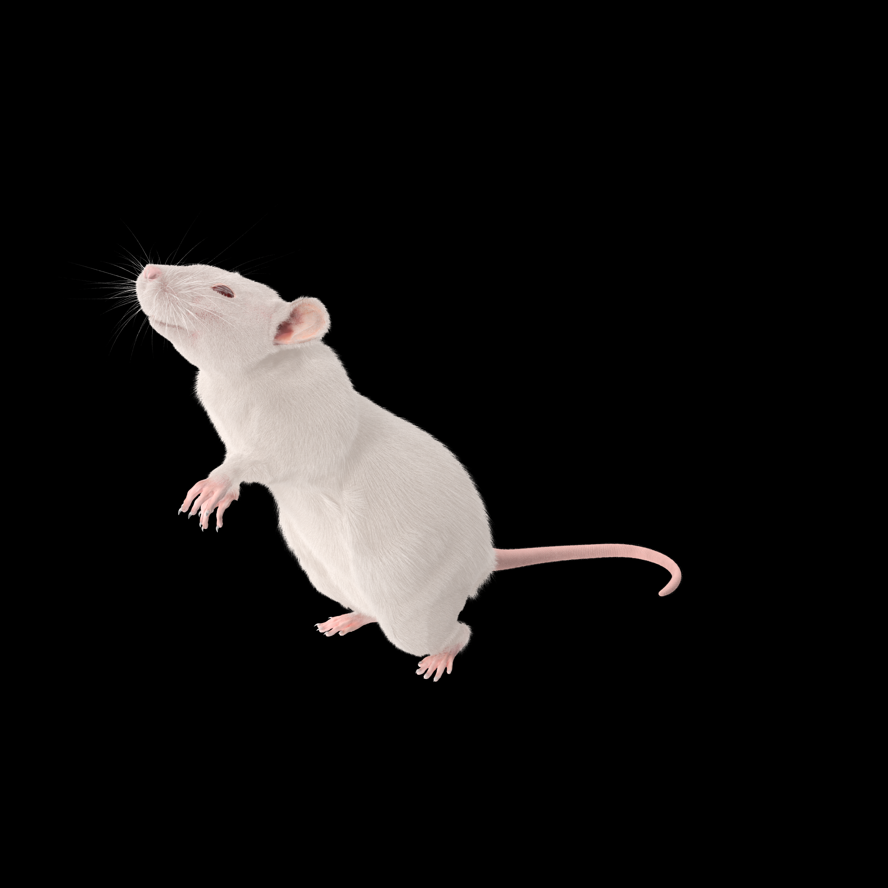
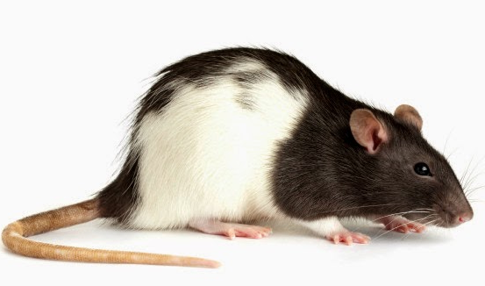
Delaying Rewards Lowers Impulsivity
Rats choose to wait for a larger reward over a smaller immediate one.
Hayden Dreis
Utah State University
Joshua Jones
Utah State University
Dr. Gregory Madden
Utah State University
Testing Rat Decision-Making
Female rats were divided into immediate (IE) and delayed (DE) and went through multiple phases:
Training: On lever press, DE rats received 2 food pellets after 17.5s. IE rats received 2 food pellets after 0s.
Discrimination: Choice between one lever that gave 3 pellets after 15s, the other gave 1 pellet immediately.
Patience for More Payout
About half of the rats are done with the experiment and we are in the final stages of the second group of rats.
Current results indicate that DE rats were more likely than IE rats to choose to wait for a larger reward (15-s delay to Larger Later Reward).
You may be tempted to think an image this big is a waste of space when you could fill it with more words. Resist that urge!
Impulse Control is Key
Impulsive choices produce small benefits now but often come at the cost of better outcomes later.
​
By reducing impulsivity, many maladaptive behaviors such as substance-use disorder, binge-eating disorder, and pathological gambling could be reduced.​
The country spends around $442 Billion dollars annually on substance use disorders.
The goal of our research is to determine if forcing subjects to wait before getting a reward will help them better control their impulses when faced with delayed rewards.
I have to wait.
Rats exposed to delays (DE) chose the larger delayed choice more often than rats who had no exposure (IE).
Application for Humans
Impulsivity is linked to many behaviors, and some of them are especially problematic:
Substance-Use Disorder
Binge-Eating Disorder
Gambling​
​
Rats are used as subjects in experiments like this one because their decision-making processes are similar to humans.
So far, rats in our study that have become used to having to wait for their reward are more likely to wait for a bigger reward over a smaller immediate one.
If the results are replicated among the second half of rats, it implies that delays work to help lower impulsivity.
Experiments like this help show what interventions could work on humans, allowing development of programs and policies.
Use simple, relevant images that are easy to explain
Notes:
Traditional poster 1

