Slide 1
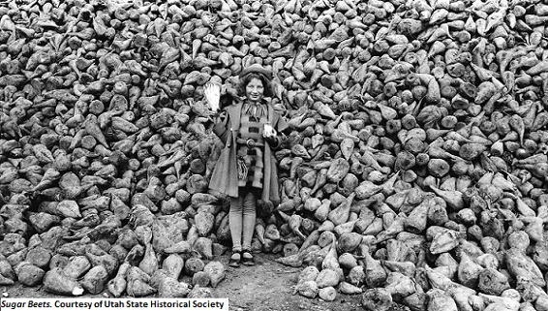
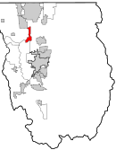
The promise of a profitable sugar crop turned a rural area into a thriving settlement.
Amalga, Utah was settled for sugar beet farming but couldn’t support itself.
A Sugar Crash
The newly-named town of Amalga experienced an economic boom as it transformed into a sugar community. However, blights of ringworms, leafhoppers, and white flies decimated its crops in 1924 and 1926.
Within months, its businesses closed, the railroad decommissioned its stop, and many families left the town.
Beau Jenson
Utah State University
Dr. Susan Cogan
Utah State University
Mormonism and the Utah Sugar Economy
When Wilford Woodruff became the president of the Church of Jesus Christ of Latter-Day Saints in 1889, he told church leadership that “the Lord would like the great business of manufacturing sugar established in our midst.”
Northern Utah was well-suited to grow the large number of sugar beets necessary for sugar. The church established the Amalgamated Sugar Company to build a community and infrastructure to manufacture sugar in an area known as Alto.
In 1916, the ASC promised farmers in Alto, Utah, that they would build a $900,000 factory capable of processing 5000 acres’ sugar beet crops into sugar. Prior to the formation of the company, Alto’s growth was stunted by its inability to grow cash crops; with the promise of a profitable sugar factory, the unincorporated settlement grew to include a store, school, hotel, church, and boardinghouses. The rail line built a stop in the new town, better roads were developed, and bridges strengthened.
Amalga Today
The remaining families returned to subsistence crops like tomatoes, alfalfa, and corn. Amalga’s current population is about 500 people, and it still produces mostly alfalfa and corn.
Amalga, formerly known as Alto but renamed for the sugar company, sits in the northern end of Cache Valley on the Utah side of the border.
Notes:
The original Better Poster format

