Slide 1
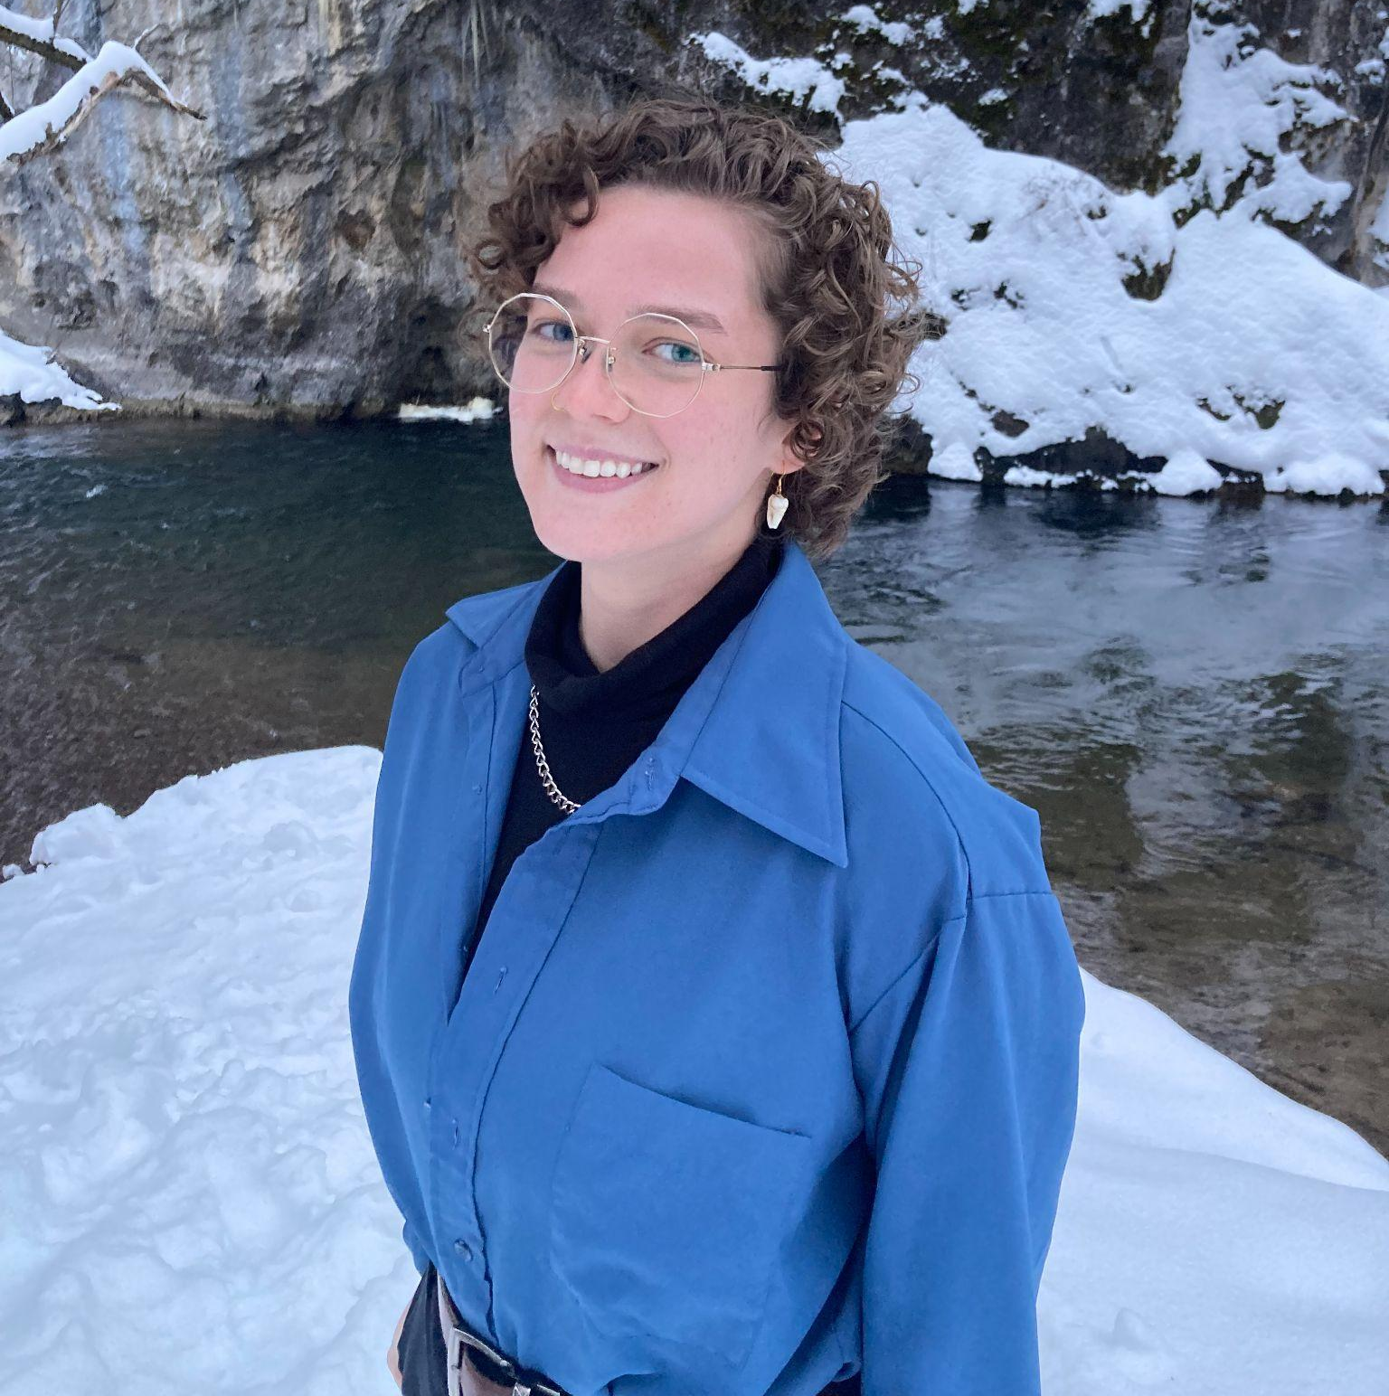
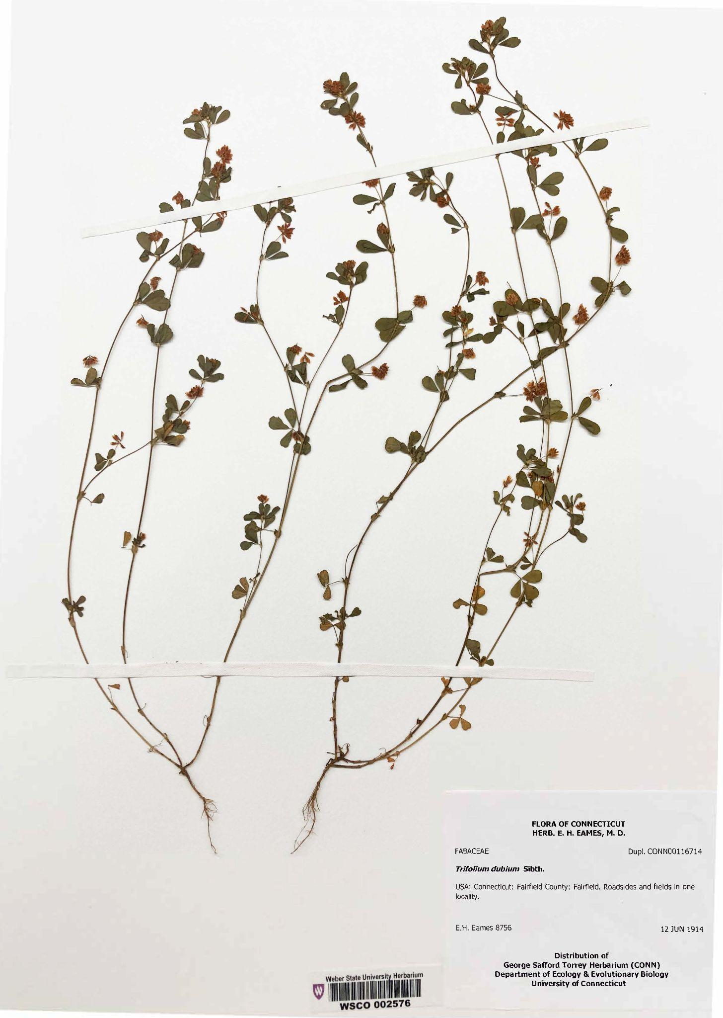
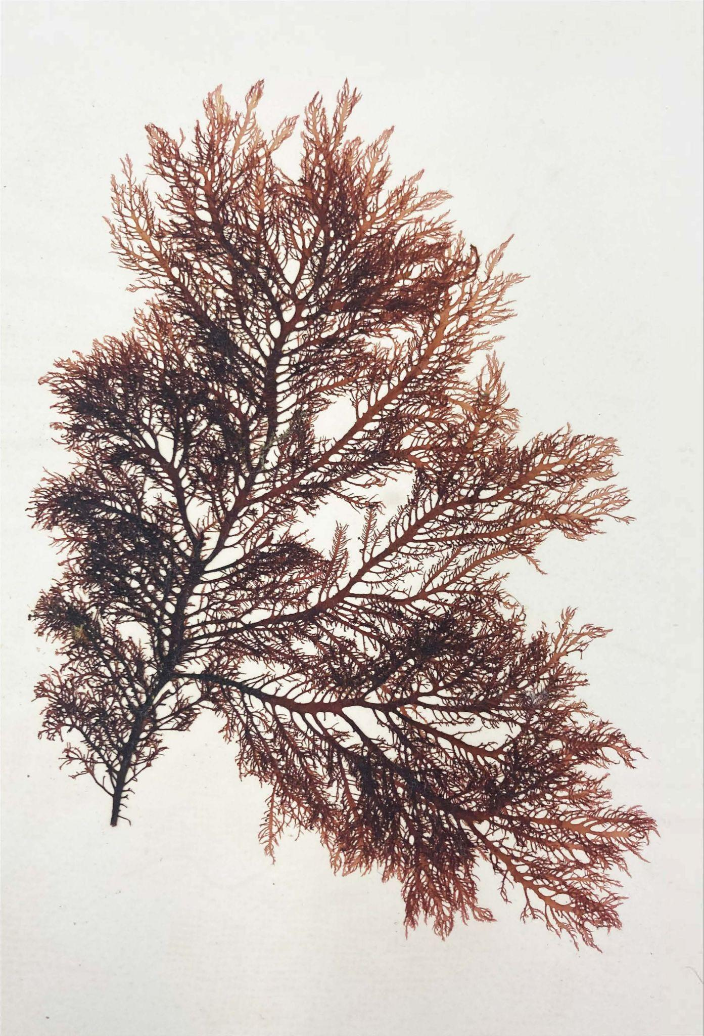
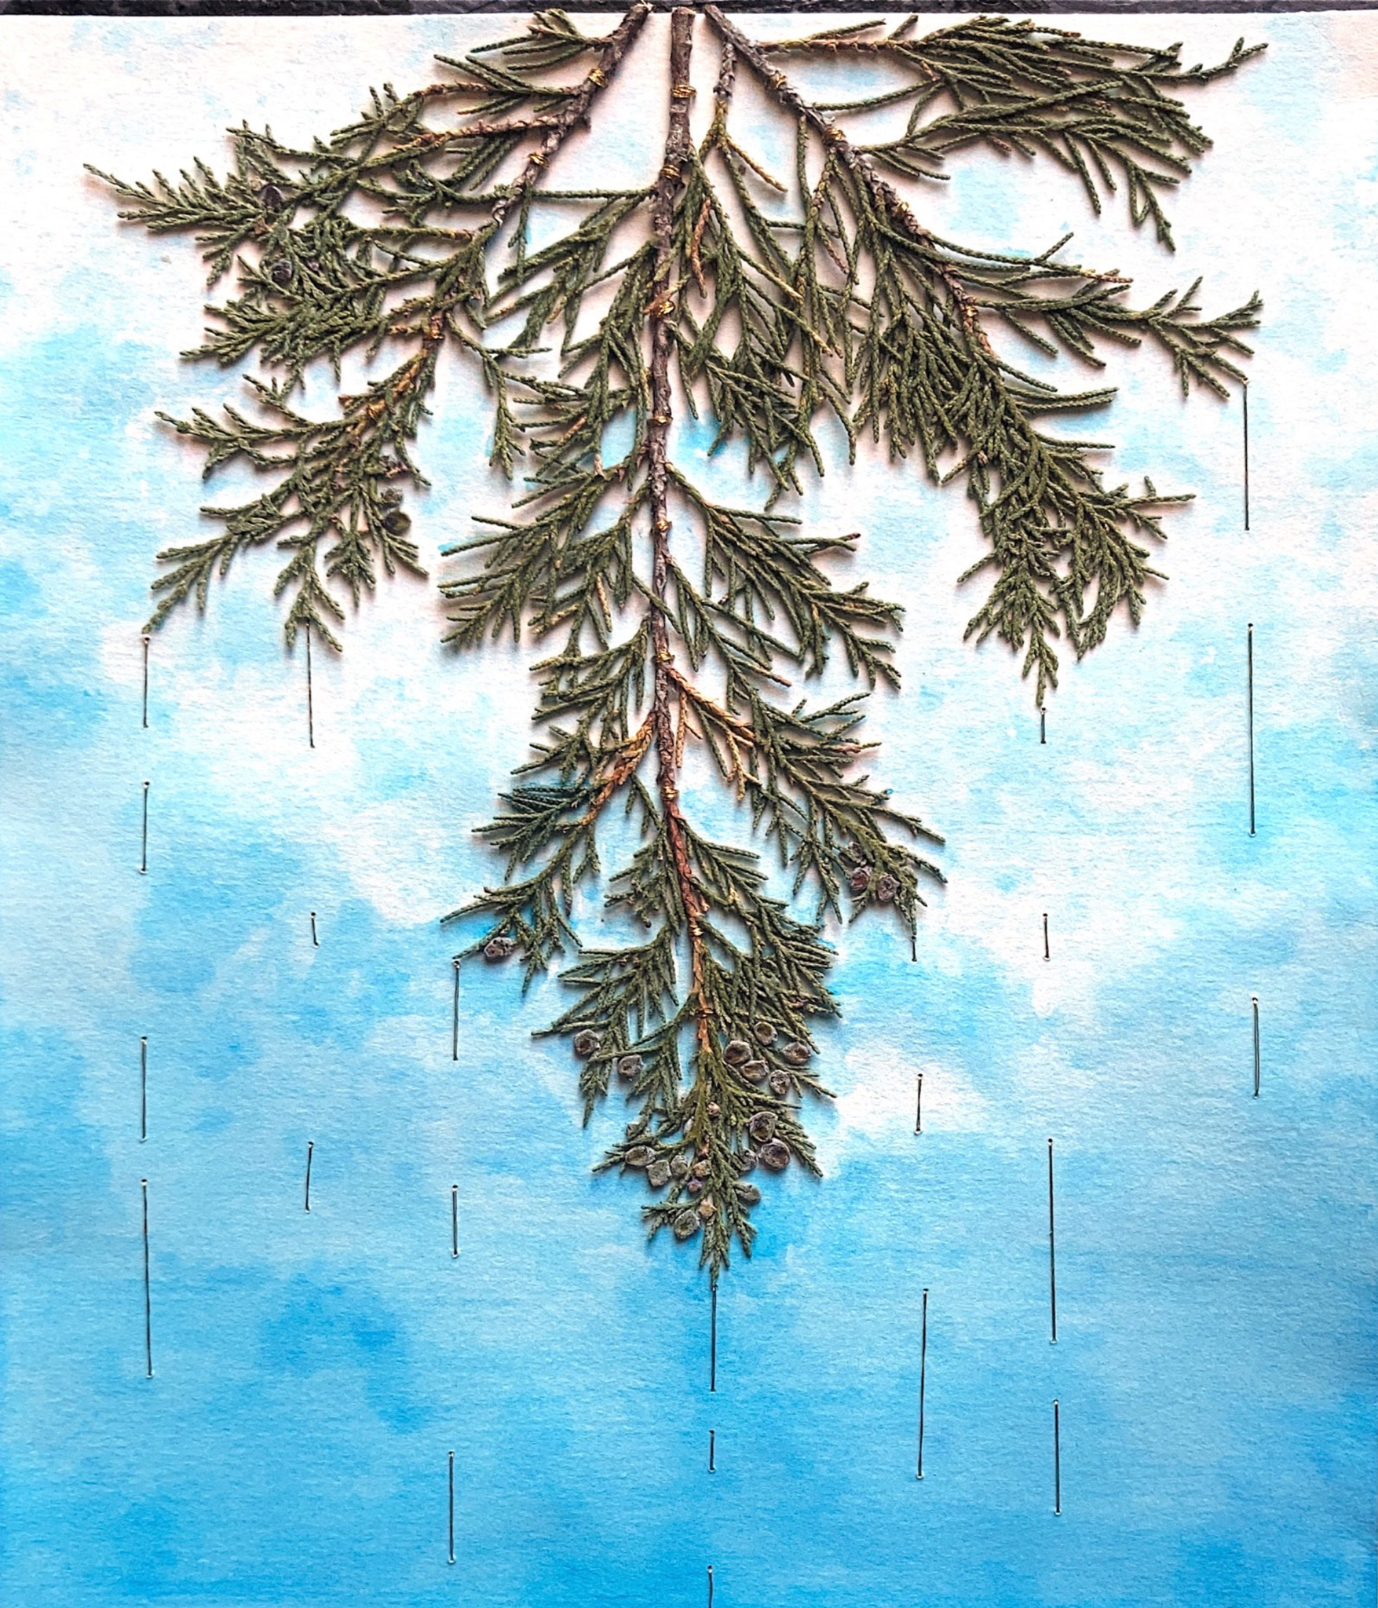
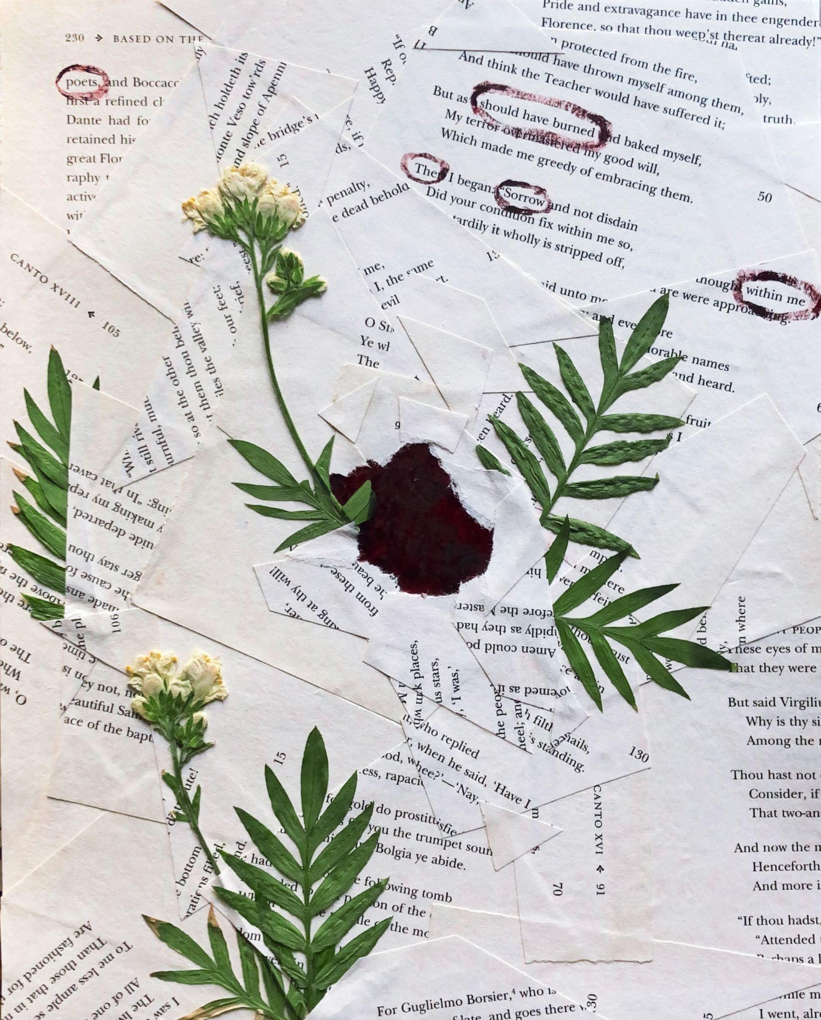
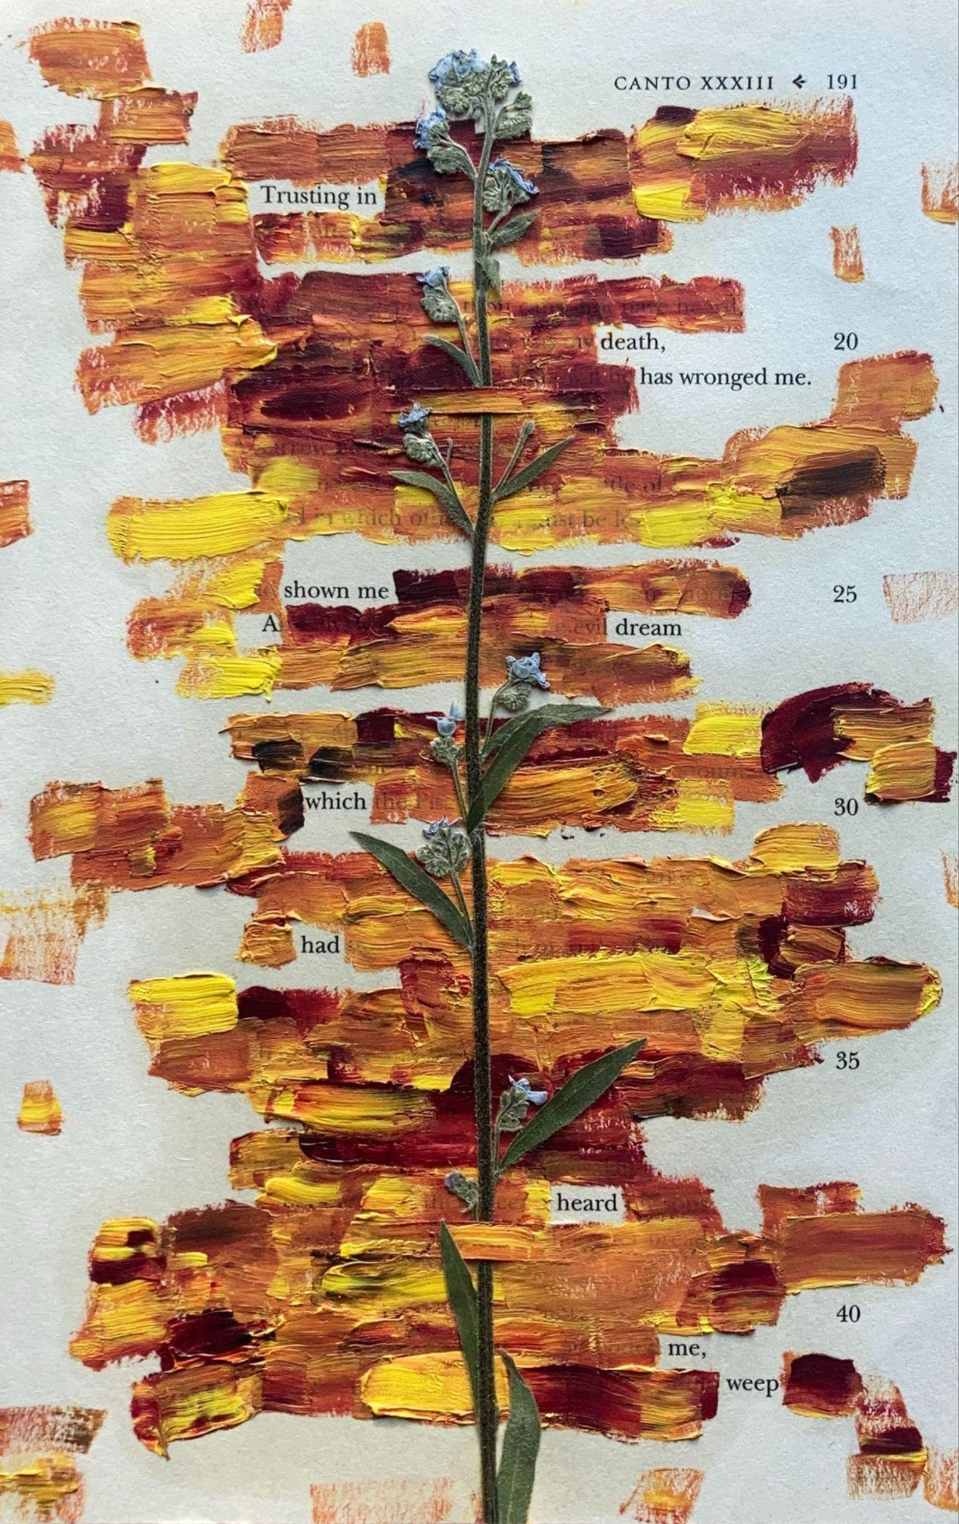
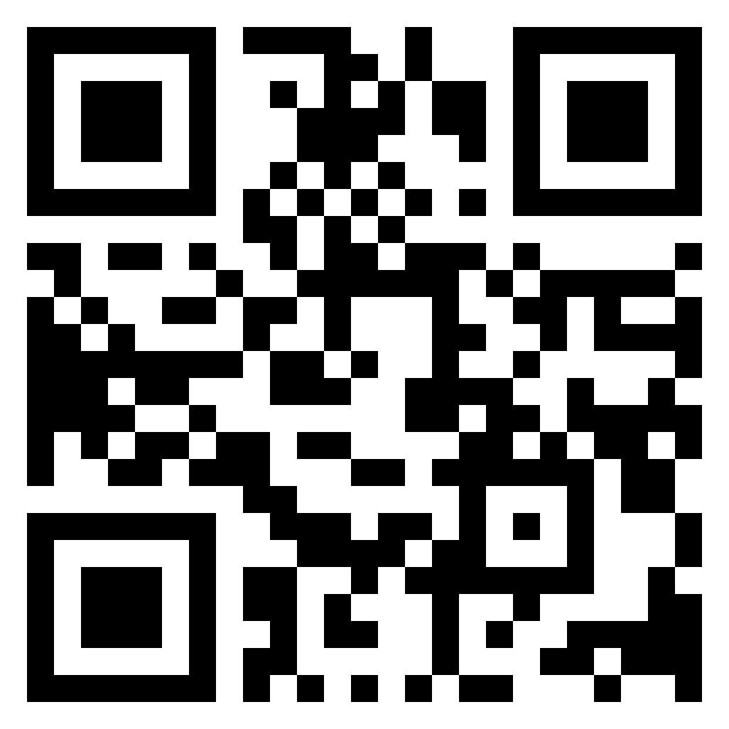
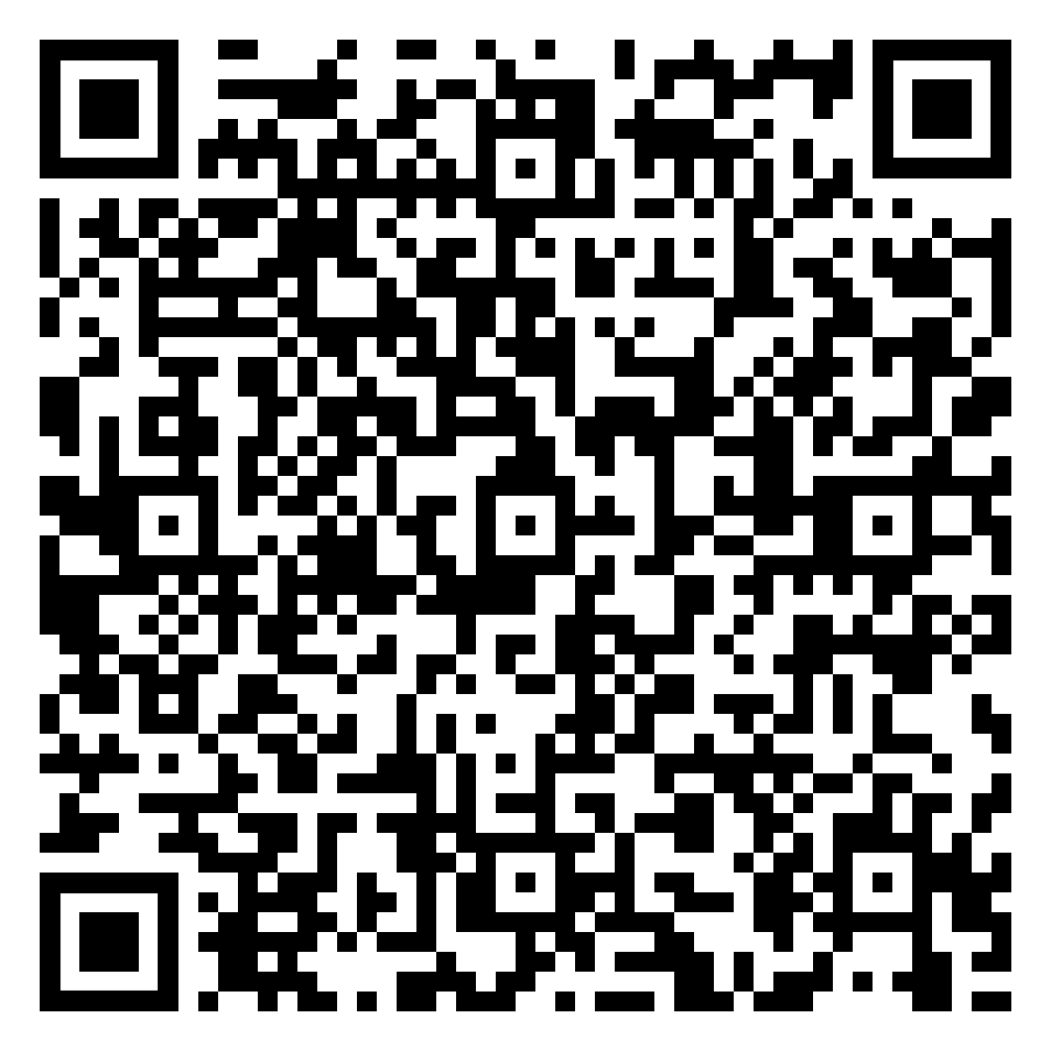
Queering the Herbarium
Plants, poetry, and multimodal expression
Basil Payne | Utah State University Dr. Christine Cooper-Rompato | Utah State University
Herbarium Specimens
Herbarium specimens are pressed, preserved plants that are used for scientific study. The plants are dried and adhered to the page using glue or thread. If kept in the right conditions, they can last hundreds of years.
Little hop clover, Weber State University Herbarium
Red algae, University of Utah Herbarium
Juniper, Basil Payne
Burning, Basil Payne
Research Steps
1. Preliminary Research
I read scholarship on the history of plant preservation and how the practices have changed over the years.
2. Visiting Herbariums
I visited the herbaria at the University of Utah, Weber State University, and Utah State University. The herbaria collections include unique 19th-century amateur collections as well as professionally produced specimens used in university classes.
3. Plant Preservation
Preservation works best when plants are dried immediately after collecting. Staff members at the USU Intermountain Herbarium shared techniques for efficient plant preservation and loaned me equipment.
4. Plant Collecting
As I collected plants in Utah, I followed the “one-in-twenty” rule–only take one plant out of twenty. I also avoided endangered and protected plants
5. Writing and Creating
As I collected plants, I drafted a poem focused on each one. Most of the plant specimens turned into collages over several drafts, and many of the poems became embedded in the specimens.
6. Significance
I created these poems as a way to accept and explore my queerness. As a member of the LGBTQ+ community and as an autistic person, I wanted to show others that being queer is positive; it can mean poetry and art. Poetry is the one way I can truly accept myself. Through my project, I hope to help others feel the same way.
7. Acknowledgements
Thank you to Dr. Christine Cooper-Rompato (English Dept.), Dr. Ben Gunsberg (English Dept.), Drs. David and Terry Peak (Peak Fellowship), Dr. Mary Barkworth (USU Intermountain Herbarium), Dr. Jim Cohen (Weber State University Mary Carver Herbarium), and Allison Izaksonas (University of Utah Garrett Herbarium).
What the fuck am i doing
Genre
Inspiration
Source Material
Genre Research
For this project, I spent time researching different authors who
look at writers who make things you like to find inspiration in them
sarah j sloat
Choosing Source Material
choose a source text that has a vocabulary you are interested in and comfortable with
enough fun words AND enough connector words
A dream which had heard me weep, Basil Payne
Scan to see the bibliography and more of my work!
Notes:
Traditional poster 3

