Slide 1
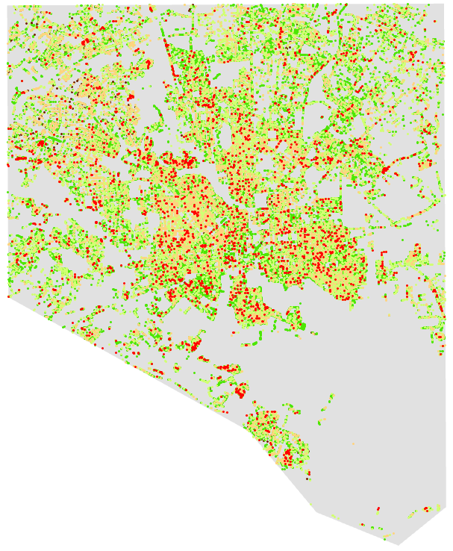
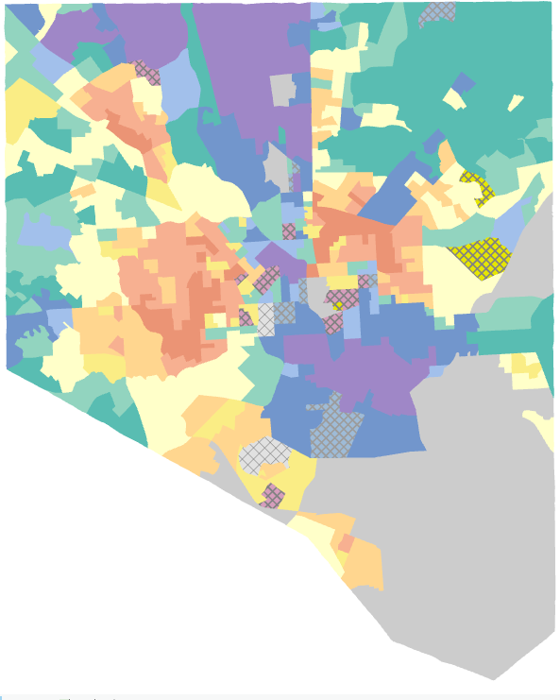
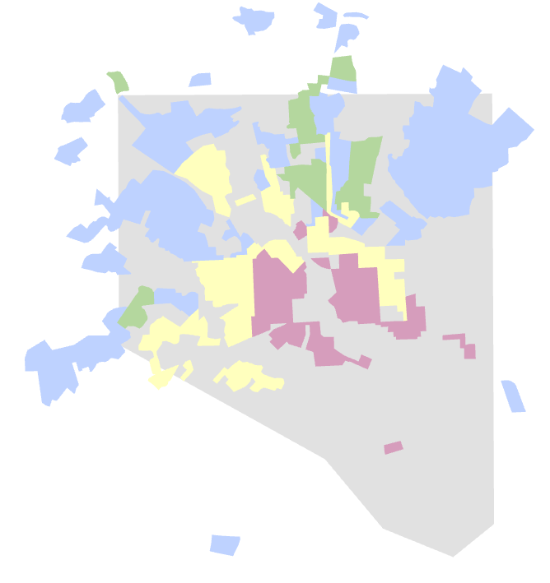
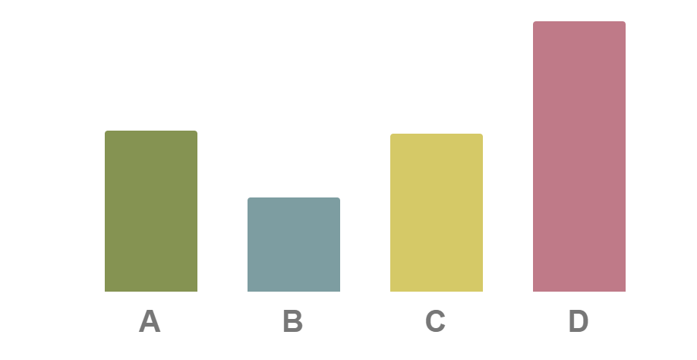
Algorithms can be biased by their training materials and can magnify class discrimination.
Can algorithms and urban greening repair historic injustice?
Comparing Maps
I used data and GIS software from the Baltimore Tree Inventory to calculate tree health and density within HMT and ‘redlining’ boundaries.
E Paige Sargeant
Utah State University
Dr. Mariya Shcheglovitova
Utah State University
Tree Data
HMT
‘redlining’
AI for Urban Greening
In Baltimore, a vacancy crisis and continuing impacts of historical ‘redlining’ that discouraged investment in minority neighborhoods prompted city officials to use an algorithm generated Housing Market Typology (HMT) map to guide municipal service distribution. The current strategy channels maintenance to wealthier areas and prioritizes tree-planting and demolitions in struggling areas.
Unhealthy Initiative
The strategy was effective at increasing tree numbers within redlined communities, but tree health is disproportionately low in those areas.
Tree Density within Historical Boundaries
Relative tree density of modern trees within historical ‘redlining’ boundaries.
Good quality trees are less prevalent in Baltimore’s struggling housing markets. There is a 12-15% percent decrease in the average proportion of good quality trees when comparing the upper and lower ends of the Housing Market Typology spectrum.
While planting trees can be beneficial, it must be paired with municipal maintenance strategies to prevent the decay of green spaces within struggling communities.
80% of area
targeted for greening
is in ‘redlined’ regions
Due to the significant overlap between HMT’s ‘struggling’ areas and historical ‘redlined’ neighborhoods, citizens are concerned that HMT will increase racial bias in city management.
Tree quality is lower in areas with struggling housing markets. This reflects the municipal investment strategies that target tree planting efforts to these communities to attract private investment but channel upkeep resources to wealthier areas.
Notes:
The original Better Poster format

