Slide 1
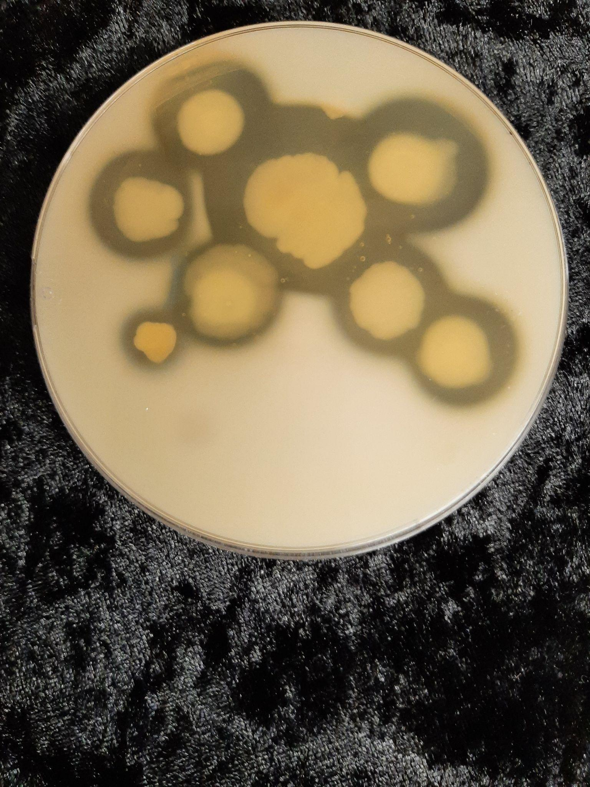
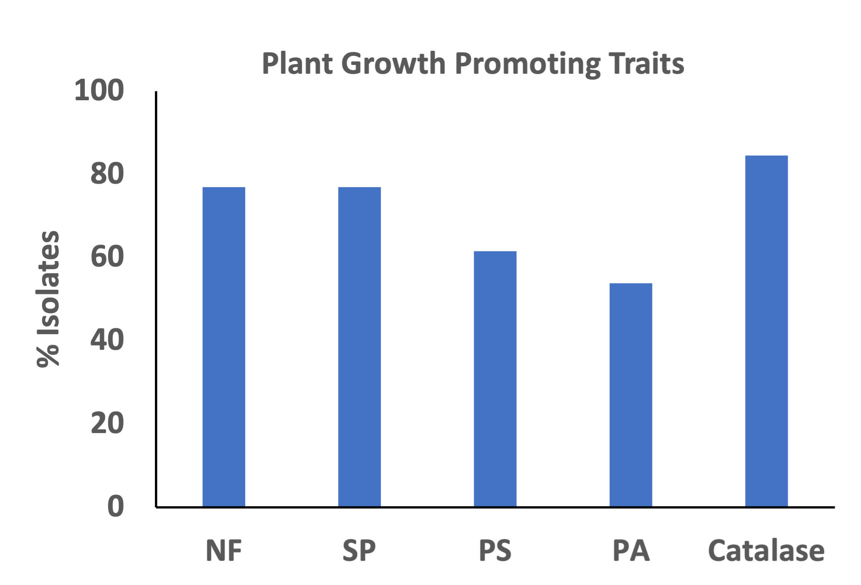
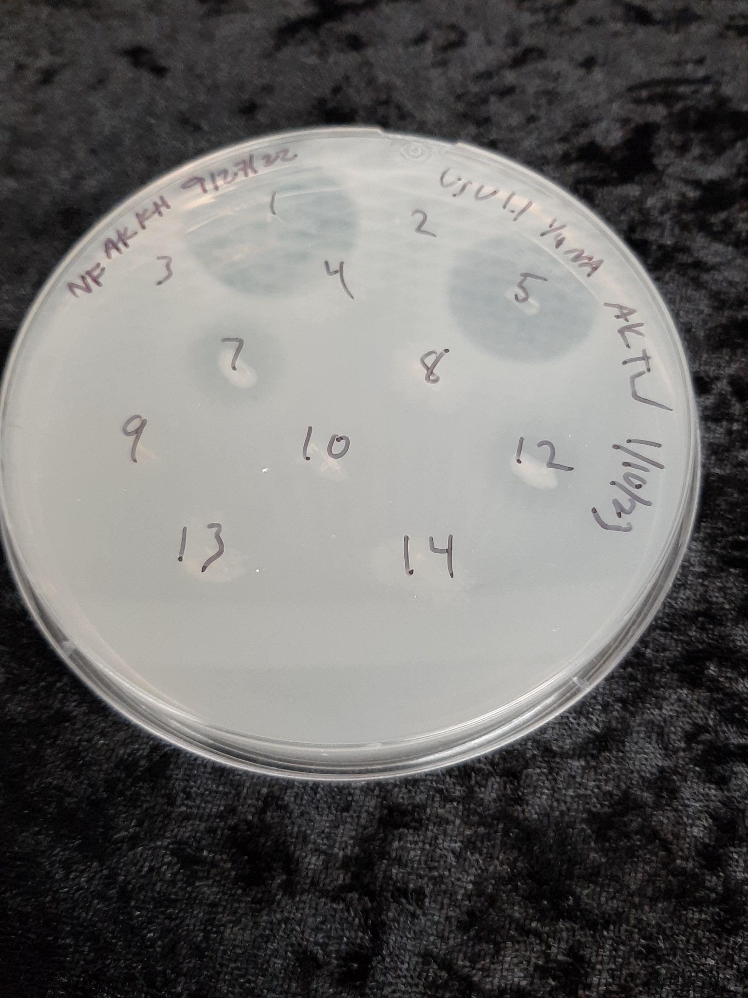
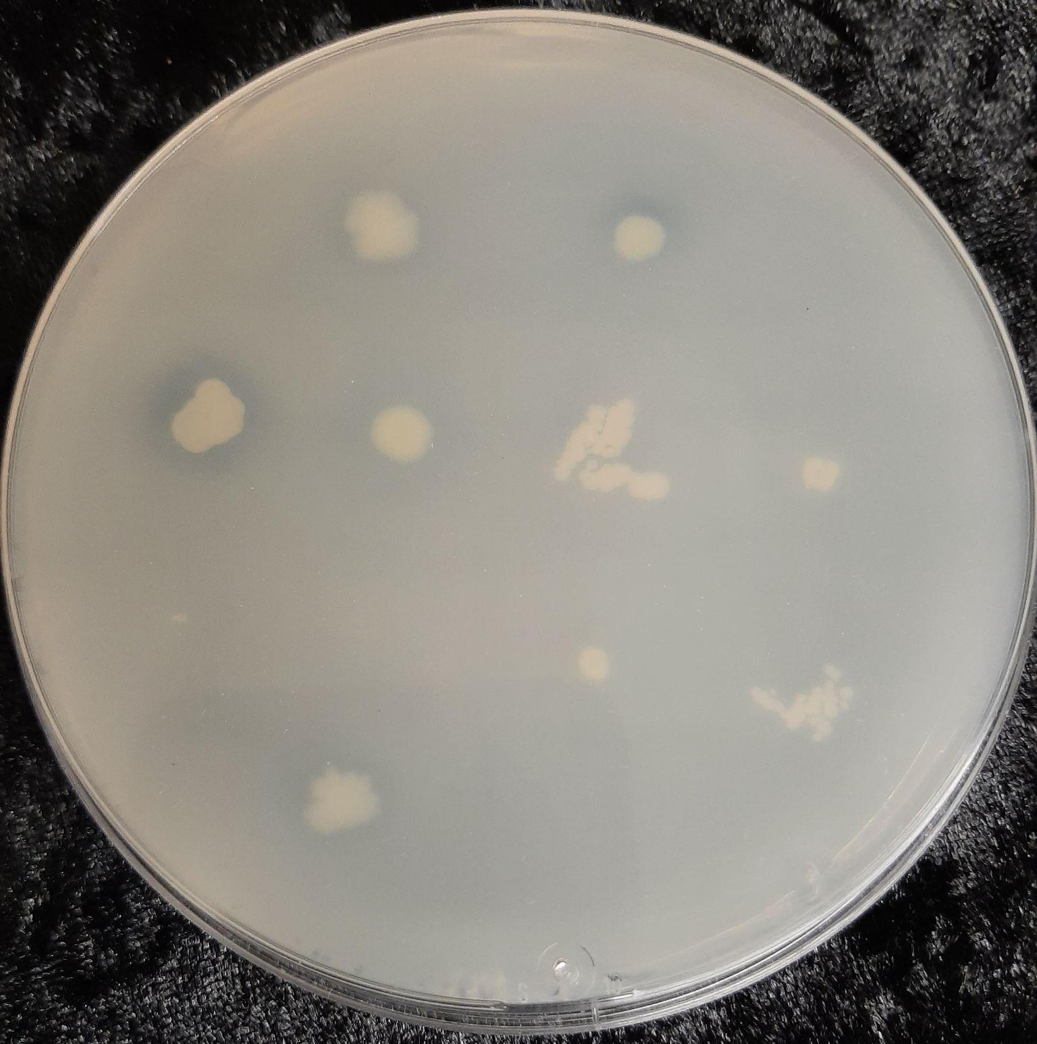
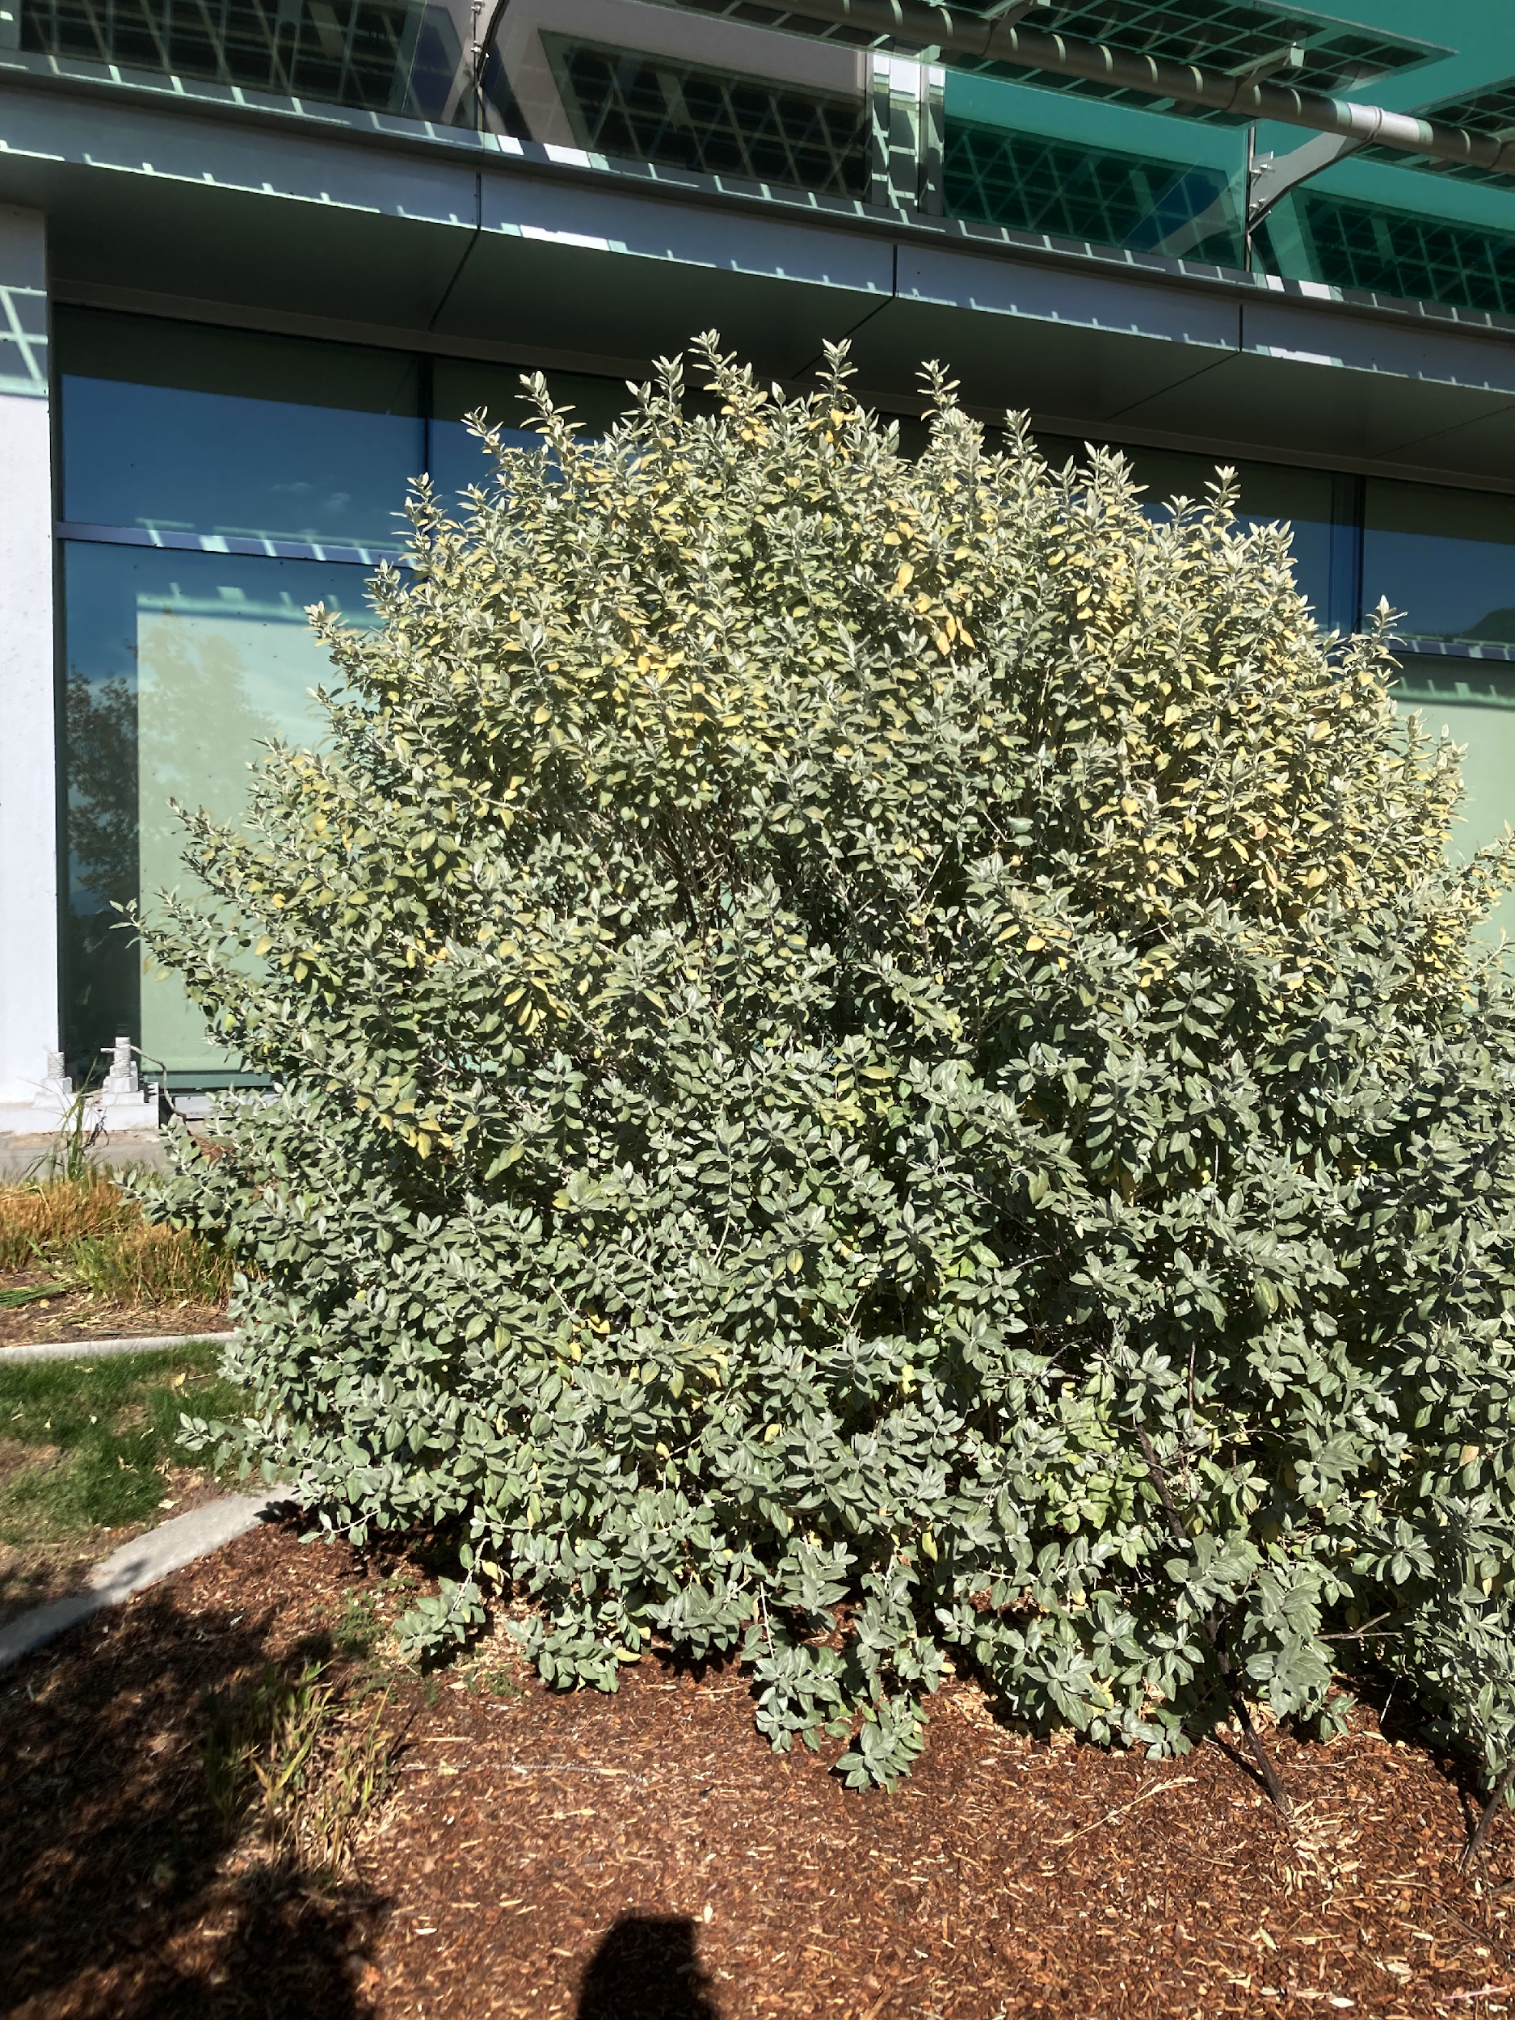
Naturally occurring microbes and plants work together to allow plants to grow in low-water environments.
Microbes from Native Plants show Drought Tolerance potential
Testing the Microbiome
We isolated bacteria from the rhizosphere of the plant, purified the microbes, and tested them for nitrogen fixation, phosphate solubilization, protease activity, and catalase, siderophore, and IAA production.
All bacteria were tested for five different plant growth-promoting traits. Many of the microbes showed positive results with multiple plant growth traits.
Ty Wilson
Utah State University
Dr. Amita Kaundal
Utah State University
We Need More Drought- Tolerant Plants
Climate-induced environmental stresses, and the increased use of fertilizers, significantly threaten food production and soil health. In natural soils, microbes perform a vital function of restoring the soil and assisting native plants’ growth.
The Intermountain West is home to high temperatures and arid soils, yet native plants still thrive. We isolated the microbiome of a cross of two highly drought tolerant native plants and tested the microbes for growth promoting characteristics.
Plant Growth-Promoting Traits: NF- Nitrogen fixation, SP- Siderophore production, PS- Phosphate solubilization, PA- Protein activity, and Catalase production.
Next Steps in Testing
​
We will test microbes for Indole Acetic Acid production.
Quantify ACC deaminase activity of isolates.
Test microbes for the effect of microbial Biofilm production on drought stress.
Testing of microbes’ effectiveness to mitigate drought stress on Arabidopsis thaliana and corn.
Clockwise from top left: 1. Protease Activity on Skim Milk Agar; 2. Siderophore production on CAS media;
3. Phosphate solubilization on PVK media ; 4. Norris Glucose Nitrogen Free media for N – Fixation ability.
Shepherdia × utahensis ‘Torrey’ at USU campus

